Slide 1

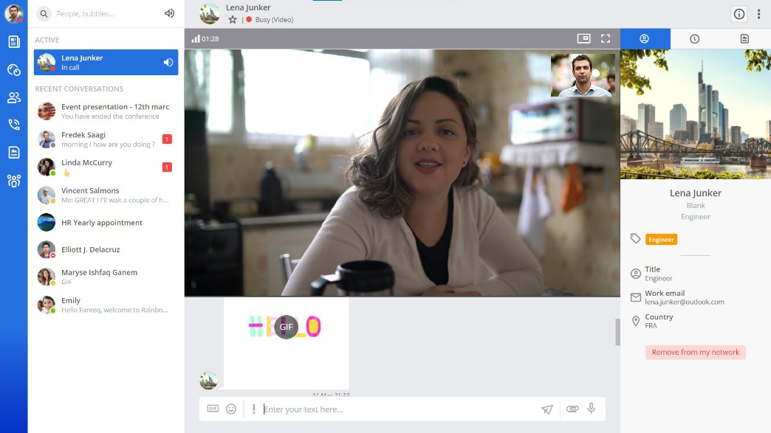
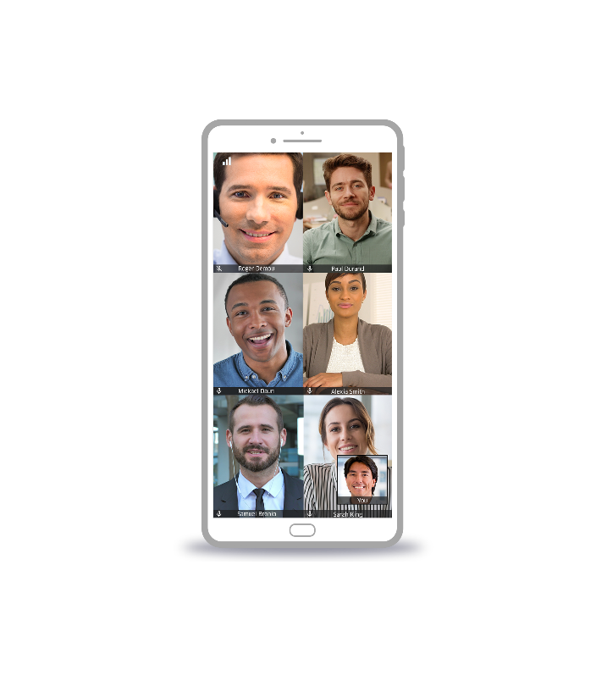
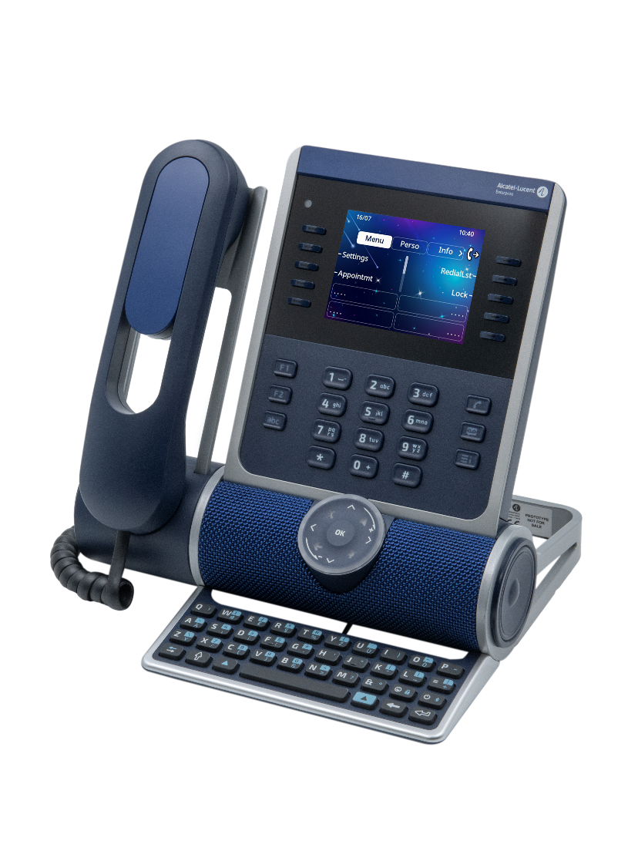
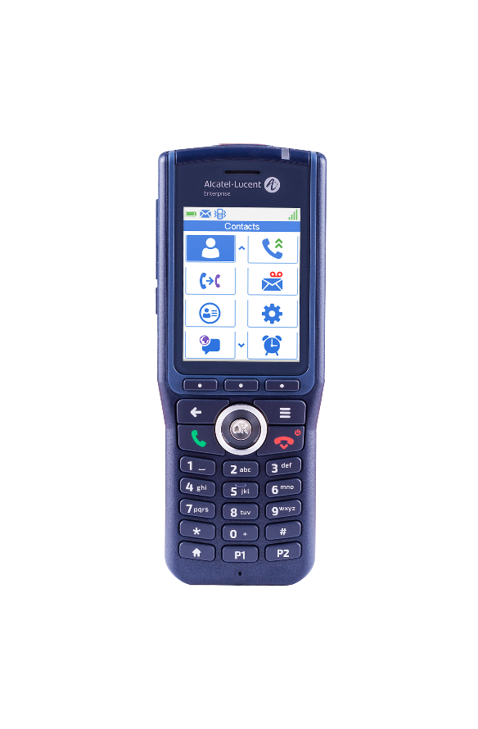
This presentation has two parts depending on the audience:
1-13: presentation for SMB customers
14-27: presentation for large companies (inc. more transformation options)
Accélérez votre Business
Avec le cloud
Customer presentation
OTEC
Communications and collaboration for agile businesses!
November 2023

Slide 2

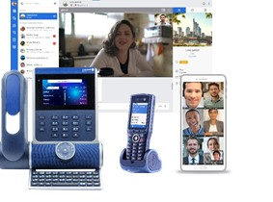


Communications are business-critical
Alcatel-Lucent Enterprise
OTEC
cloud communications
Connect
all employees
With team members
and external contacts
Everywhere
Improve
all customer interactions
Automated
Customer welcome
Using voice and video collaboration
Simplify and secure
all communications
Per user, per month
subscription
ISO27001-certified,
high availability at the core
Notes:
Communications are business-critical to
Connect all employees – wherever they work – so they can work together and engage with external contacts
Improve customer interactions – by automating customer welcome to free time for important calls and by using voice and also video meetings to build a stronger relationship with customers.
With OTEC, it’s easy to simplify and secure all communications. It’s a per user per month subscription to a cloud service that’s ISO27001-certified with high-availability at the core for security and peace of mind.

Slide 3



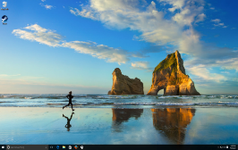
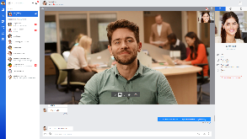
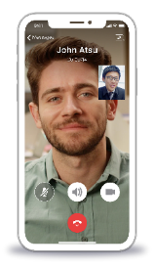
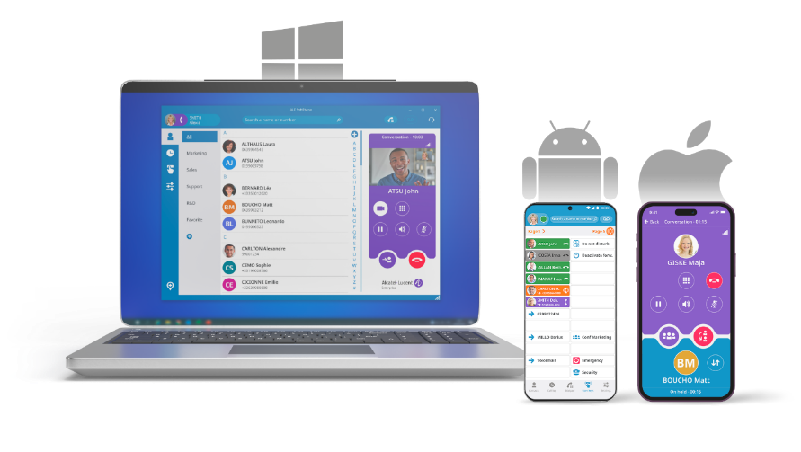
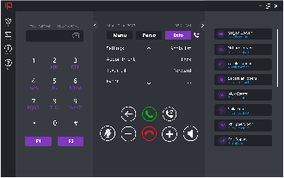

Unified directory for quick connection
WORK FROM ANYWHERE
Full UC and
Collaboration
Encrypted WebRTC communications
Softphone on mobile, PC, MAC or web browser
Video with team members and external contacts
Simple softphone
ALE SoftPhone
IP Desktop Softphone
Why choose OTEC? One number service across Rainbow application and the office phone, or use a simple softphone
Notes:
OTEC betters connect your team members by enabling work from anywhere.
OTEC offers Rainbow, a digital workspace with a strong focus on communications.
Rainbow offers business communications – that is a softphone - on any device, using latest super-secure webrtc standards.
The directory offers quick connection to other Rainbow users and to office phone users.
It offers video conversations and meetings with team members and external contacts – who don’t need to create an account
In addition OTEC offers one number service – that is dual ringing across Rainbow application and the office phone to automatically receive business calls wherever you are

Slide 4

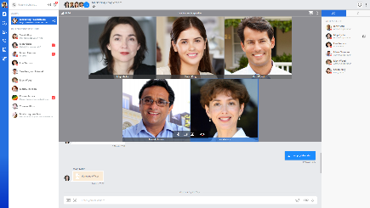



EASY-TO-ADOPT
WORK-FROM-HOME
COMMUNICATIONS
Conference and screen sharing with colleagues and external contacts (including direct dial-in from PSTN number in local country)
"Bubbles" are secure groups: file exchange, messaging, etc.
1 click
View peers’ status: connected, online, conversation, in-a-meeting
Recording and remote control
Business communications including call greeting, agent features
Phones can be used securely at home
Why choose OTEC? A single Rainbow application for
business calls + video + secure messaging
Notes:
An increasing number of team members are working from home, at least part of the time.
The most important factor for successful work-from-home is user adoption of tools.
Rainbow offers a view on peers’s tatuts including phone and calendar status.
Users can receive calls from external contacts and benefit from OTEC call greeting and basic agent features using their Rainbow app.
OTEC phones can also be used securely at home, with or without Rainbow on laptop.
Peer-to-peer conversations can be recorded. Rainbow offers screen share and remote control – that helps for supporting work-from-home employees.
Secure messaging works with secure groups – named Rainbow Bubbles. Participants exchange files and messages and can escalte to video and screen sharing in one click. Colleagues and external contacts can be invited.
Rainbow offers a single pane-of-glass view on business calls and digital workspace including video and secure messaging.

Slide 5

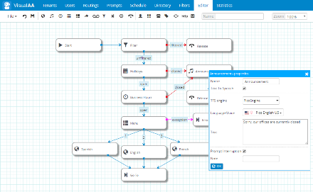
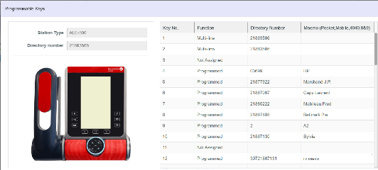
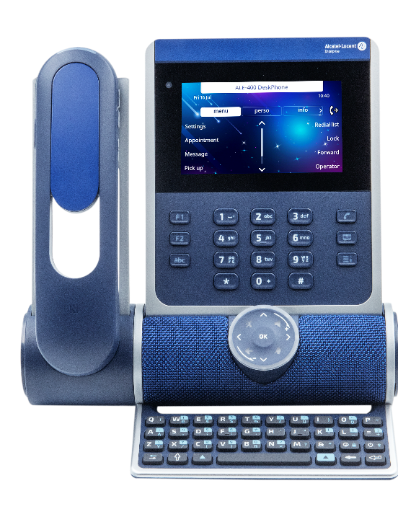
RELIABLE
CUSTOMER SERVICE
24/7 greeting and routing. Multi-tenant customization.
Phone configuration from a web portal
Large screen display for easy call management
"Symphonic HD«
audio quality
Speaker phone for
laptop / smartphone
Voice messaging and recording
for reliable follow-up
Why choose OTEC? Powerful hunting group, call screening and supervision features are included in the subscription
Notes:
OTEC offers what’s required for reliable and great customer service.
There is an automated attendant for 24/7 greeting and routing. It offers multi-tenant customization capabilities via phone or a web application. Each department can customize and update voice prompts and routing rules without disrupting call management of the other departments.
OTEC offers a range of high-quality phones. They offer a large screen display for easy call management so that customer calls can be immediately put through to the right person. It’s perfect for first call resolution. Employees and admins can configure the phone settings very easily by using a web portal.
The phones also offer Symphonic HD audio quality for conversation clarity. Some models offer Audio Hub to enjoy the phone’s speakerphone for conversations on smartphone and laptop. AudioHub works using USB or Bluetooth.
OTEC offers voice messaging and call recording for reliable follow-up.
OTEC offers ALE powerful hunting group, call screening and supervision features in the user subscription so that all employees can manage customer calls with ease.

Slide 6




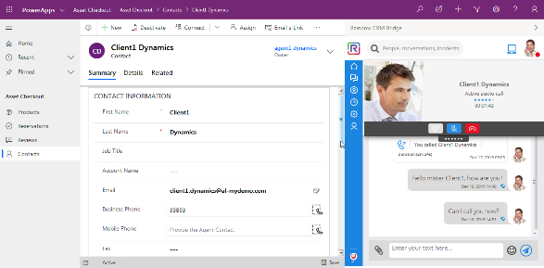
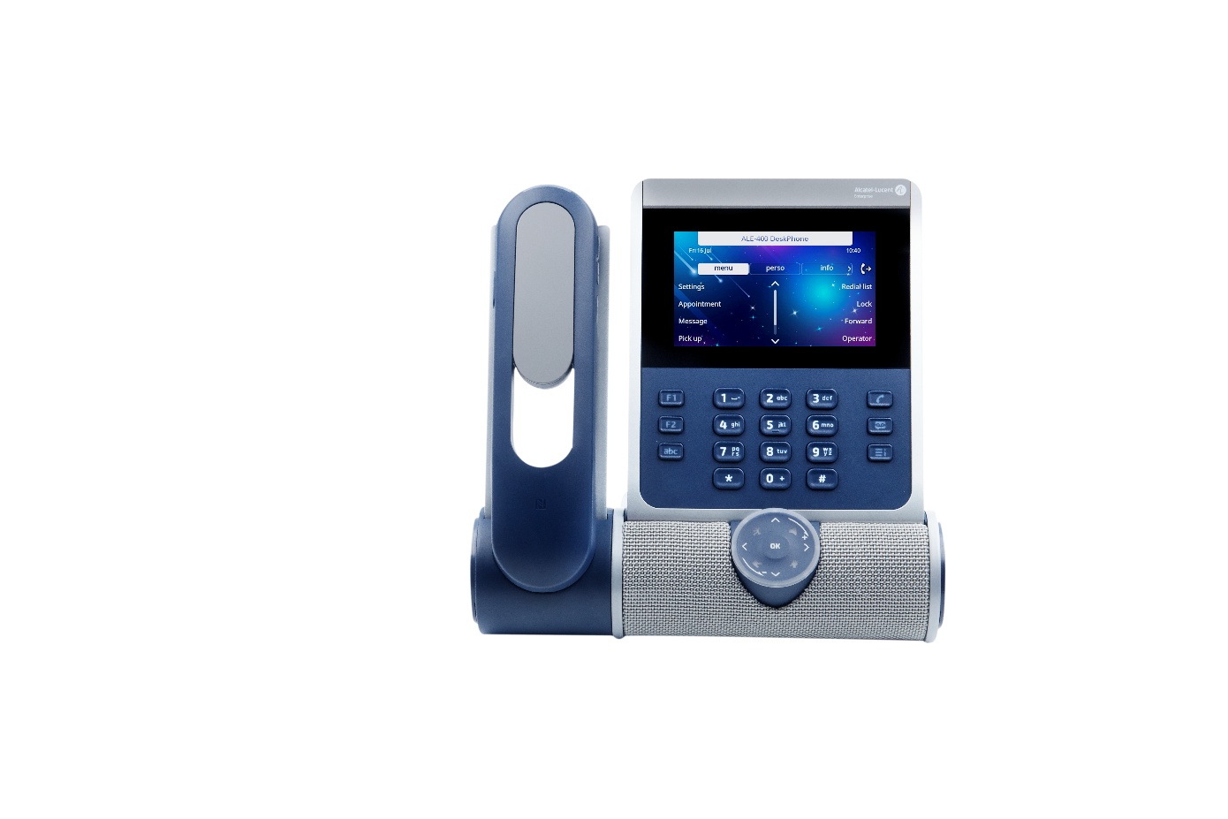


Personalized
customer interactions
CRM screen-pop on incoming call
Customer number is automatically added in CRM
Many SaaS connectors
Click-to-call using phone or PC
DTMF support
Collaboration between agents and experts
Videoconferencing with external contacts
Agent features,
Supervisor dashboard
Why choose OTEC? Quality communications
from within favorite SaaS application
Notes:
Some of the team members may spend most of their time with customers. So how can they easily improve the customer experience?
By offering personalized interactions. That is knowing their name and previous interactions with the company.
OTEC offers connectors to SaaS CRM applications such as Microsoft Dynamics, SalesForce, ServiceNow. The CRM data automatically pops on incoming call so the employee knows who’s calling. Customer number is automatically recorded in the CRM so there’s no dialing mistake when calling back. Calling back and dialing other employees is easily done in one click. Customer service staff can also chat, exchange files from within the SaaS application with agents or experts.
OTEC also offers agent features that are easy to use from the phone. There’s a built-in contact center with supervisor dashboard.
If follow-up requires video meetings, Rainbow video meetings are open to guests by just sending a link.
OTEC offers quality communications from within the SaaS of choice.

Slide 7
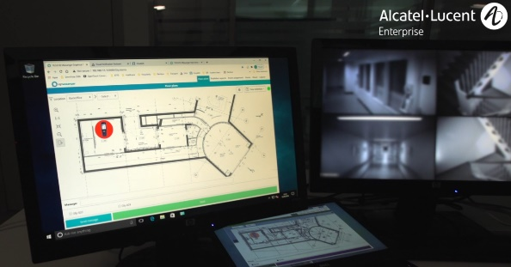

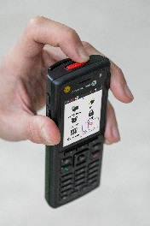
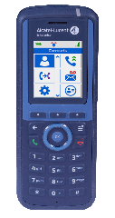
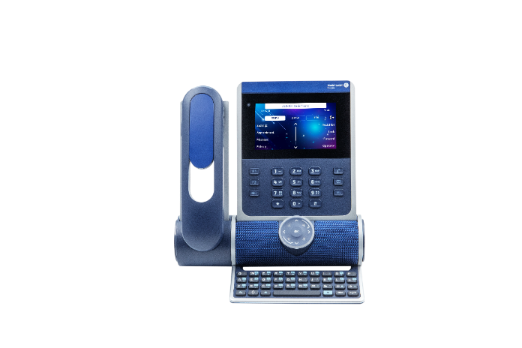
Everywhere
communications
Excellent audio quality on all sites
Ruggedized, antibacterial handsets
End-to-end ALE quality using
DECT, IP DECT, WLAN networks
Notification server for alarms
Alarms, isolated worker protection
One number service
with office phone
Why choose OTEC? Quality of mobile communications,
choice between apps and mobile handsets
Notes:
Not all jobs have same mobile communication requirements.
This is why OTEC offers a choice of devices for excellent audio quality on all the company’s locations.
OTEC offers Rainbow for smartphone users, IP DECT and WLAN handsets. These handsets are very solid and offer a long talk-time for mission-critical communications. Some models offer antibacterial coating, and some have integrations with alarm systems or isolated worker protection systems.

Slide 8

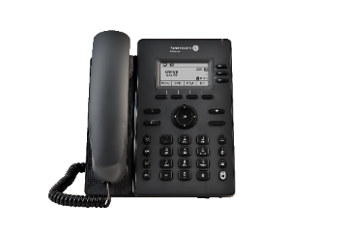
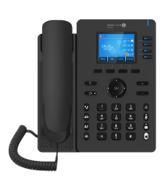
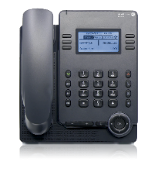
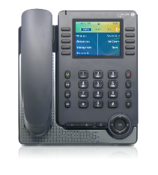
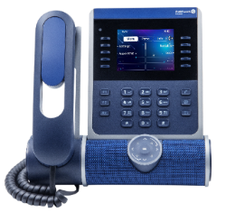
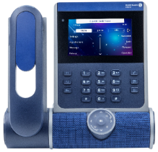
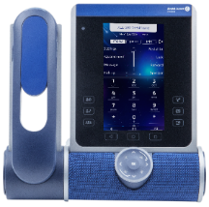
ALE DeskPhones for all workstyles
Basic
Essential
Enterprise
ALE-2 SIP
DeskPhone
ALE-3 SIP
DeskPhone
ALE-20
DeskPhone
ALE-20h
DeskPhone
ALE-30h
DeskPhone
ALE-300
DeskPhone
ALE-400 DeskPhone
ALE-500
DeskPhone
SIP
ALE-NOE: Advanced services
ALE-NOE & SIP (dual-stack)
IP only
Hybrid TDM/IP models
IP models with Audiohub (USB and Bluetooth)
Color screen
Large color screen
Touch screen
100% Touch
Options:
Alphabetic keyboard ALE-10
Alphabetic keyboard ALE-100,
WiFi/Bluetooth module ALE-108
2*10 Key module with color screen EM-200
2*12 Key module with color screen ALE-120
Customization kits: Factory, Ruby, Azure, Neptune ALE-140 and ALE-145 (Key module)
Bluetooth handset ALE-160
ALE-500 no handset
Wall mounting kit
Wall mounting kit
Wall mounting kit ALE-110
Notes:
Here is a summary of all ALE DeskPhones ranges and models, from left to right, with the key features highlighting the benefits of more advanced models:
The Basic range is composed by 2 models of SIP phone
The ALE-2 which is a phone with a backlit screen
The ALE-3 benefits from a color screen and USB connectivity
The Essential range is composed by 3 models
The ALE-20 which is IP phone with a backlit screen
The ALE-20h and ALE-30h which are hybrid Digital and IP. The ALE-30h has a color screen
The Enterprise range is composed by 3 models: the ALE-300, the ALE-400 and the ALE-500
They all have the 3D sound bar and customization kits. They also have an alphabetic keyboard and a key add-on in option
The ALE-400 and ALE-500 have touch screens. They also have a Bluetooth handset in option
The ALE-500 exists in a no handset version
All Enterprise models support a dual stack and can be configured to use either the proprietary NOE protocol or standard SIP protocol

Slide 9

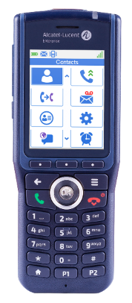

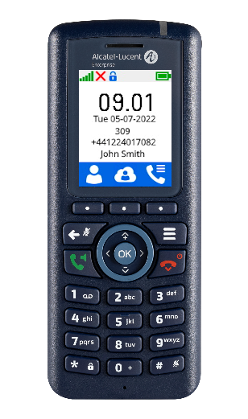
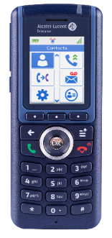
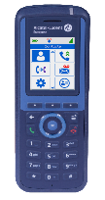
Wireless DECT HANDSETS FOR FIRST-LINE STAFF
Sanitized,
Rugged, IP65
Large screen
Wireless headset
Alarms and notifications
BLE location
Lone Worker Protection BGR139,
Shock resistant, wireless headset,
pull cord, man down detection,
BLE location, IP65, ATEX model
For office work
GAP
Compact device
All ALE communication services
8214
8234
8254
8244
8262
8262EX

Slide 10
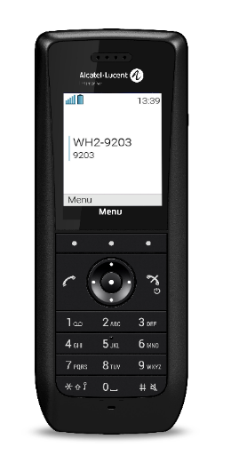
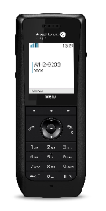

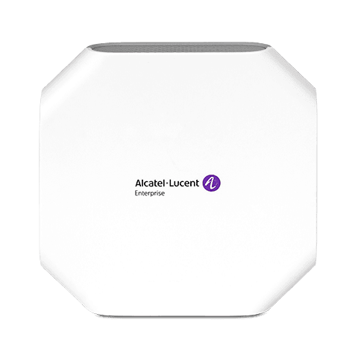

IMPROVE THE CUSTOMER EXPERIENCE
WLAN: CALL CONTINUITY EVERYWHERE
Robust handsets
ALE features and navigation
8158s
8168s
Modern design
Alarm button
NOE
8168s
Modern design
Alarm button
NOE
Wideband audio
Bluetooth
Compact, modern design
8168s: Bluetooth
Wideband audio
Alarm
button on top
8168s: Push-to-talk button
100% ALE solution
Stellar WLAN
Notes:
The 2 new robust VoWLAN handsets benefit from ALE NOE communication features and navigation.
They have a modern design and alarm button on top.
The 8168s WLAN handset offers Bluetooth and wideband audio.
Push-to-Talk is for group communications.
All handsets work with Stellar WLAN Access Points for an 100% ALE solution that’s easy to install, operate and evolve.

Slide 11








OTEC: simple and secure
Simple
One subscription
Local hosting by ALE partners,
ISO27001-certified
technology
Ultra-reliable options including high availability and security
Hot redundancy of communications
On-site communications redundancy
Encryption of communications
Easy
Price
per user per month
20 million users
of ALE business communications
Flexible
+ call center options, etc.
Notes:
OTEC is a cloud service that is simple to subscribe to and secure to use.
It offers one per user per month subscription which includes ALE advanced call management.
It’s a flexible offer: customers can add or remove subscriptions and options at any time to adjust costs to business.
It’s secure because it’s hosted by ALE partners in our country. And it’s ISO27001 certified: The governmental certification for secure cloud offers.
In addition, OTEC relies on proven ALE technology that currently enable 20 million users. This technology offers extra reliability options including hot redundancy of communications, on-site redundancy and communication encryption.

Slide 12

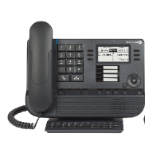



Already an ALE customer?
OTEC = SMOOTH cloud transformation
Immediate user adoption
Leverage existing investments
Smooth transformation
Media Gateway for analog/digital
phones
Hybrid cloud/premise
networking
Keep ALE features
Keep compatible phones
Notes:
OTEC offers additional benefits for existing ALE customers:
Employees keep the ALE features they like for immediate user adoption
Existing analog/digital phone cabling can be leveraged to benefit from cloud benefits immediately
Compatible phones can be leveraged
OTEC can be networked with on-site ALE communication servers for smooth transformation

Slide 13



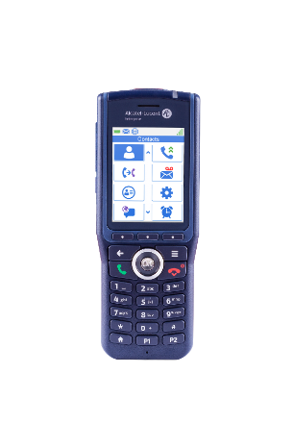
Elevate your business to the cloud!
With Alcatel-Lucent Enterprise
OTEC
cloud communications
Connect
all employees
Everywhere
With team members
and external contacts
Improve
all customer interactions
Personalized
Customer welcome
Using voice and video collaboration
Simplify and secure
all communications
Per user, per month
subscription
ISO27001-certified,
High availability at the core
Notes:
With OTEC, elevate your business to the cloud!
Connect all employees – wherever they work – so they can work together and engage with external contacts
Improve customer interactions – by automating customer welcome to free time for important calls and by using voice and also video meetings to build a stronger relationship with customers.
Simplify and secure all business communications. OTEC offers a per user per month subscription to a cloud service that’s ISO27001-certified with high-availability at the core for security and peace of mind.

Slide 14
This presentation has two parts depending on the audience:
1-13: presentation for SMB customers
14-27: presentation for large companies (inc. more transformation options)
Accélérez votre Business
Avec le cloud
Customer presentation
OTEC
Communications and collaboration for agile businesses!

Slide 15












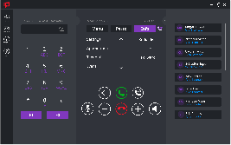
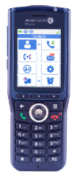
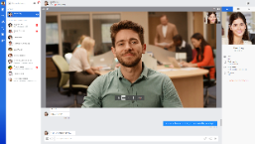
₊
…
Communications from within many CRM and productivity applications
Scalable
+
With on-demand options to boost customer interactions and simplify teamwork
3
Hosted on our partners’ cloud… or on your premises
Secure
OTEC
2
Available on demand via a single license
per user per month
Optimized
1
All business ALE communications
wherever your employees are
Connected
OTEC, cloud communication for AGILE organizations
Notes:
ALE proposes OTEC, the cloud communications service for AGILE organizations.
With OTEC:
All business ALE communications are available where team members are – for true work-from-anywhere
The service is available on demand via a single license per user per month - for a predictable and optimized price
The service is hosted on a cloud belonging to our partners or on the company’s premises – depending on the organization’s security requirements
OTEC offers on-demand options to improve customer interactions and simplify teamwork when working-from-anywhere. These options can be added or removed at anytime adjusting costs to business.
OTEC business communications can be integrated in business productivity and CRM applications to ease user adoption.

Slide 16

OTEC: ELEVATE YOUR BUSINESS TO THE CLOUD
Connect
Adapt fast
Simplify everything
All
employees
wherever they are
With
100%
flexibility
on licences
With
Zero
compromise
on security and service quality
100% digital workspace,
call continuity anywhere
Easy to access,
per user, per month
Reliability and security of ALE communications
Hosted by the ALE partner or in your data centre
Managed by the ALE partner or by your team
Notes:
With OTEC, organizations can connect all employees wherever they are. They benefit from a true digital workspace including softphone, collaboration apps and business phones that can be used in the office or remotely. Call continuity exists between all employees wherever they are to get things done faster.
With OTEC, organizations adapt quickly to any changes such as more work-from-home communications, adoption of customer service Software as a Service or even the addition of branch offices. The OTEC service is available per user and per month with 100% flexibility regarding the license and its options.
With OTEC, the IT department simplifies the management of its communication system with zero compromise on security and the level of service:
- Communications are reliable and secure because they are based on ALE technology for large companies
- The service is hosted by the ALE partner or in the customer's data center depending on the customer requirements
- The service is fully managed by the partner, or certain operations can be delegated to users or to the IT department via a web portal.

Slide 17
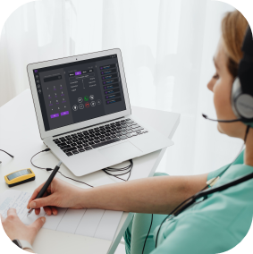


Hybrid workplace communications for all profiles
Remote working,
Work-from-anywhere
Agents,
customer service staff
on-site mobility, industry,
healthcare and retail
Connect
All
employees
wherever they are
100% digital workspace,
call continuity anywhere
Softphone
Desk phones, softphone
WLAN, DECT handsets
Telephone at home
Attendant console, agent / supervisor features,
App for smartphone
Extension for smartphone
messaging and recording
Protection for lone workers
+ Secure videoconference and group messaging service
Notes:
As the OTEC service uses ALE technology for large companies, it offers a hybrid workplace communications that are suitable for all user profiles:
Employees working from home, or working from anywhere, can communicate easily using a softphone, a phone deployed at home, or can communicate from the Rainbow application on a smartphone
Customer service features such as automated attendant, call queueing and monitoring, voice messaging and call recording are available for customer service staff and contact center agents.
Finally, OTEC offers many on-site mobility options including mobile handsets, smartphone apps for use in office and in the industry, healthcare and retail vertical sectors,
And all these people can work together from wherever they are and communicate via video meeting with external contacts, thanks to Rainbow's secure video conferencing and group messaging capabilities. In fact, OTEC is at source connected to the Alcatel-Lucent Enterprise Rainbow cloud service.

Slide 18


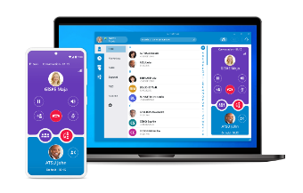


A Simple service catalogue
for A COMPREHENSIVE DIGITAL WORKSPACE
Communicate anywhere from PC or smartphone as if using an ALE business phone.
Configure the phone settings from a web portal. Admins configure user accounts.
Never miss an important call and call back as soon as possible.
Log on to a phone and make it yours for the day.
Work as a team remotely, communicating by group messaging, voice, video calls.
Communication
services
Softphone
Configuration
web portal
Messaging
Hot-desking option
for phones
Mobility,
Video collaboration
Digital
Workspace
3
Call waiting, conference call,
Call grouping,
Filtering, line supervision…
Simplicity: Single licence
Choice of options for a fair price
Predictable budget: price per month
Notes:
Apart from a phone, all you need is one licence per user per month to be able to use features such as call waiting, 6-person conference calls, call grouping, call filtering and line supervision. These features are ideal for customer advisors.
In addition, OTEC offers multiple communication options so that customers get the right price on what they really need. All prices are calculated per month. Take note of the options then click to continue.

Slide 19



a simple service catalogue
TO BOOST customers INTERACTIONS
Welcome your clients 24/7 and automatically route their calls to the relevant contacts; employees update department-specific prompts and routing rules.
Attendants quickly process a large number of calls from a dedicated application that displays employee availability.
Minimize customer waiting time by distributing calls according to the agents who are logged on.
Monitor call distribution performance indicators, adjust the strategy in real time and adapt the reports to your activity.
Record calls to reduce disputes, coach agents by example, and find solutions using what has been said.
Communicate from within your business application using screen pop on incoming call, instant click to call and collaboration with other agents
Automated Attendant
Attendant
console
Supervisor
desktop
Call
recording
API for integrations
REC
</>
Customer
reception
Agent features
Simplicity: Single licence
Choice of options for a fair price
Predictable budget: monthly tariff
Notes:
OTEC offers options to boost interacitons with digital buyers
Automated attendant
Attendant console
Contact center agent features
Contact center supervisor desktop
Call recording
APIs to communicate from within a business application of choice
These options are available at a monthly tariff. Read the options then click to continue.

Slide 20




Adapt communications TO BUSINESS AT any time
Adapt quickly
+12 x softphone / month
With
100%
flexibility
on licenses
We need 12 more
softphones
Predictable budget and rapid access to the service
Express your
needs
Partner
configures
Access the service instantly
You are billed
monthly
1 minute
Easy deployment because available on all sites!
Notes:
Many organizations choose OTEC to adapt communications to business at any time.
OTEC offers 100% flexibility on licensing.
In this example, the customer wants more softphones.
The partner configures the option or additional licence, and the service becomes instantly available.
Additional options will be billed per user per month.
This makes it extremely easy to budget for extras - with software insurance included - and to access the service regardless of which site or phone server the user depends on.

Slide 21

ADAPT COSTS TO BUSINESS
Your choice
Adapt quickly
First month for free
No bill.
Monthly bills
Based on the maximum value of configured licences. Invoice at end of month.
Flexibility +
Your need:
more licences,
more options
Flexibility -
Your need:
fewer licences,
fewer options
With
100%
flexibility
on licences
Only what you need per user per month.
M0
M1
M2
M3
M4
M5
One month for deployment
Readability and
predictability
of the costs
Adaptation to activity peaks and new needs
Optimisation of the
costs at any time
Notes:
Some organizations want to better adapt costs to business
OTEC offers total flexibility. The first month is free which allows time to configure additional licences and options.
Invoices are monthly, established at the end of the month and based on the maximum value of the licences configured. The costs are easy to understand and predict.
Positive flexibility means more licences and options are available in seconds. This is important so as to allow adaptation to peaks in activity or new needs.
Negative flexibility is a way to adapt costs to business by removing unnecessary licences and options.

Slide 22



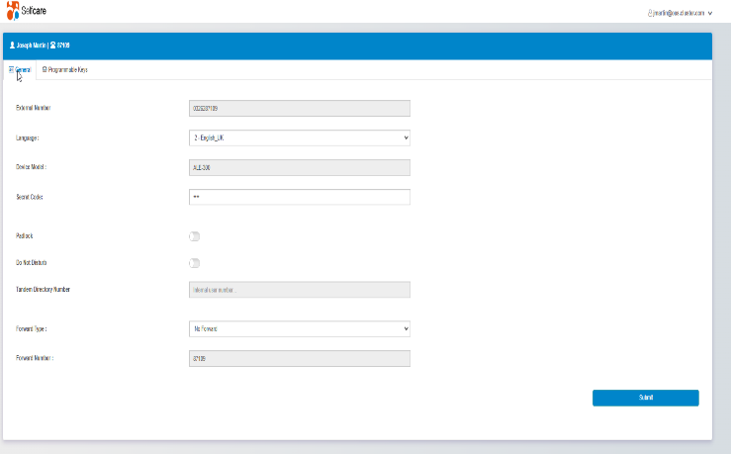
Simplify operations WITH As-A-SERVICE OFFER
Simplify everything
Your choice
With
Zero
compromise
on security and service quality
Maintenance included.
Systematically-applied
security patches
Immediate access to new features
State-of-the-art, all-inclusive service
Fully managed by
ALE partner
System management
by the ALE partner
+ Delegation of management
Via an intuitive web portal
(by geography, by role)
Reassign your administrators to value-added tasks
Delegate day-to-day operations to local administrators
Innovative ‘Selfcare’ web portal
for employees and local administrators
Notes:
Finally, a SaaS or cloud service enables the IT team to spend less time on management and maintenance.
OTEC is managed entirely by the ALE partner, freeing up time for business-oriented tasks.
Maintenance is included. Security patches are systematically applied.
And access to new features is immediate.
In some large companies, the customer may request to delegate day-to-day operations to local administrators.
Administrators can configure the service from anywhere using the OTEC Selfcare web portal. There are simple forms for creating and updating settings and accounts.

Slide 23



Simplify WITH LOCAL, SECURE HOSTING
Simplify everything
Your choice
With
Zero
compromises
on security and service quality
Communications stay on your network
Hosted by the
ALE partner
On-site
Choose hosting
by our partner or
in your own data centre
Choose a local hosting service
In your data center
IP-VPN
or MPLS
Hybrid mode with digital and analogue connectivity
Communications remain on your extended network
Centralize communications from all your sites
Hybrid: Save money by leveraging existing cabling
ALE cloud service and technology
secured by design
EAL2+
under renewal
Notes:
With OTEC, customers simplify their business communications by hosting them in a secure environment.
The partner can host OTEC in their data center or with a hosting service. Communications remain within the corporate network, which is extended to the data center where OTEC is located.
Some large companies choose the option of on-site hosting in their data center.
They centralize all communications for all their sites.
Those with ALE compatible hardware can connect it to OTEC to take advantage of their existing analogue or digital cabling.
In all cases, the communication technology and cloud service have received certifications from security organizations, respectively Common Criteria (under renewal for 2021) and ISO 27001.

Slide 24


HIGH AVAILABILITY FOR the most demanding sectors
Control
Continuity of calls in the event of a software or server failure
Continuity of calls in the event of a Wide Area Network failure
Prevention of Denial of Service, malicious eavesdropping
Secure access to the service provider SIP network
Connecting existing equipment
With
Zero
compromise
on security and service quality
Real-time redundancy of communications
On-site redundancy of communications
Encryption of communications
Firewall* for access to SIP public network
Gateway with digital and analogue ports**
High availability, security, and extended connectivity at the right price
Your choice
Options
+
Proven communication system
20 million users
(OmniPCX Enterprise)
EAL2+
under renewal
Used by multinationals,
Hospitals, governments
* Software: perpetual licence
** Chassis + electronic boards: CAPEX
Notes:
OTEC offers options that are aimed at the most demanding industries in terms of SLA.
OTEC uses the proven OmniPCX Enterprise technology used by more than 20 million users around the world, especially in sensitive business areas such as hospitals and government agencies.
These options ensure the right price for high availability, security and connectivity features.

Slide 25









OTEC: single licence
And simple options at the right price
+ Open license offer
+ simple ppm catalogue,
+ Software insurance included
+ 100% flexibility
Simplified management
Managed by an
ALE partner
Selfcare web portal option
Optimized
infrastructure
or
or
ALE cloud for billing
Hosted by an
ALE partner
Virtualized
in a data
centre
ALE servers
Maximum values configured
during the month
Virtual machine
OV8770 MCS
(Selfcare portal,
Usage report)
Extensive
connectivity
All ALE desk phones
and handsets
SIP, digital and analogue ports
High availability,
local site survivability options
Encryption
option
OXE Purple
Hosted on-site or
by the partner
Work-from-anywhere, customer service apps
Work-from-anywhere options: softphone, hot-desking on desk phones, voice mail, secure messaging with Rainbow video conferencing
Customer interactions options:
Agent, supervisors, recording, attendant console, automated attendant, fax server
Single
licence
* Project mode
In italics: fixed costs
Notes:
Here you will find a summary of the OTEC catalogue:
- Single licence and options for the digital workspace and customer service applications
- Connectivity, hosting and management options.
On the right, this is how OTEC works:
- OTEC uses the OmniPCX Enterprise software suite hosted on-site or by the partner
- An OmniVista 8770 MCS virtual machine that the partner hosts provides the selfcare web portal and extracts OmniPCX Enterprise usage reports. 8770 can be shared across multiple customers.
- The maximum values configured during the month are transmitted to the ALE cloud for billing and then retransmitted to the partner.
OTEC is therefore an open license offer, with a price per user and per month. ALE software insurance is included. It is possible to add or remove options at any time.

Slide 26


OTEC
ELEVATE YOUR BUSINESS TO THE CLOUD
Work-from-anywhere,
Connect all employee profiles,
Boost the customer experience
For a controlled budget,
total flexibility and
a limited initial investment
Zero compromise:
Choice of hosting,
Maximum security
20 Million users
Certified secure
Under renewal
Notes:
In summary, OTEC is the cloud communications service for agile businesses.
- OTEC provides business communications to work from anywhere, connect together all employee profiles and boost the customer experience
OTEC offers a price per user per month for a budget that can be kept in check, total flexibility and a limited initial investment
OTEC uses proven and reliable technology, with a choice of hosting and options for maximum security
ALE business communications for medium and large enterprises are used by over 20 million users and are certified secure .

Slide 27




CONTACT US
WEBSITE
www.al-enterprise.com
Follow us :
The Alcatel-Lucent name and logo are trademarks of Nokia used under license by ALE.

