Slide 1

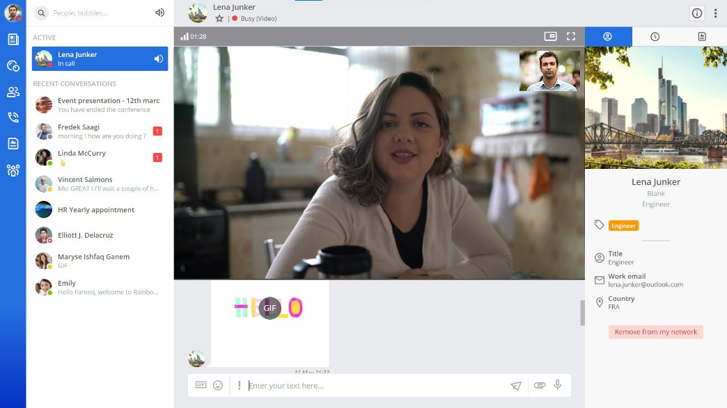
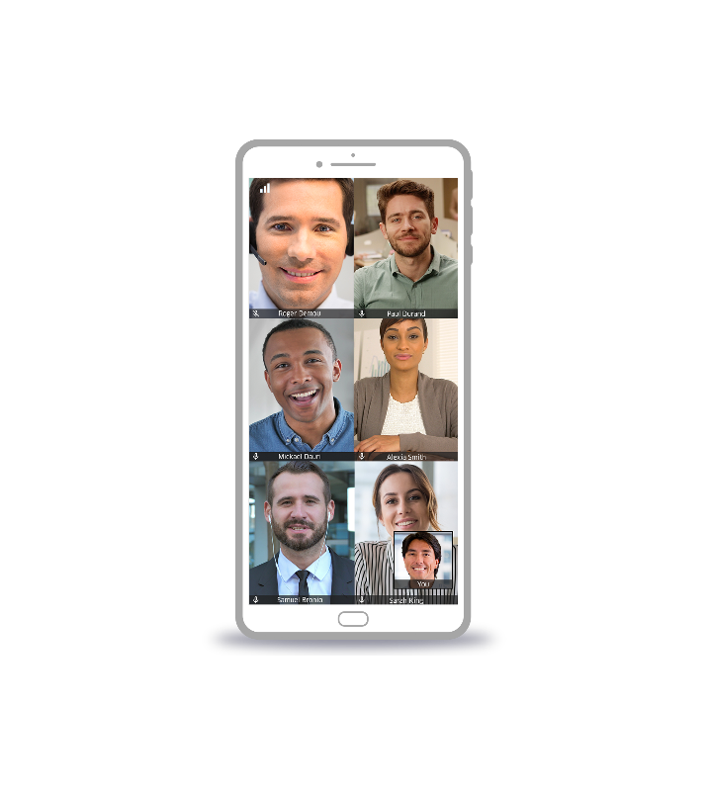

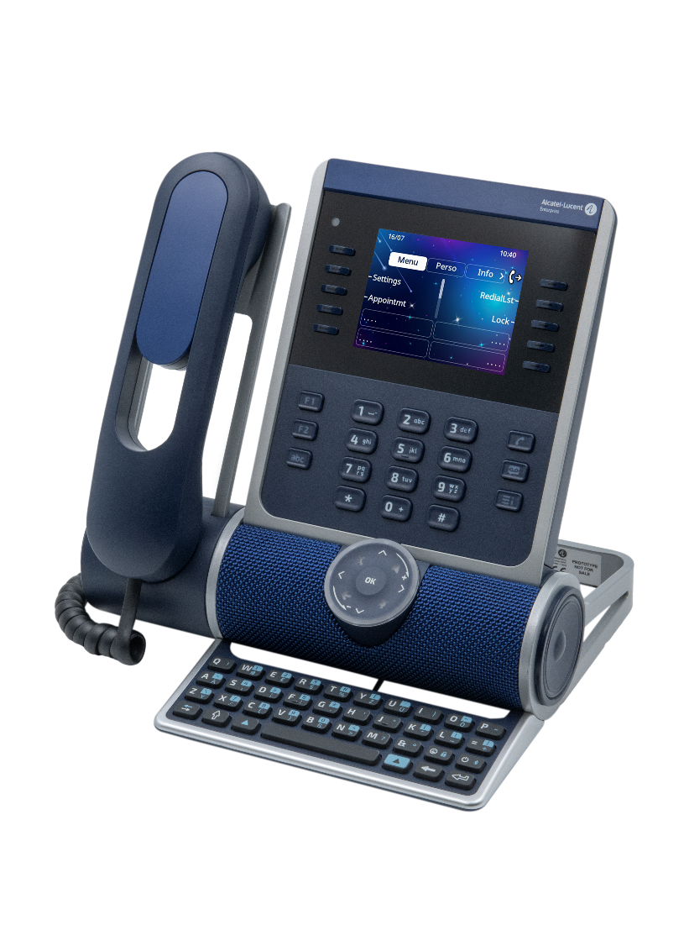
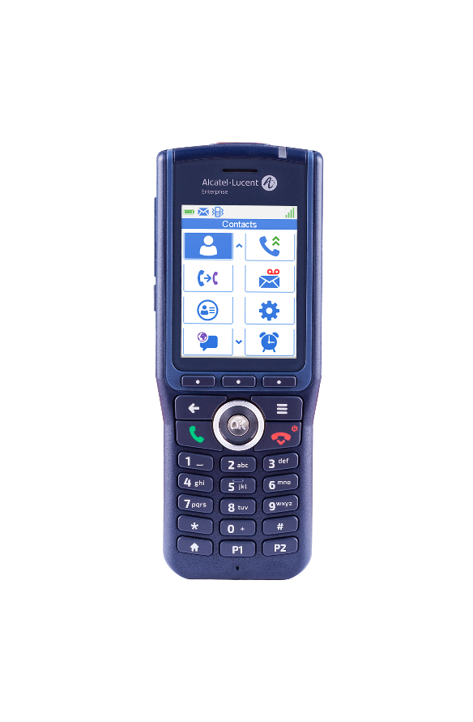
Accélérez votre Business
Avec le cloud
Elevate your Business
to the Cloud
Solution Guide
OpenTouch Enterprise Cloud (OTEC)
Cloud communications and collaboration for sustainable growth.
November 2023

Slide 2

Who is this guide for?
OTEC:
Elevate your business to the cloud
Digital transformation is accelerating. Work habits and consumer expectations are changing profoundly. Companies are adapting faster thanks to the cloud.
This is also true for Business communications. If you ask yourself the following questions:
How to improve teamwork when more employees are working remotely?
How to manage a growing number of customer calls with fewer staff working on site?
How to simplify business communications using the cloud without compromising data security and privacy?
Then this guide is for you.
In the following pages, you'll discover how to elevate your business to the cloud with OpenTouch Enterprise Cloud (OTEC) business communications.

Slide 3

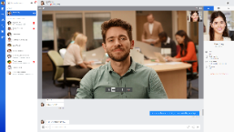

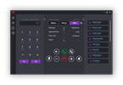







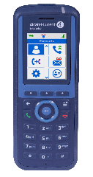
OTEC business communications boost growth
+
…
OTEC
All ALE business communication services
Available on demand via a single license per user per month
Hosted in one of our partner's cloud
With multiple communication options
and Rainbow Video Collaboration
Accessible from within your business or productivity application

Slide 4

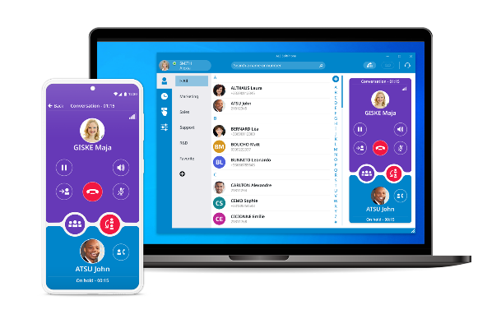
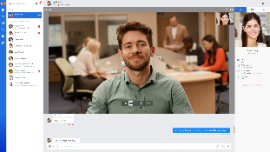
+ Ease Work-From-Home with online business communications!
Work-From-Home employees communicate easily using their computers or mobile devices.
Adoption is rapid: Phones and softphone offer a similar call management experience including call supervision and contact center functionalities. DDI and call routing are preserved.
+ Ensure excellent quality of communication wherever your employees are.
ALE phones have large screens and key modules for easy call management. Symphonic HD audio preserves voice nuances and eases mutual understanding. The wireless handsets are resistant to falls and offer excellent voice quality in office, industrial and healthcare environments.
Improve teamwork and deliver
a great customer experience.
Work together.
From home. On site.
Wherever they are, all your employees work together to ensure customer satisfaction. They communicate with the device or app of their choice: desktop phone, mobile handset and an easy-to-use video collaboration application.
+ Ease teamworking with chat groups, video meetings and screen sharing
Phone presence indication, secure chat and screen sharing simplify teamwork with remote contacts. Exchange files within project groups that external contacts, customers or suppliers can attend. Work better together by attending video meetings in a single click.

Slide 5

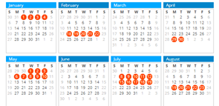
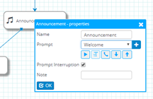

Answer all customer calls. At any time.
Automate customer welcome
Don't miss any calls even outside of business hours. Automatically put calls through to the requested department. Personalize the customer experience by sharing your latest business news: Employees can update the attendant service in just a few clicks.
+ Offer a 24/7 personalized welcome to customers
Our interactive voice service greets your customers during business hours and beyond. Easily customize greeting guides and call routing procedures at any time using the calendar management application.
+ Update voice guides and routing rules at any time
Employees can update voice guides from a very simple web application. The attendant service offers multi-tenant capabilities such as updating voice guides by department without impacting other department’s rules and voice prompts.
+ Automate customer welcome using speech recognition
Automatically process the customers’ most common information and connection requests without involving your staff, using to speech recognition, text-to-speech and SQL queries to your business databases.

Slide 6
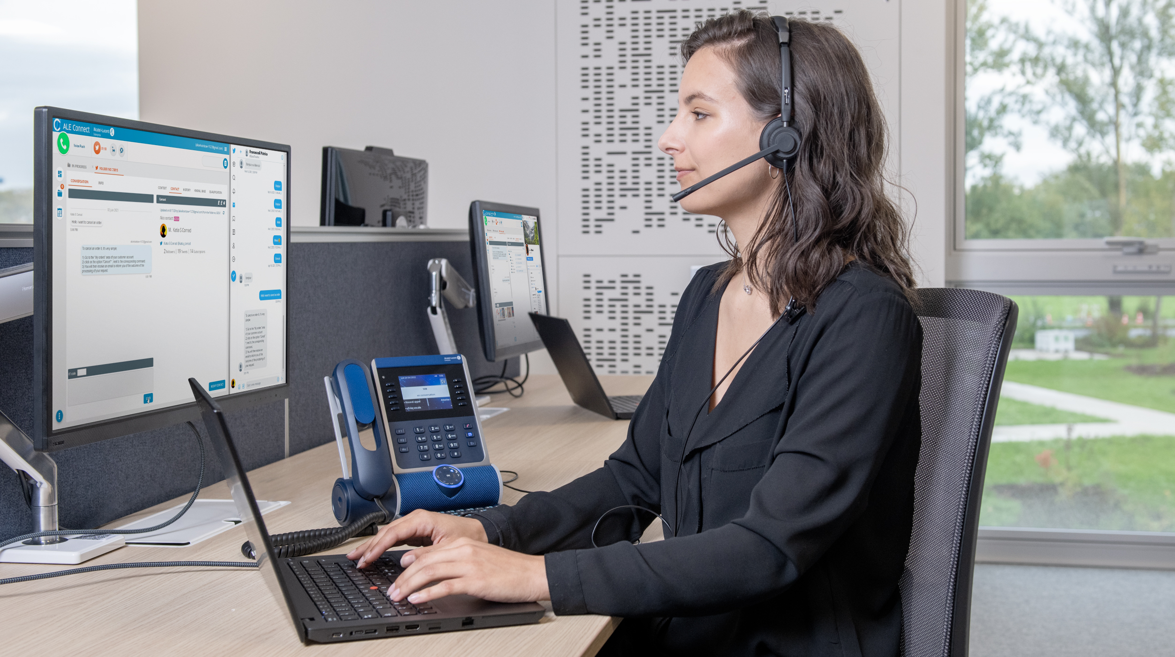
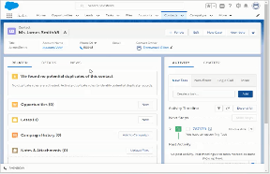
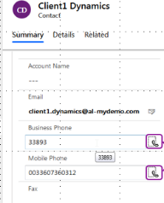
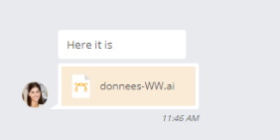
+ Greet customers by their name!
Improve the customer experience and reduce the duration of the interactions by immediately accessing customer data when customers calls. With our CRM connectors, the customer form pops up with each call. The main SaaS CRMs on the market are supported: SFDC, Microsoft Dynamics, ServiceNow, ZenDesk,...
Improve first call resolution
Communicate from
the CRM application
+ Call your customers faster!
Our CRM connectors automatically retrieve the customer’s calling number and save it in your CRM. Employees call back with one click without risk of dialing mistake or loss of time.
With our CRM connectors, employees automatically have access to customer data during all communications. Employees can get assistant from experts using built-in collaboration capabilities. Responses are fast and accurate. Follow-up is personalized.
+ Work as one team to improve the customer experience!
Employees can help each other with a click thanks to our secure professional messaging system. Respond with relevance to customer requests by using chat, file exchange, screen sharing or call with experts. On the first call.

Slide 7

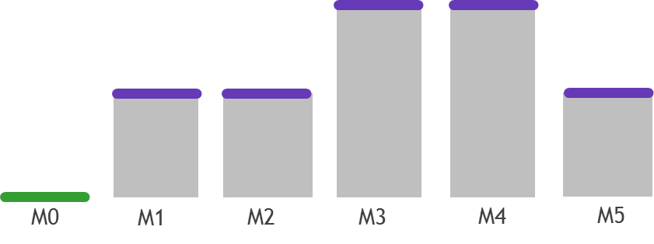
Adapt communications to business.
Manage your business communications
with total flexibility.
With OTEC, you only pay for the communication services you use. Each month, you can remove or add on-demand options to tailor your communications to your business needs.
+ Plan and control costs easily
The service is offered per user per month for a predictive and controlled budget.
+ Adapt communications to the business in a few hours
Need to quickly deploy work-from-home communications? Need to open or close a branch? Need to reinforce your contact center team during sales?
The number of users and their options can be changed each month, up and down with total flexibility.
What is configured will be billed at the beginning of the following month.
Budget:
+ First month is free of charge
No investment required⁽¹⁾ and first month free of charge
(1) Excluding telephones, cordless handsets and specific connectivity options.

Slide 8


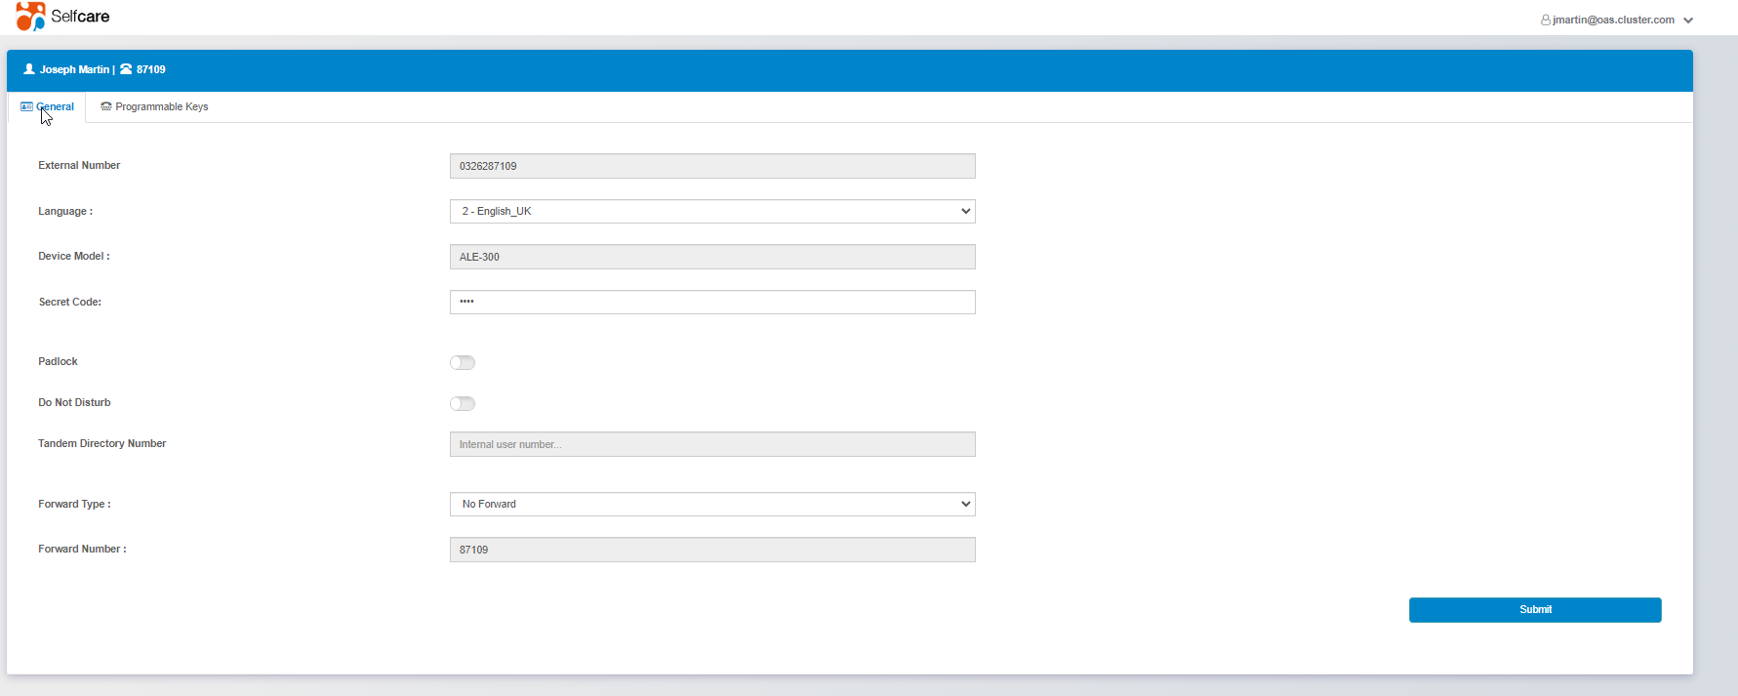
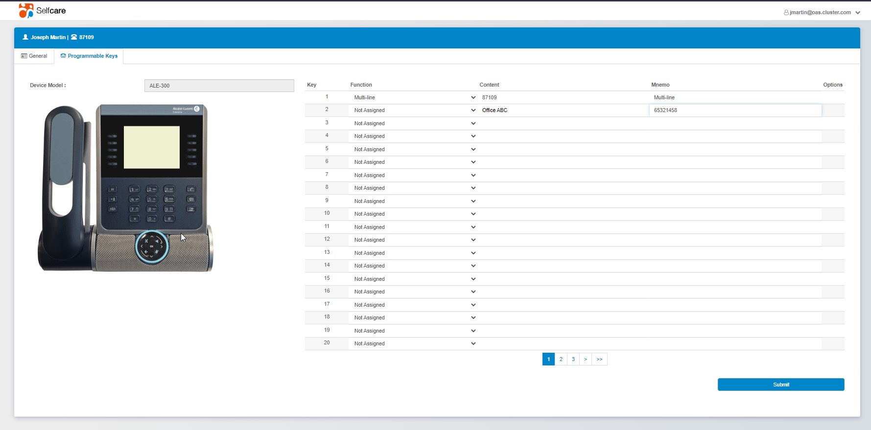
+ Rely on a cutting-edge communications.
The service includes manufacturer’s software insurance and software updates managed by our certified expert partners. Security patches protect against cyber attacks. New features are immediately available without commercial negotiation or additional costs.
+ Delegate day-to-day operations
Easily perform common operations such as creating or deleting accounts using a simple web portal. The interface is intuitive for easy adoption by local IT admins.
Simplify daily maintenance and operations
Get ready in a matter
of minutes.
Perform daily operations using an intuitive web portal. Our expert partners keep your communication system constantly up to date.
+ Offer self-care capabilities for employees to better manage their business communications.
Delegate the programming of business phones to employees: it's easy to do from a web interface. Call groups, number supervision, call forwarding can be configured at the office or remotely.

Slide 9


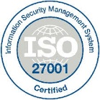


Simplify communications with a secure cloud service.
Secure communications and customer data.
Our technology is ISO27001 and Common Criteria EAL2+⁽¹⁾ certified: Your communications and customer data are protected.
+ Select a service that is secure by design
Our ISO27001 certification demonstrates our commitment to securing our cloud processes. The Common Criteria EAL2+ ⁽¹⁾ certification of our communication server demonstrates our commitment to design business communications software in a secure way.
+ Keep control over your data with local hosting options
Our expert partners host your communications either in a local cloud or on your premises. The service complies to GDPR requirements.
+ Protect your communications from cyber attacks.
OTEC encryption option protects communications against denial-of-service attacks and eavesdropping attempts. OTEC Session Border Controller option secures your SIP network access to the public network.
(1) Renewal in progress with ANSSI (French National Security Agency)

Slide 10





+ Minimize the risks with high availability
Our hot-switching high availability option provides uninterrupted access to the service in the event of a software defect or server failure. The “PCS” local backup option provides basic communications in your premises in the event of a network failure.
+ Keep your communications on site
if required
OTEC can be deployed in your data center if your business requires on-site communications. Your business communications can be hosted in a partner cloud while keeping some of the servers onsite to make the transformation easer: it’s hybrid cloud at work!
Select a highly available cloud service
Be there when customers need you.
Our high availability options minimize the risk of downtime: stay in touch with your customers at any time.
20+ Million users daily rely
on ALE Communications
20 Million users daily rely on ALE for their business communications in many sectors including hospitals, public services, insurance, transportation, industry, small businesses.

Slide 11

Connectivity and business integrations
Click here for more information
Security and high availability
Click here for more information
Maximize the customer experience
Click here for more information
The OTEC License Catalog
Communicate anywhere
Click here for more information
The user license
Click here for more information

Slide 12
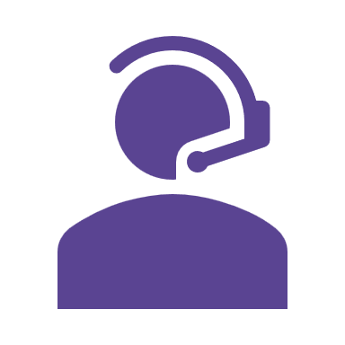
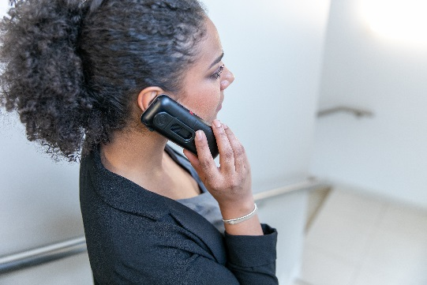
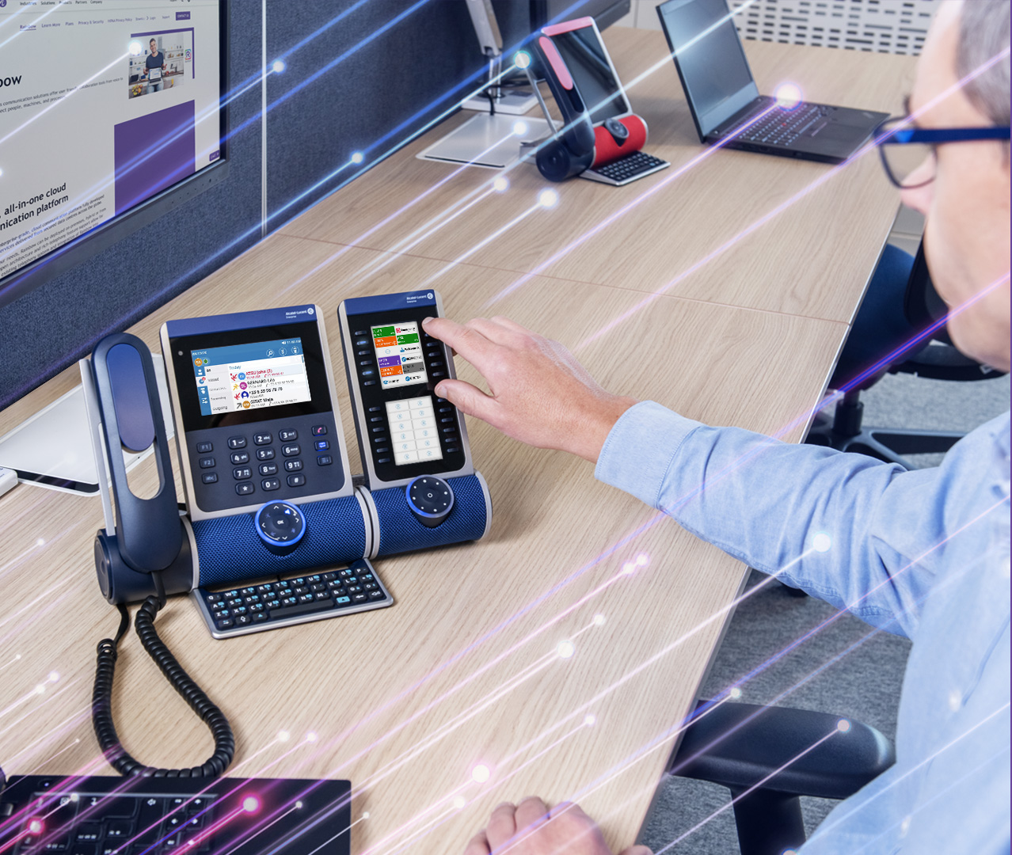
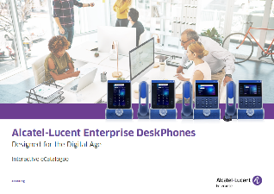
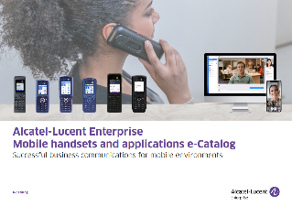
+ Begin at full speed: you only need one license per user
Our business communication services are available via a single, per user per month license.
1
+ Delight your customers with excellent call management.
Features such as multiple lines, call filtering, line supervision, call grouping, configurable call forwarding, speed dialing are included in the user license.
Simplify communications
using a single license.
All your professional communications
with one license per user
per month
+ Connect ALE latest phones and wireless handsets
This license can be completed with options that are described in the following pages
Discover our phones and handsets :
Click here
Click here
Business Phones
Rainbow
and mobile applications

Slide 13

OTEC Work-From-Anywhere options
Use case | Availability per month | Advantage
Softphone for work-from-home staff | Per user | Communicate anywhere from your computer or Android smartphone as if you were using an ALE business phone, with line supervision, group calls, etc.
Communications on any device | Per user | Communicate from the Rainbow mobile application or any web browser, keeping your business number thru dual ringing with your desktop phone.
Secure messaging, video collaboration | Per user | Work together wherever you are with Rainbow: exchange files, chat or share screen with just a few clicks. Set up project groups to share and meet on video. Invite external contacts.
Management Portal | By port | Set up the deskphone’s quick access keys, call forwarding from a web application anywhere. IT local administrators perform daily operations on user accounts using the same portal.
Voicemail | Per user | Don't miss any important calls. Call back easily.
Hot desking mode for phones | Per user | Log in to a phone for the day and retrieve your business number and phone settings.

Slide 14
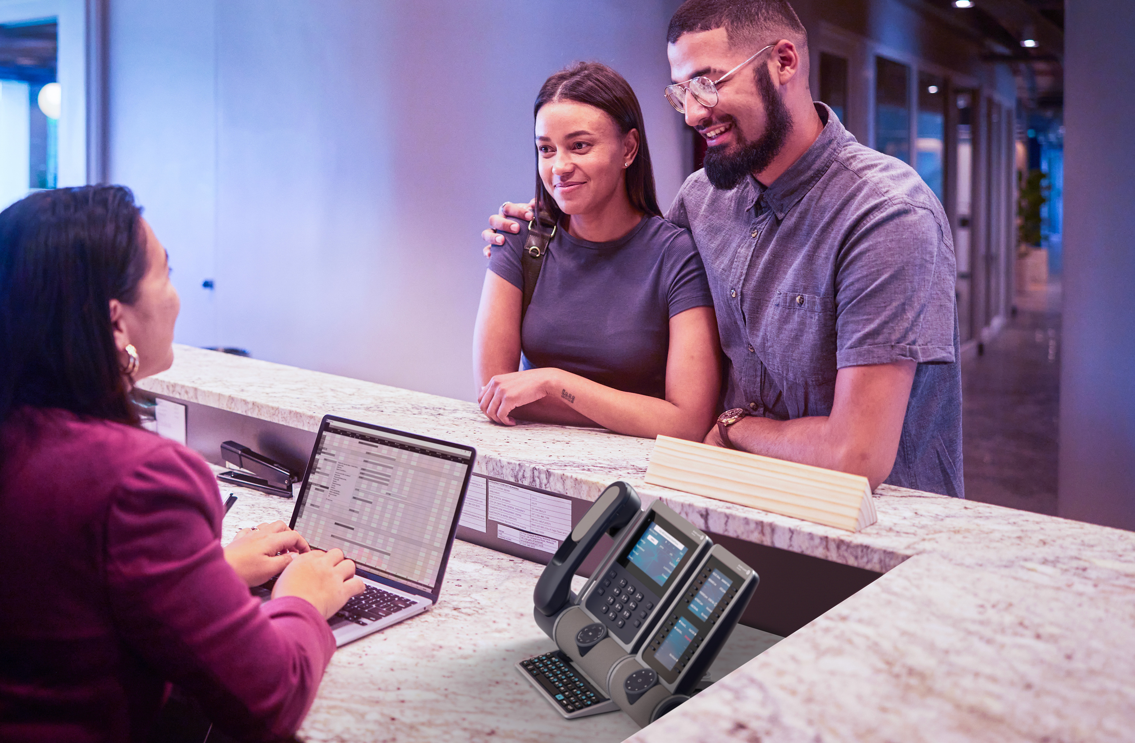
OTEC customer interactions options
Use case | Availability per month | Advantage
Softphone for work-from-home agents | Per user | Communicate from anywhere on your computer or Android smartphone as if you were using an ALE business phone, including call management features for agents.
Automated attendant | By port (simultaneous calls) | Your company is easy to reach 24/7. The welcome guides are updated by the staff to keep up with your news. People are put through to the relevant department by using menus or voice recognition.
Access to CRM data during the call | Per user | Save time by automatically accessing customer details during calls. Collaborate from within the CRM application to solve issues on first call. Call back faster.
Attendant console | Per user | Your reception agent connects your customers with your employees quickly thanks to the graphical interface and the configurable company directory. A large volume of calls is handled without stress.
Customer welcome agents | Per user logged in simultaneously | Calls are distributed to teams of agents according to adapted criteria. Queues are managed to minimize waiting time.
Customer welcome Supervisor | Per user logged in simultaneously | Monitor the activity of agents in real time and optimize routing rules by using an intuitive graphical interface. Design activity and performance reports.
Recording of communications | Per user | Record calls on demand or systematically to reduce disputes, better train customer service staff, and keep track of interactions to better respond to requests.

Slide 15

OTEC security and high availability options
Use case | Availability per month | Advantage
Encryption of communications | Per user | Protect your network from cyber attacks including denial of service attacks that can cripple your business. Strengthen the confidentiality of exchanges by preventing eavesdropping on communications.
High availability | For the company | Communicate at any time without loss of service. Your communications switch in real time to another server in case of software or server fail and access to the data center falls.
Local Communication Survival | By site | Are communications on some of your sites critical to your business? Employees can continue to communicate with each other and with the outside world if access to the data center fails.
Secure access to the public SIP network using a firewall | Only by perpetual license | Protect your network from attacks from the Internet with a Session Border Controller. Make protocol adaptations to connect to specific SIP networks.

Slide 16

OTEC connectivity and business integrations
options
Use case | Available per month | Advantage
Access to the public SIP network | By simultaneous call | Rationalize your costs by centralizing your subscriptions to the public network.
Digital and analog connectivity | Perpetual license + chassis + boards | Save by reusing your analog cabling and phones.
Communications integrated in business applications | Only by perpetual license | Your employees control their calls from their business application. Traditional CSTA/TSAPI APIs are provided to connect to common applications. A REST format facilitates SaaS integration.
Agent application on PC | Per user | The customer welcome agents control their business phone from a light application banner on PC without taking eyes off the computer screen.
Integration with hotel management software | Per room | Save money by only paying for occupied rooms. Automatically manage phone settings based on check-in and check-out from your hotel’s Property Management System.

Slide 17




CONTACT US
WEBSITE
www.al-enterprise.com
Follow us :
The Alcatel-Lucent name and logo are trademarks of Nokia used under license by ALE.

