Slide 1
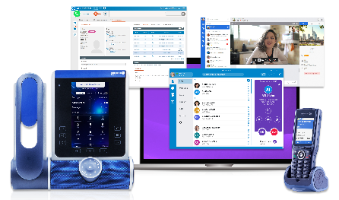

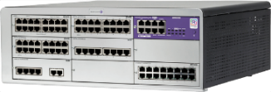
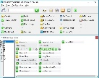
What’s new in otec R100.1 md6
OTEC
Terminals
Verticals
Applications
R100.1
presentation for business partners
november 2023

Slide 2
OTEC R100.1 md6 offer update
Refer to EF-Phase-in-C217-EN published in MyPortal.
Effective 21st November 2023
New Alcatel-Lucent OpenTouch® Enterprise Cloud (OTEC) Release 100.1 MD6
Bundling licenses for the following releases and components:
  OmniPCX Enterprise 100.1
  Alcatel-Lucent OmniVista® 8770 Network Management System (NMS) R5.1
  OpenTouch 2.6.1 (only for existing subscriptions having OpenTouch options)
  Alcatel-Lucent Visual Notification Assistant (VNA) R2.2
  Alcatel-Lucent Visual Automated Attendant R4.5 - new release
  Alcatel-Lucent OmniPCX RECORD R2.5 - new release
  Alcatel-Lucent OmniPCX Open Gateway (O2G) R2.7 - new release
  Alcatel-Lucent Dispatch console R3.3 - new release
A new O2G option for OTEC-R “Contact Center services” is introduced with O2G R2.7.
A monthly Right-To-Use (RTU) is charged per node that benefits from the O2G Contact Center services license:

Slide 3

offer general information
Components which have not evolved compared to OTEC R100 MD6 offer
Components which have evolved compared to OTEC R100 MD6 offer
Availability in OTEC R100.1 MD6 catalog
Components that is end-of-sales
RAINBOW
CLOUD CONNECT OPERATION
ALE CONNECT
OXE Purple R100.1 MD6
Rainbow WebRTC Gateway
OV8770 R5.1 MD3
OTCC SE R10.15
OT-SBC R7.4
OPR R2.5.0.10
O2G R2.7
CC-IVR R12.3
CAPEX
CAPEX
VNA R2.2
VAA R4.5
IQ Messenger R13.0 (*)
OTFC R9.2
CAPEX
CAPEX
OTMS R2.6.1 MD3
OTMC R2.6.1 MD3
Dispatch Console
R3.3
Selfcare R2.15
* IQ Messenger new sales and addons must be purchased through a SERVICE offer from ALE Professional Services.
Notes:
Notes:
In the above slide, the components in light purple have not evolved compared to the previous MLE offer.
Summary of past OTBE phase-out steps:
End of OTBE new sales with H1 2019 MLE offer (ACTIS 22.4). For more details, refer to the “OpenTouch R2.5 overview” pre-sales presentation (TBE075).
End of OTBE upgrade with H2 2020 MLE offer (ACTIS 22.7).
End of OTBE full add-ons with H1 2021 MLE offer (ACTIS 22.8). Only light add-ons are authorized in case of OTBE in R2.4 or R2.5 (no add-on of OTFC embedded in OTBE).
End of OTBE add-ons (ACTIS or direct keying) with H1 2022 MLE offer (ACTIS 23.2). The one-year SPS contract is no longer available (multi-years contracts have been phased-out previously).

Slide 4
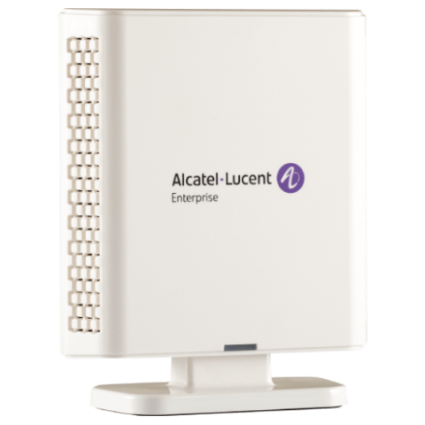
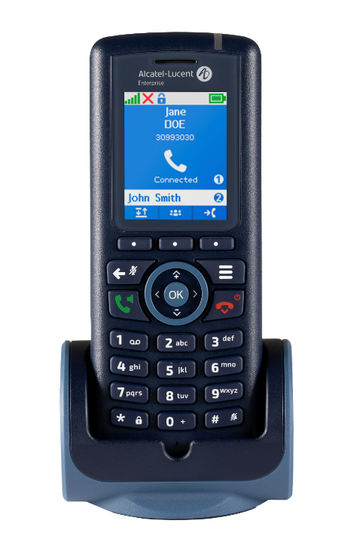
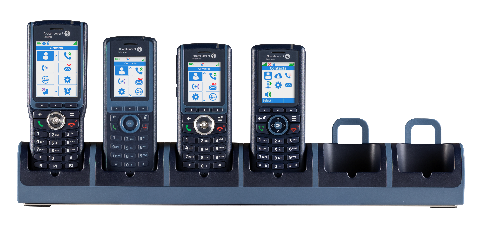


DECT solution update
New
New
PROFESSIONAL ENTRY LEVEL HANDSET
COMPACT AND ROBUST DESIGN
x2 BATTERY AUTONOMY (vs 8212)
8328 SIP-DECT Single Base Station
ON-SITE MOBILITY FOR SMALL BRANCH
Homogeneous design for the full range and common accessories!
ULTRA COMPACT ECO-DESIGN
SINGLE/DUAL CELL COVERAGE
8214 DECT Handset
with charger
82x4 DECT Handset rack charger
Sell the pack 8328 BS+8214 DECT Handset at an attractive price!
8244
8254
8234
8214
+
Notes:
The 8214 DECT Handset by Alcatel-Lucent Enterprise is a professional entry level handset that shares the sleek, compact modern DECT product family design. The 8214 DECT Handset offers telephony features either in GAP mode on Alcatel-Lucent DECT TDM and IP-xBS infrastructures or in CAT-iq mode on Alcatel-Lucent DECT SIP-DECT infrastructure. A 1.8 inch color screen that provides crystal clear readability makes day-to-day communications activities easier for the mobile workforce.
The 8328 SIP-DECT Single Base Station by Alcatel-Lucent Enterprise is a wireless base station that provides on-site mobile communications to small branch offices and stores in shopping malls. It offers single/dual DECT cell coverage with excellent quality voice communications for 10 parallel calls with Alcatel-Lucent 8212 DECT handsets with up to 20 SIP accounts per system.

Slide 5

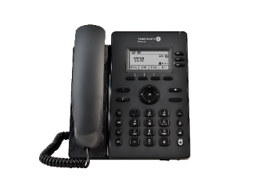
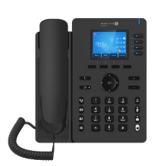
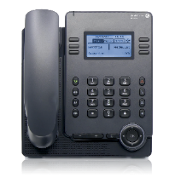
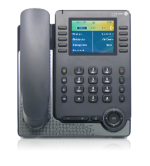
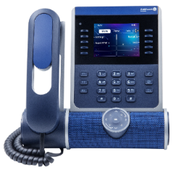
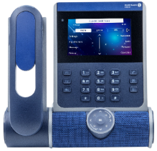
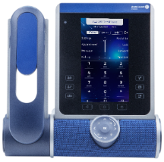
ALE DeskPhones update
Basic
Essential
Enterprise
ALE-2 SIP
DeskPhone
ALE-3 SIP
DeskPhone
ALE-20
DeskPhone
ALE-20h
DeskPhone
ALE-30h
DeskPhone
ALE-300
DeskPhone
ALE-400 DeskPhone
ALE-500
DeskPhone
SIP
ALE-NOE: Advanced services
New
ALE-NOE & SIP (dual-stack)*
IP only
Hybrid TDM/IP models
IP models with Audiohub (USB and Bluetooth)
Color screen
Large color screen
Touch screen
100% Touch
Options:
Alphabetic keyboard ALE-10
Alphabetic keyboard ALE-100,
WiFi/Bluetooth module ALE-108
2*10 Key module with color screen EM-200
2*12 Key module with color screen ALE-120
Customization kits: Factory, Ruby, Azure, Neptune ALE-140 and ALE-145 (Key module)
New
Bluetooth handset ALE-160
ALE-500 no handset
Wall mounting kit
Wall mounting kit
Wall mounting kit ALE-110
* SIP stack on all Enterprise models with OXE Purple from R100.1 MD6
Notes:
Here is a summary of all ALE DeskPhones ranges and models, from left to right, with the key features highlighting the benefits of more advanced models:
The Basic range is composed by 2 models of SIP phone
The ALE-2 which is a phone with a backlit screen
The ALE-3 benefits from a color screen and USB connectivity
The Essential range is composed by 3 models
The ALE-20 which is IP phone with a backlit screen
The ALE-20h and ALE-30h which are hybrid Digital and IP. The ALE-30h has a color screen
The Enterprise range is composed by 3 models: the ALE-300, the ALE-400 and the ALE-500
They all have the 3D sound bar and customization kits. They also have an alphabetic keyboard and a key add-on in option
The ALE-400 and ALE-500 have touch screens. They also have a Bluetooth handset in option
The ALE-500 exists in a no handset version
All Enterprise models support a dual stack and can be configured to use either the proprietary NOE protocol or standard SIP protocol when connected to OmniPCX Enterprise Purple from R100.1 MD6

Slide 6
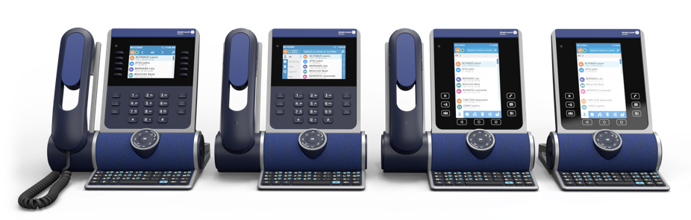
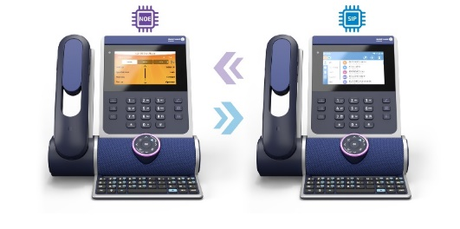
ALE Deskphones enterprise new SIP mode
ALE DeskPhones Enterprise full range:
Dual-stack to configure as NOE phone or SIP phone:
ALE-300
ALE-400
ALE-500
ALE-500 no handset
New modern and intuitive UX
Homogeneous UI with client ALE SoftPhone
New with
OXE R100.1 MD6
New with
OXE R100.1 MD6
New with
OXE R100.1 MD6
SIP compliance for RFP
Dual stack NOE-SIP
Notes:
ALE has developed SIP at the heart of OXE Purple and has enhanced it with the services needed for business telephony (named "SIP+").
With OXE R100.1 MD6, the new SIP mode is now available on all the ALE DeskPhone Enterprise models: ALE-500, ALE-400 and ALE-300 (already available since H2-2022).

Slide 7


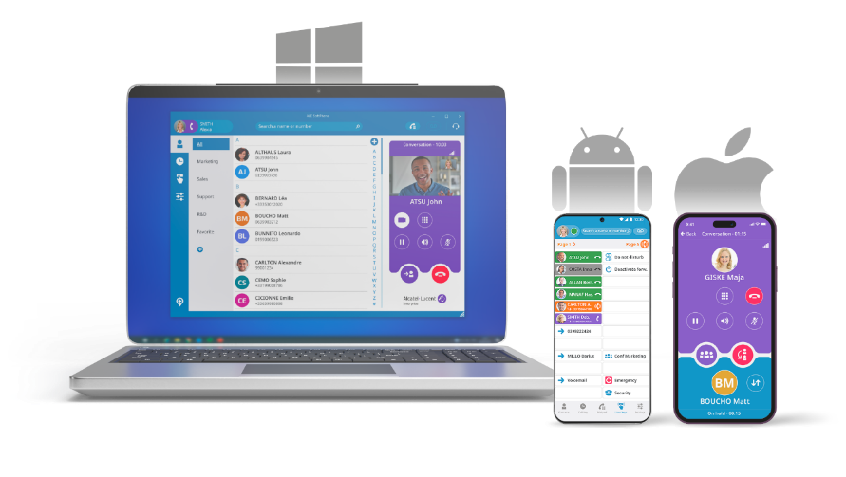
ALE Softphone update
Secure user authentication
using LDAPS/Azure AD/Microsoft AD
Secure remote work
Using on-site OT SBC/RP – no VPN client on PC required
Support of SBC active/active redundancy
NEW
Value proposition
Easy user adoption with a modern user experience to benefit from business telephony and video calls everywhere
Application natively integrated with the existing phone system, with no external connectivity to a cloud-based service
Secure communications over the Internet without the need to deploy a VPN client on PC
Never miss a business call in mobility thanks to the app for smartphone Android and iPhone
SIP+ user experience
Modern user interface
Make call, take call, decline call, forward, second call, merge, on hold, DND, meet-me
Groupware (Hunting Groups)
Multi-line call management
Programmable keys
Supervision / Pickup
Hotkey to select-and-call
Video call (peer-to-peer)
Custom actions on call events
NEW
NEW
Reliable and agile communications
All OmniPCX redundancy options, Centralized management with OXE
Multiple devices
Windows PC (Desktop, laptop and touchscreen)
Android smartphone app (with MDM)
iPhone smartphone app
ALE DeskPhones Enterprise range
Microsoft integration
.msi deployment
Installation and upgrade tools (SCCM and MDT)
MS 365 and Outlook contact synchronization
MS Teams integration – mini-view PC and support of Android smartphone
NEW
Planned Dec’23

Slide 8
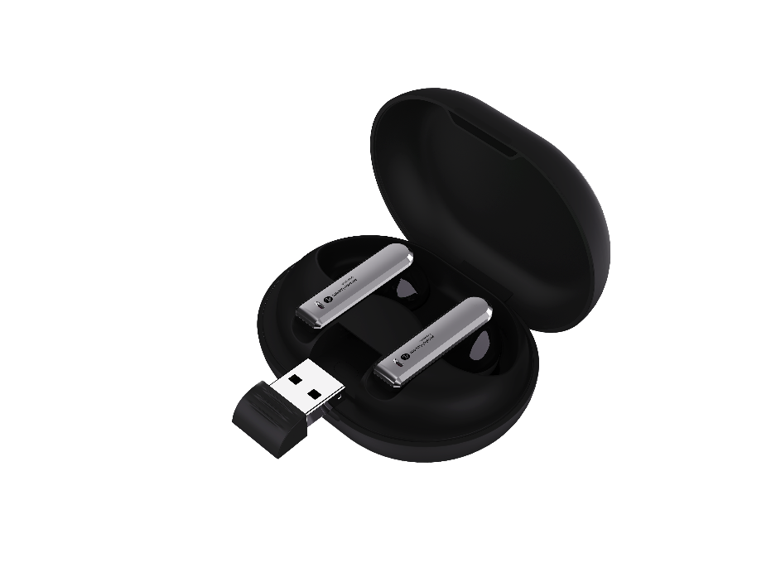
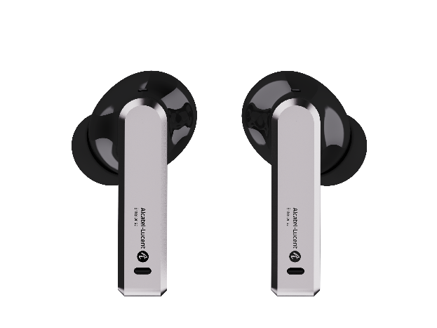


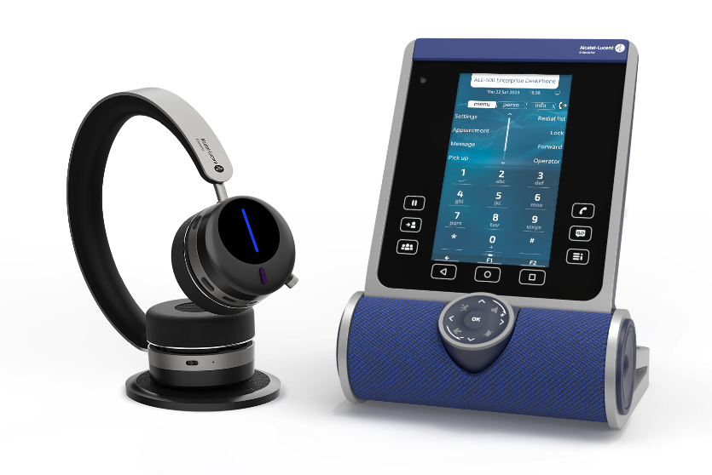
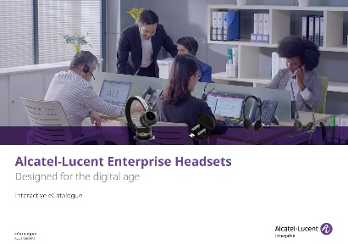
Ale headsets update
Soon available
AT10
ON THE GO
AT THE OFFICE
AH80
Check out the new AT10 product datasheet
Check out the new e-catalogue ALE Headsets

Slide 9
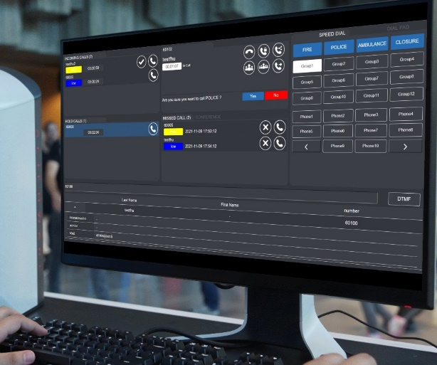

Dispatch console
Intelligent call processing for control centers
Opportunities:
Sell call management for Operation Control Centers
SCADA integration projects
Differentiate with end-to-end solution including call dispatch, interworking with emergency call stations and Rainbow-based automations: Metros, Energy and utilities, Smart Cities
Web browser
Present the various calls which are queued on one or several services
Display priority, presentation order and the kind of service called
Operators can pick up any of such calls according to the called service or priority indication
WHAT’S NEW?
Redial button (bis)
Role based management
Security policy enforcement for passwords
Multi-tenant configuration
Visit the product web page
>> Video demonstration
Notes:
Dispatch Console application is proving very popular with customers in the field of operational control centres (OCCs) but also in more conventional working environments such as town halls and courts.
As the name suggests, it is a solution for receiving, prioritising and distributing calls to operators according to the nature of the call and the operator's expertise.
It can easily manage call matching, trader mode conferences (micro-listener control), prioritised queues and much more.
A possibility that is highly appreciated by customers in the OCC context is the possibility of integrating the application on the SCADA platform, which is THE standard in this field.

Slide 10
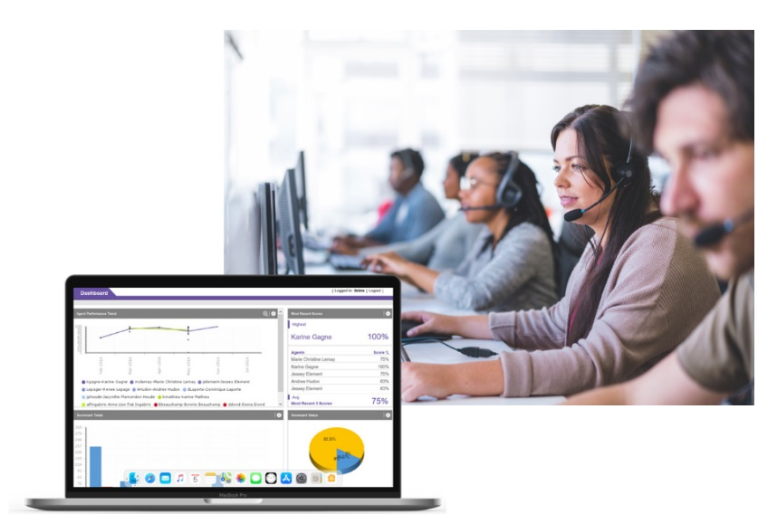


Omnipcx record suite
When everything must be on the record
RECORD CALLS
SCREEN CAPTURE
SILENT MONITORING
QUALITY MONITORING
WHAT’S NEW:
Support OPUS codec for all recording methods
Web hooks extended with additional call events
FIPS security standard compliance
Two-factor authentication (Microsoft and Google authenticators)
Optimization for encryption processing (+25% simultaneous live recorded calls)
Support of virtualization with Hyper-V server 2019 and 2022

Slide 11
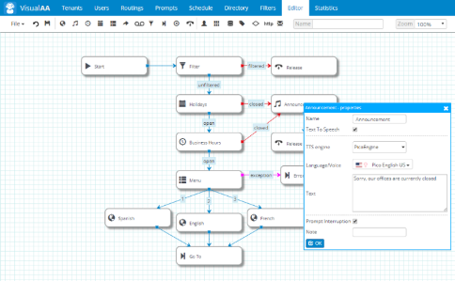

Visual automated attendant
AUTOMATED 24/7 CALL ROUTING AND GREETING
Opportunities:
Easy to sell 24/7 automated greetings and call routing services for organizations on top of the existing telephone system
Complement of the attendant position used during business hours
IVR option for collecting customer data and queuing action in a contact center environment
Professional automated customer welcome
Personalized greetings, routing and news broadcast
Easy-to-use, cost-effective and scalable
WHAT’S NEW:
Scheduled reports generation and export via email
Security: SIP Trunk encryption between VAA and OXE Communication Server
Visit the product web page
>> Video demonstration
Notes:
To complete the greeting and call distribution, ALE offers Visual Automated Attendant for customers who need a professional 24/7 automated greeting so that an out-of-hours call does not go unanswered.
With this application it is possible to easily personalise greetings, any employee without IT skills can do so, by typing the message in text and with text-to-speech conversion, or by recording an announcement from a telephone or smartphone. The application also offers the possibility of using voice recognition so that the calling customer can say their request vocally, rather than typing on the handset ("For sales, type 1, ...").

Slide 12
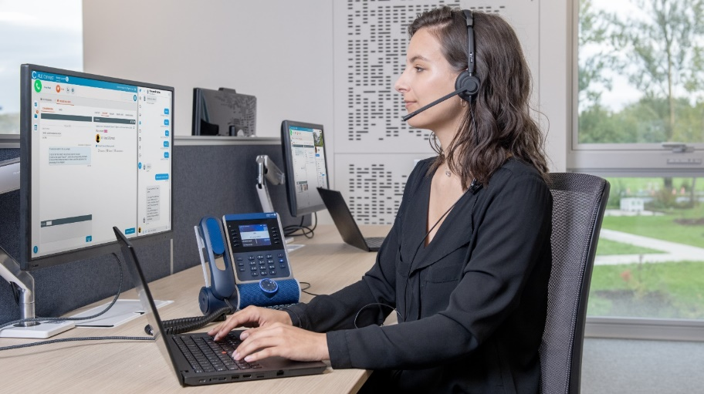
Ale connect
Omnichannel contact center to boost customer interactions
Opportunities:
Leverage the existing OXE CCD installed base
Address customer’s needs for business applications integration (CRM/ERP)
Modernize the voice contact center platform of the customer with new services and an omnichannel approach based on hybrid cloud
Generate recurrent revenues for your company
Web-based agent application
Multiple channels: voice, email, web chat, Twitter, Facebook Messenger
Improve first call/contact resolution
Integration with any business application (CRM/ERP based on Webhook)
WHAT’S NEW?
Improved agent UX: search contact, call by name
Web chat enhancement: pre-contact survey, Tag Management System (TMS) integration
Multiple CRM integration
Optimized distribution for email channel
Visit the product web page
>> Video demonstration
Notes:
Optimized distribution for email channel:
Each agent benefits from a custom folder list with the email to be treated
The global collaboration workspace is no longer accessible to the agents, replaced by the customized one
KEY VALUE: improved media blending as the application can send voice and email interactions to the agent + ensure the quality of service as voice interactions have priority over email interactions

Slide 13
OTEC offer roadmap
Q4 2022
Q4 2023
H1 2024
OTEC w. OXE R100.1
OTEC w. OXE R100.1
OTEC w. OXE R101
R next TBD
OTEC R100.1
OTEC R100.1MD6
OTEC R101
OTEC R next TBD

Slide 14




CONTACTUS
WEBSITE
www.al-enterprise.com
Follow us on:
The Alcatel-Lucent name and logo are trademarks of Nokia used under license by ALE.

