Slide 1
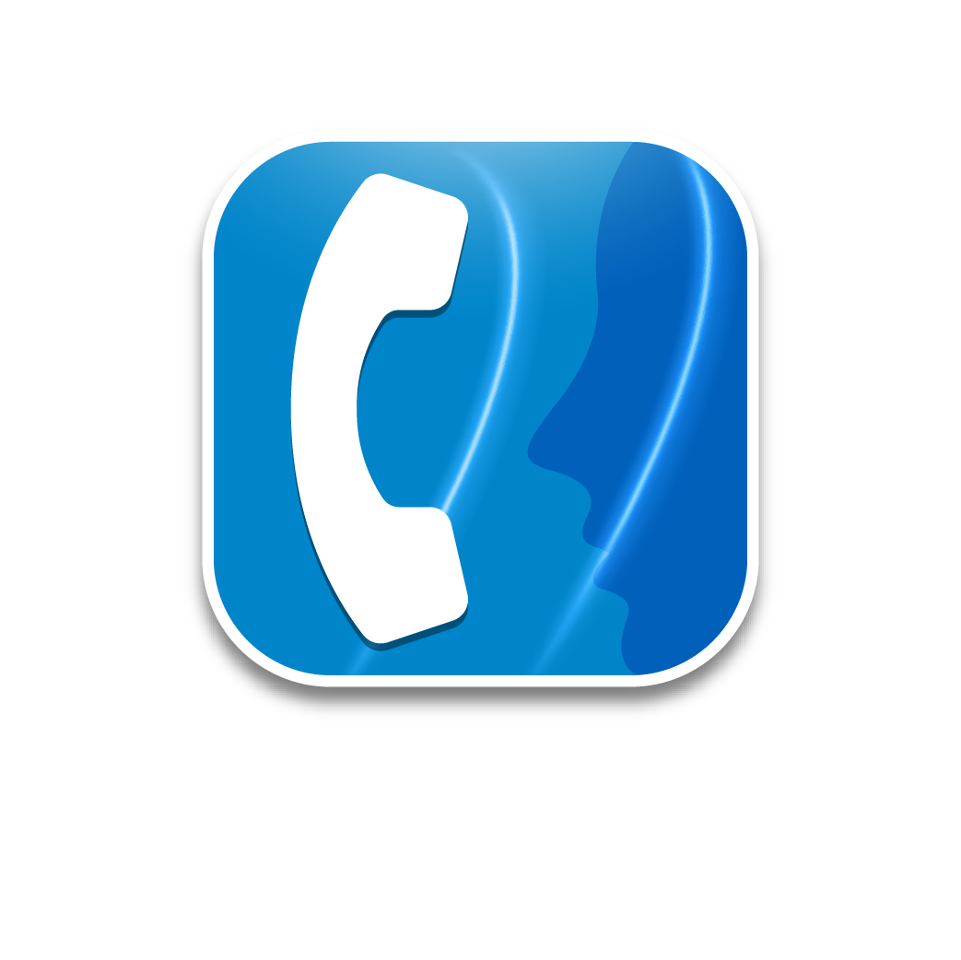
OmniPCX Enterprise purple
ALE softphone
customer presentation
november 2023

Slide 2
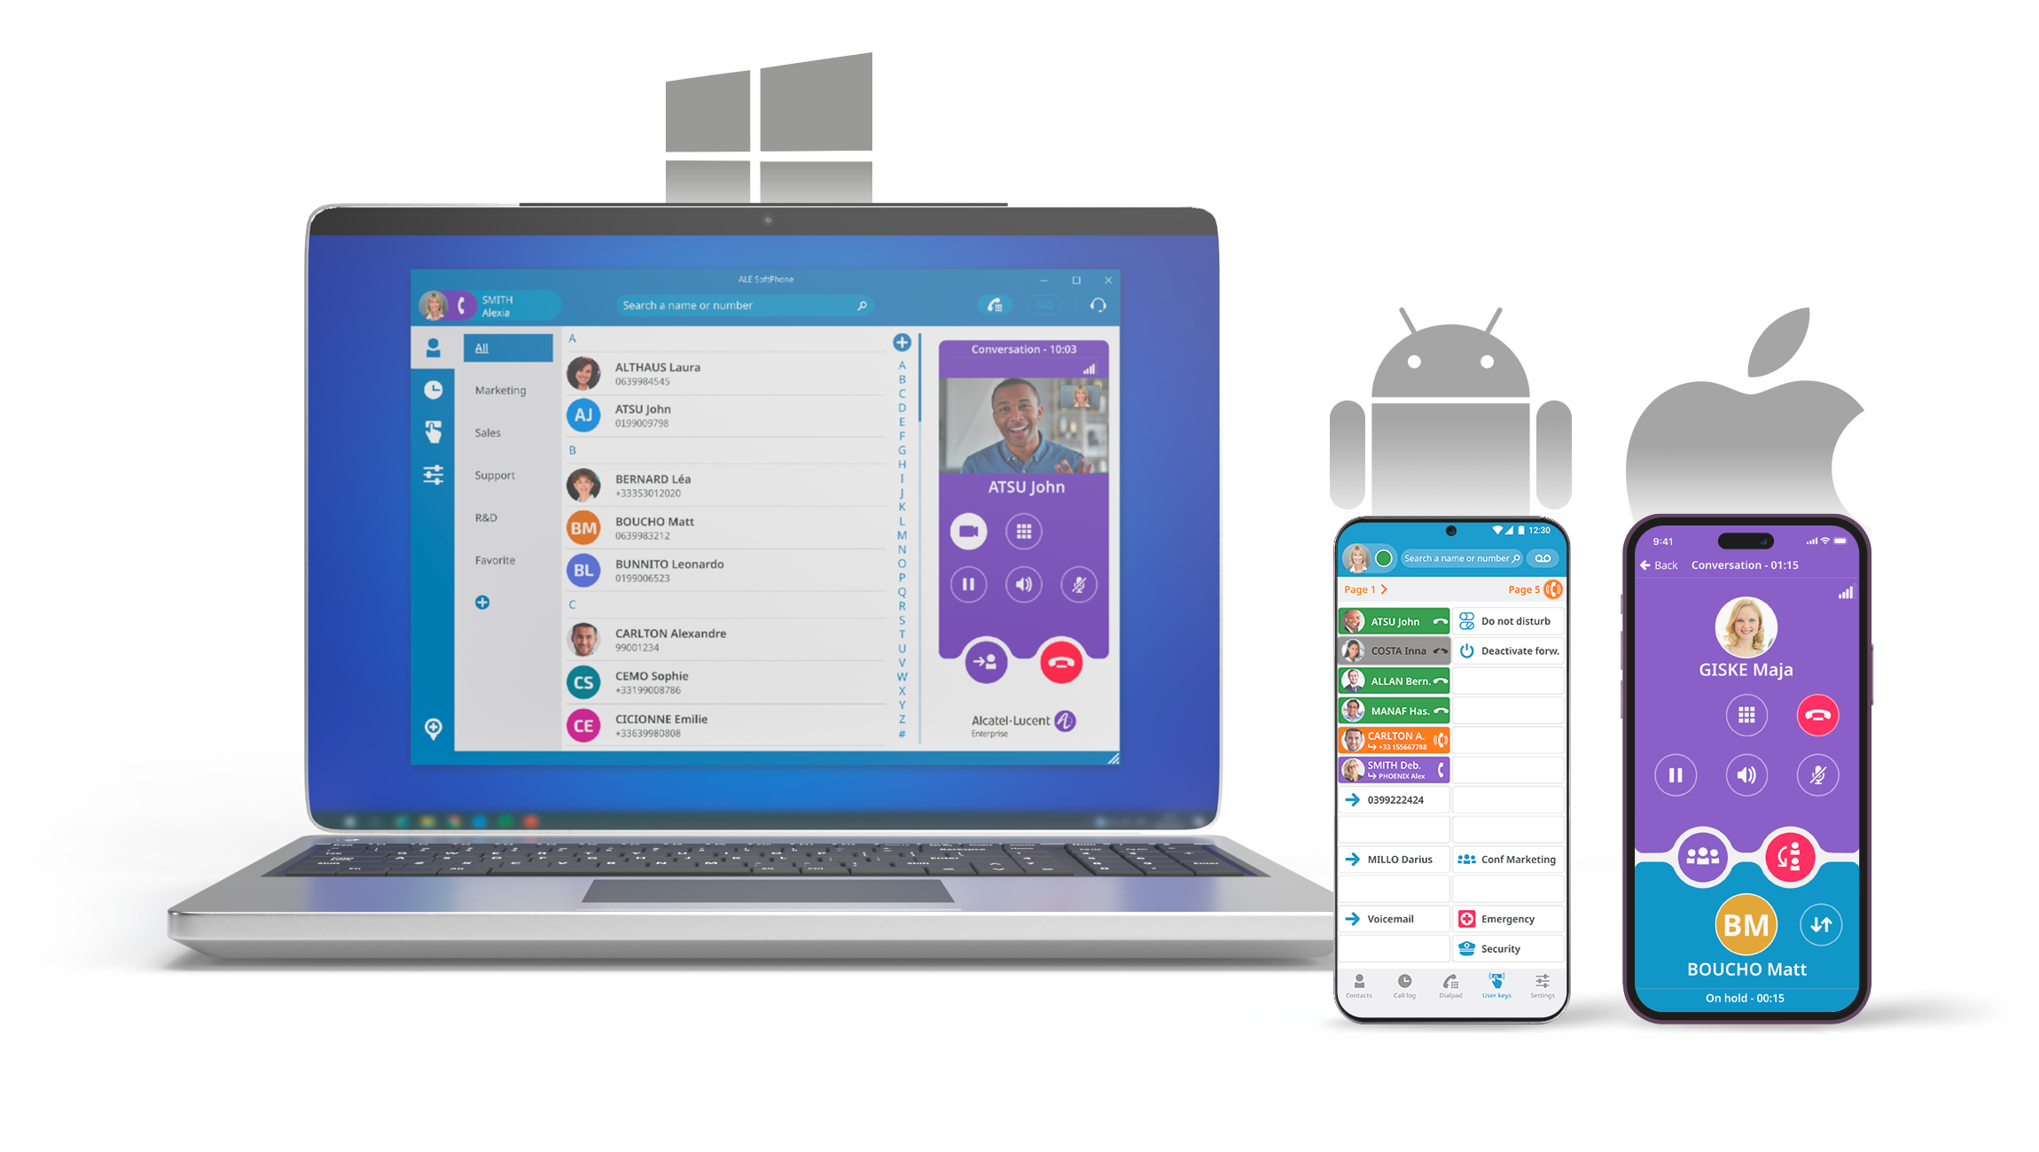

Enterprise-grade softphone to manage all your business communications, everywhere.
Alcatel-Lucent Enterprise SoftPhone (ALE SoftPhone) is a unique telephony application available on a laptop, touchscreen, desktop (Microsoft® Windows OS), iPhone and Android smartphone for high quality business conversations.
The ALE SoftPhone application provides advanced SIP telephony features and call management of the Alcatel-Lucent OmniPCX® Enterprise Purple.
ALE SoftPhone is easy to use, on-site or remotely, with an intuitive and user-friendly interface.

Slide 3

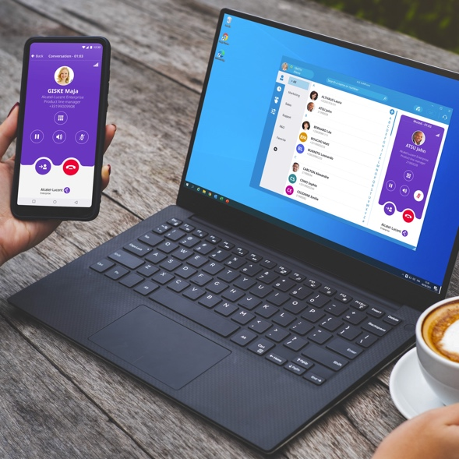



ALE Softphone designed for THE HYBRID WORKplace
  ALE SoftPhone is available from everywhere and designed for group collaboration
Optimise premises
Simplify home working
Group collaboration supervision

Slide 4


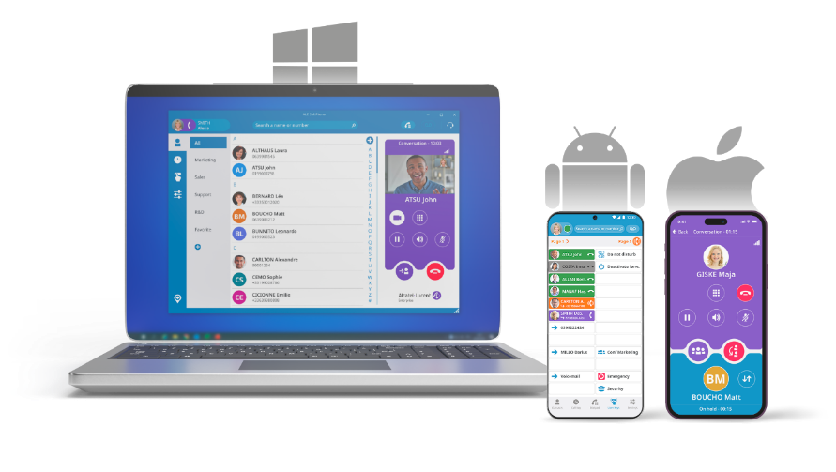
ALE Softphone overview
Secure user authentication
using LDAPS/Azure AD/Microsoft AD
Secure remote work
Using on-site OT SBC/RP – no VPN client on PC required
Support of SBC active/active redundancy
Value proposition
Easy user adoption with a modern user experience to benefit from business telephony and video calls everywhere
Application natively integrated with the existing phone system, with no external connectivity to a cloud-based service
Secure communications over the Internet without the need to deploy a VPN client on PC
Never miss a business call in mobility thanks to the app for iPhone and Android smartphone
SIP+ user experience
Modern user interface
Make call, take call, decline call, forward, second call, merge, on hold, DND, meet-me
Groupware (Hunting Groups)
Multi-line call management
Programmable keys
Supervision / Pickup
Hotkey to select-and-call
Video call (peer-to-peer)
Custom actions on call events
Reliable and agile communications
All OmniPCX redundancy options, Centralized management with OXE
Multiple devices
Windows PC (Desktop, laptop and touchscreen)
iPhone app
Android smartphone app (with MDM)
ALE DeskPhones Enterprise range
Microsoft integration
.msi deployment
Installation and upgrade tools (SCCM and MDT)
MS 365 and Outlook contact synchronization
MS Teams integration
Notes:
ALE SoftPhone is a unique telephony application available on a laptop, touchscreen, or desktop (with Microsoft Windows OS), providing audio and video support for business conversations.
It features:
Secure user authentication with integration into the corporate active directory infrastructure
Secure remote work, with no need of a VPN client on the PC thanks to the centralized SBC
A modern and intuitive user interface
SIP at-the-core, to benefits from all the telephony features of OXE Purple for call management, multi-line, supervision, call pickup and video call
Reliability with support of system redundancy mechanisms and easy centralized deployment
Integration with Microsoft ecosystem, including Teams PowerApp and Microsoft Outlook add-in and Office 365 contacts and groups synchronization
ALE SoftPhone is available for Windows PC client, iPhone and smartphone Android.
ALE SoftPhone for smartphone Android supports deployment through Mobile Device Management (MDM) and AppConfig standard (https://www.appconfig.org/), to ease IT administration on deployment and increase security.
The new UX is also brought to the ALE DeskPhones Enterprise models (ALE-300, ALE-400, ALE-500) configured in SIP mode.

Slide 5
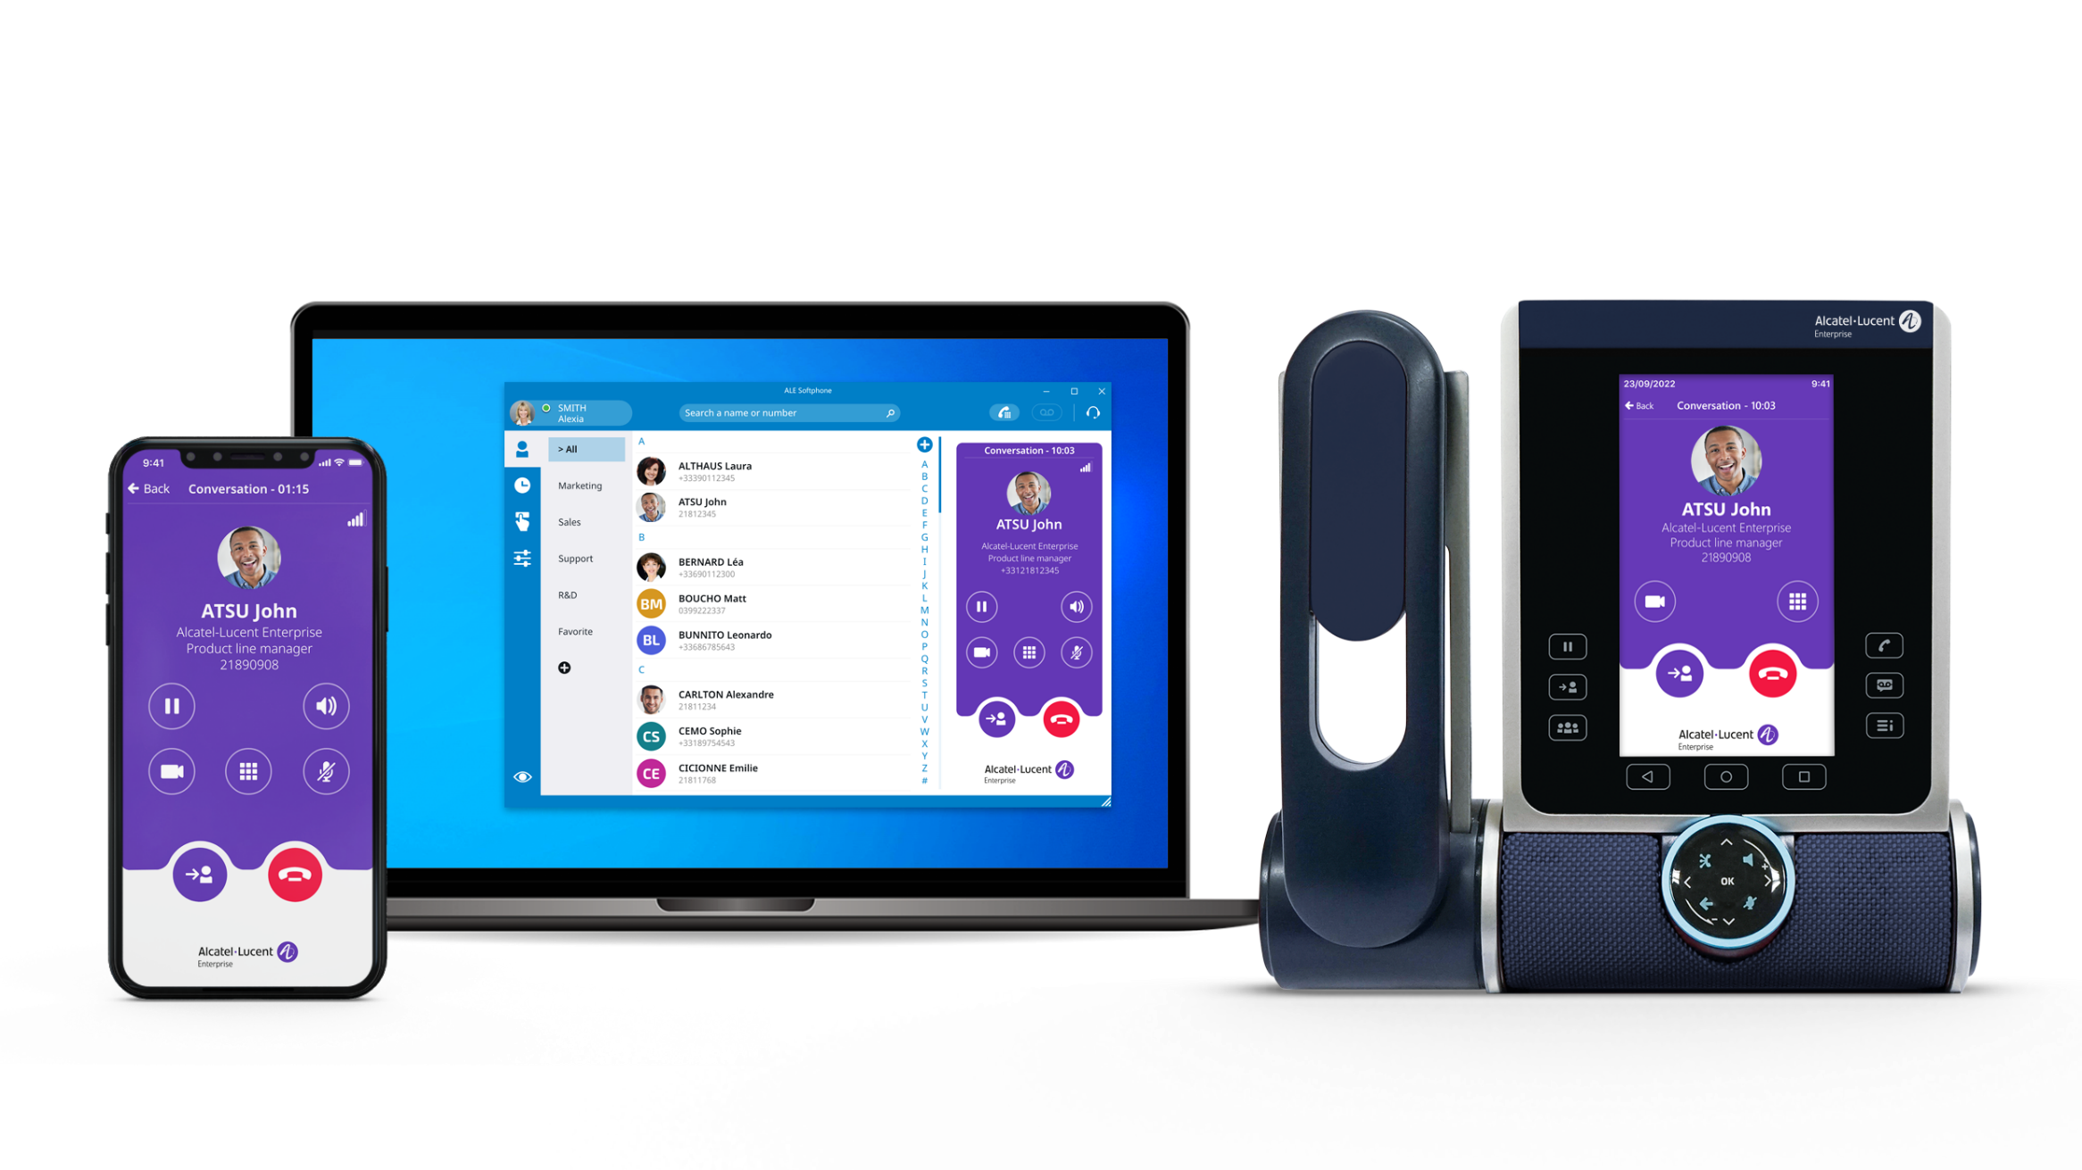

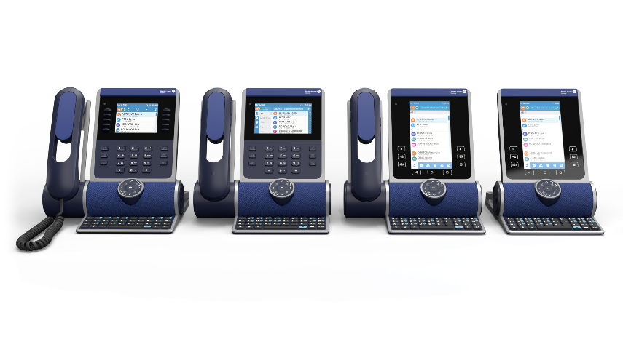
Multi-devices
A unique phone number to reach someone on the desk phone, PC softphone and mobile.
Routing features are user centric, and phone status synchronized between devices.
Calls presented on all devices of the user
Status and routing rules applied to all
Switch on going call from one device to another

Slide 6
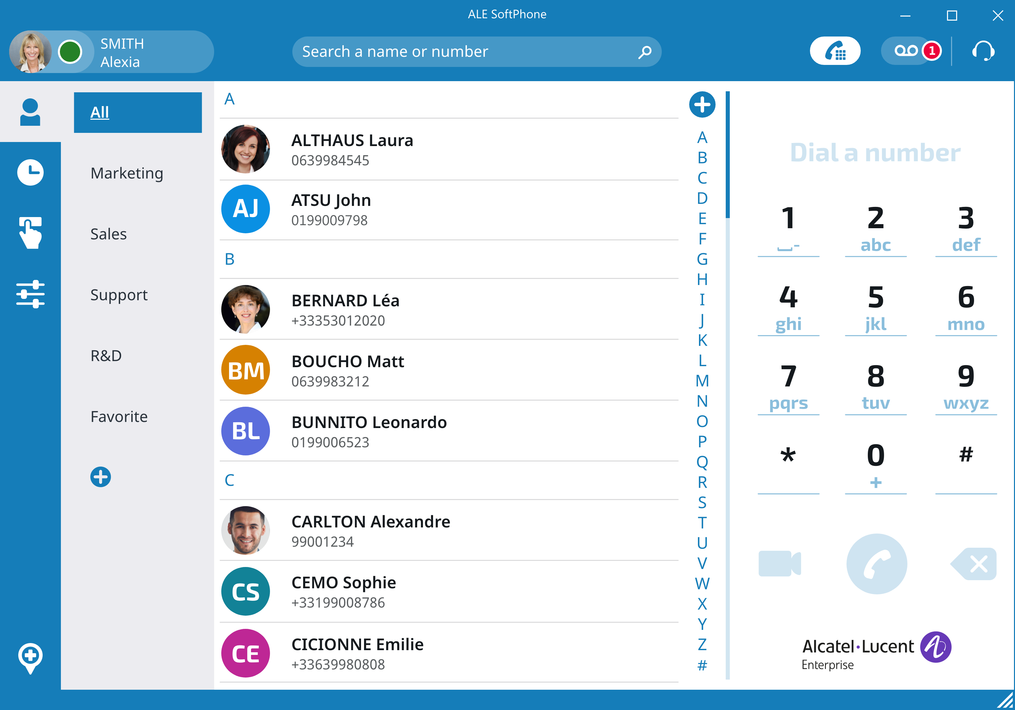

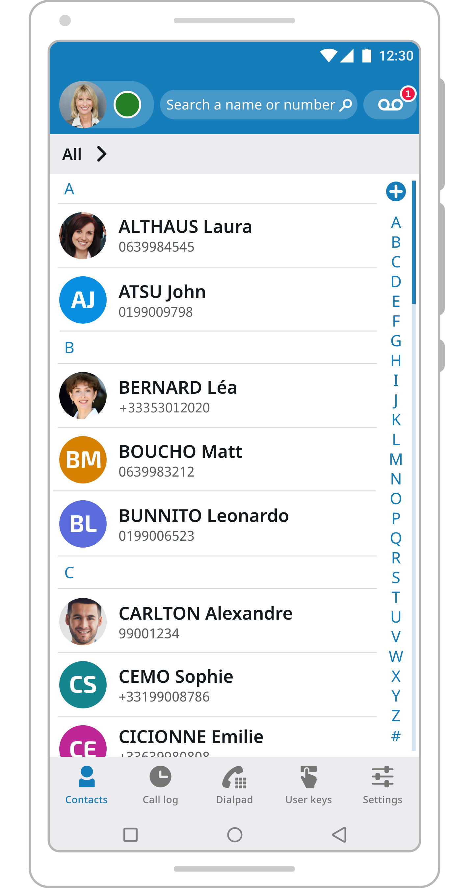
ALE Softphone user interface
Dialpad
User status
DND/Forward
Global search (corporate and local contacts)
Voice mail
Audio device status/configuration
Contacts/Groups
Call history
Programmable keys
Settings
Geolocation
PC Windows
Smartphone app

Slide 7
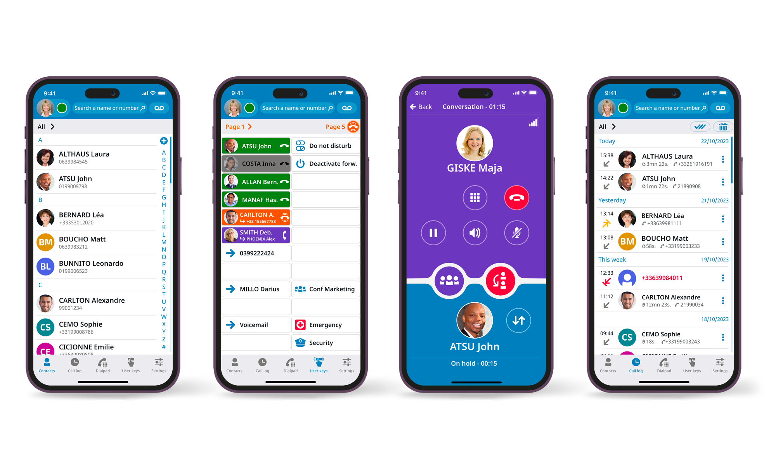

Smartphone app views
Contacts
User keys
In conversation
Call log

Slide 8
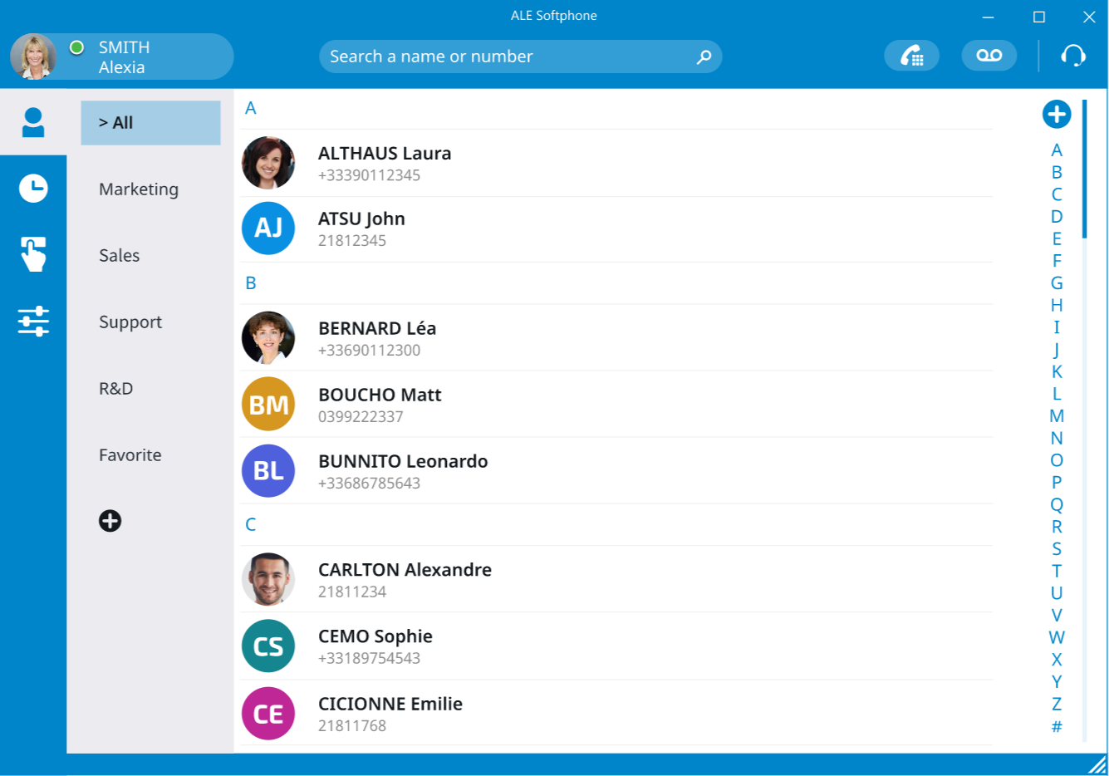
Contacts and groups
Manage your contacts
Merged view with local and corporate
Local copy to add personal information
Optionally synchronized with Microsoft O365 Contacts and Groups
Contacts list
Alphabetic sort
Add a new contact
Groups list
Add a new group

Slide 9
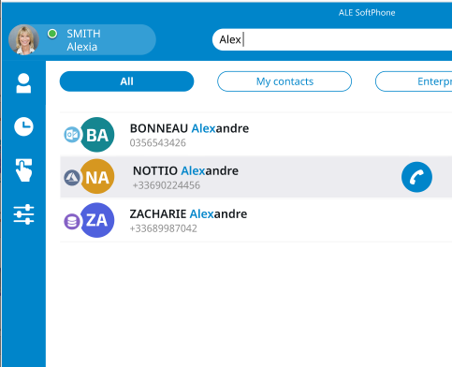



directory search Multi-source
Search is performed from the first character. Add more character to reduce the result list.
Merge multiple sources of contact
Search in corporate directories and local/personal
Microsoft Azure AD
Active Directory
Office 365
LDAP
Source of contact
Start call
Microsoft Outlook
No
icon
Personal

Slide 10
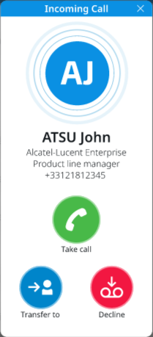
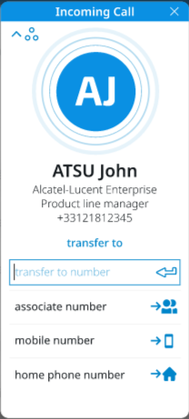

Incoming call on PC
Close the incoming call window.
The PC no longer rings, but all other devices, such as a desk phone in case of multi-devices, continue to ring.
Back
Divert call to the destination number entered,
or to predefined numbers
Answer the incoming call
Decline the incoming call and
forward it to your voicemail box
(when available)

Slide 11
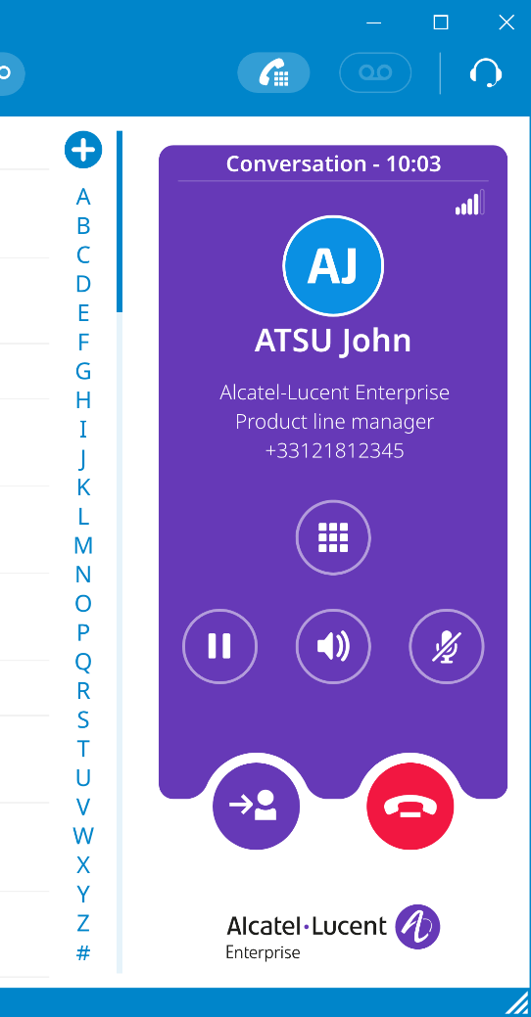


Conversation
VoIP network quality indicator
Information about your contact, such as number, name, company, and job title
Add video
When necessary, during the conversation open the numeric keypad for numeric processing
Put the call on hold/retrieve the call
Activate/deactivate the loudspeaker
Mute/unmute the audio
Transfer the call to another person
End the active call/conference with all participants

Slide 12
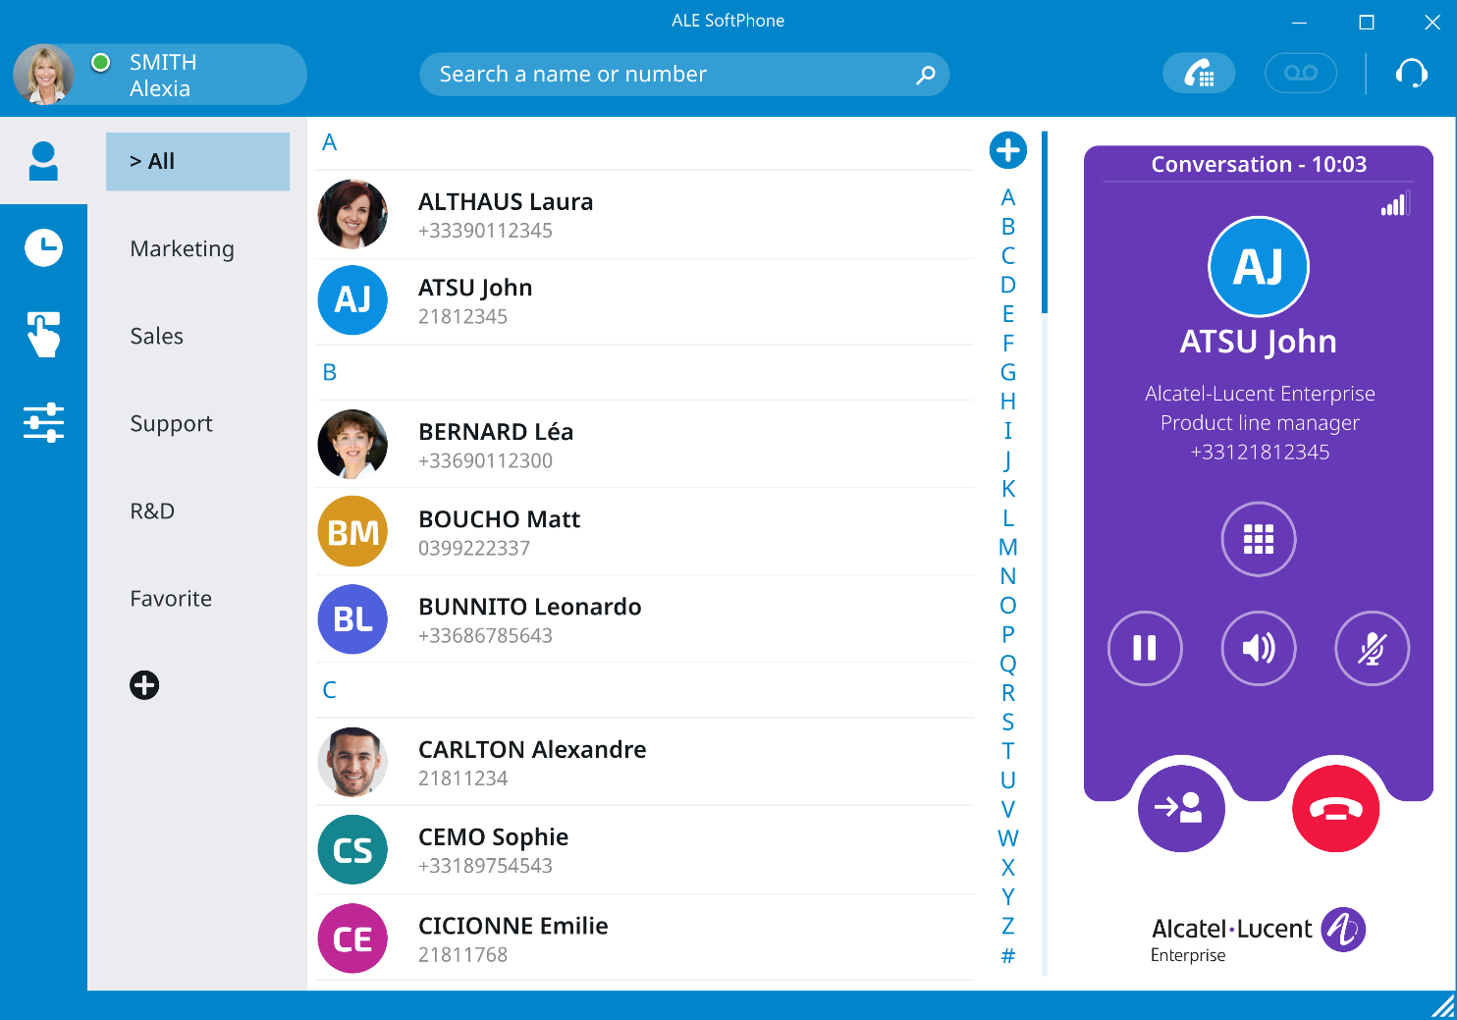
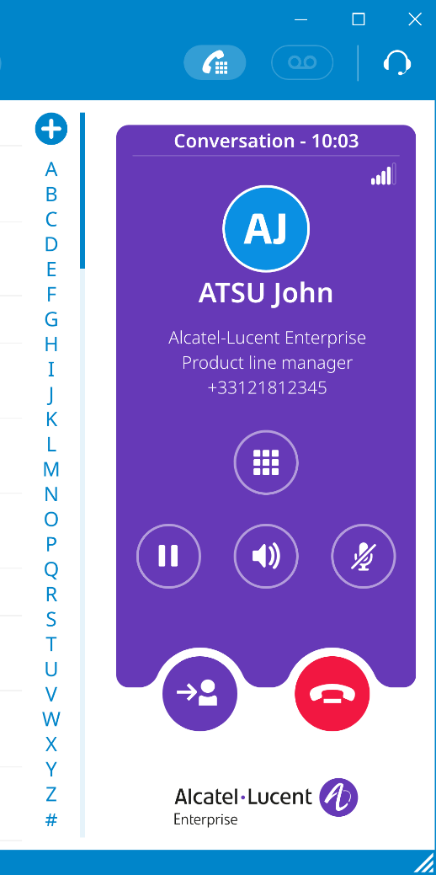

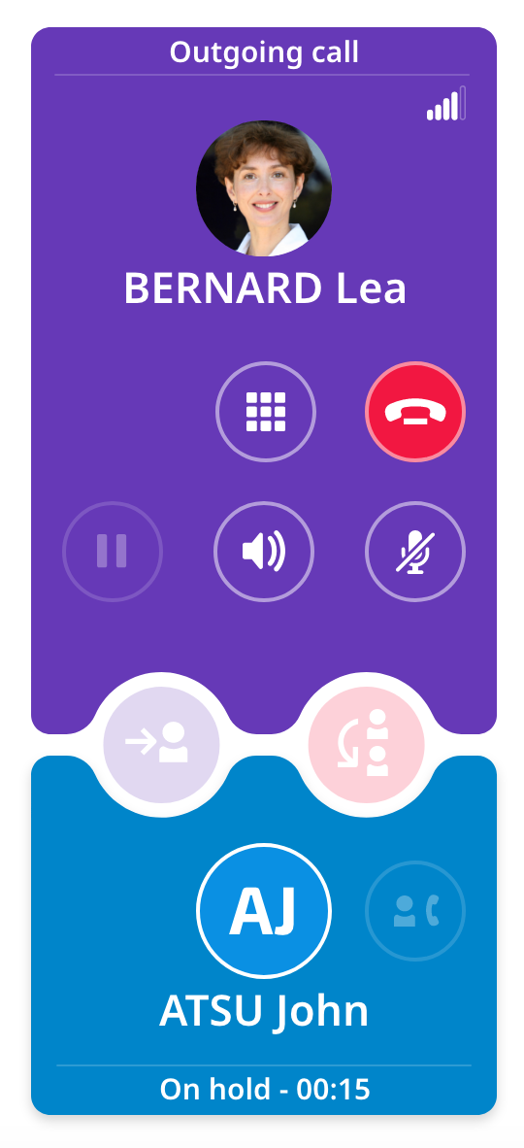
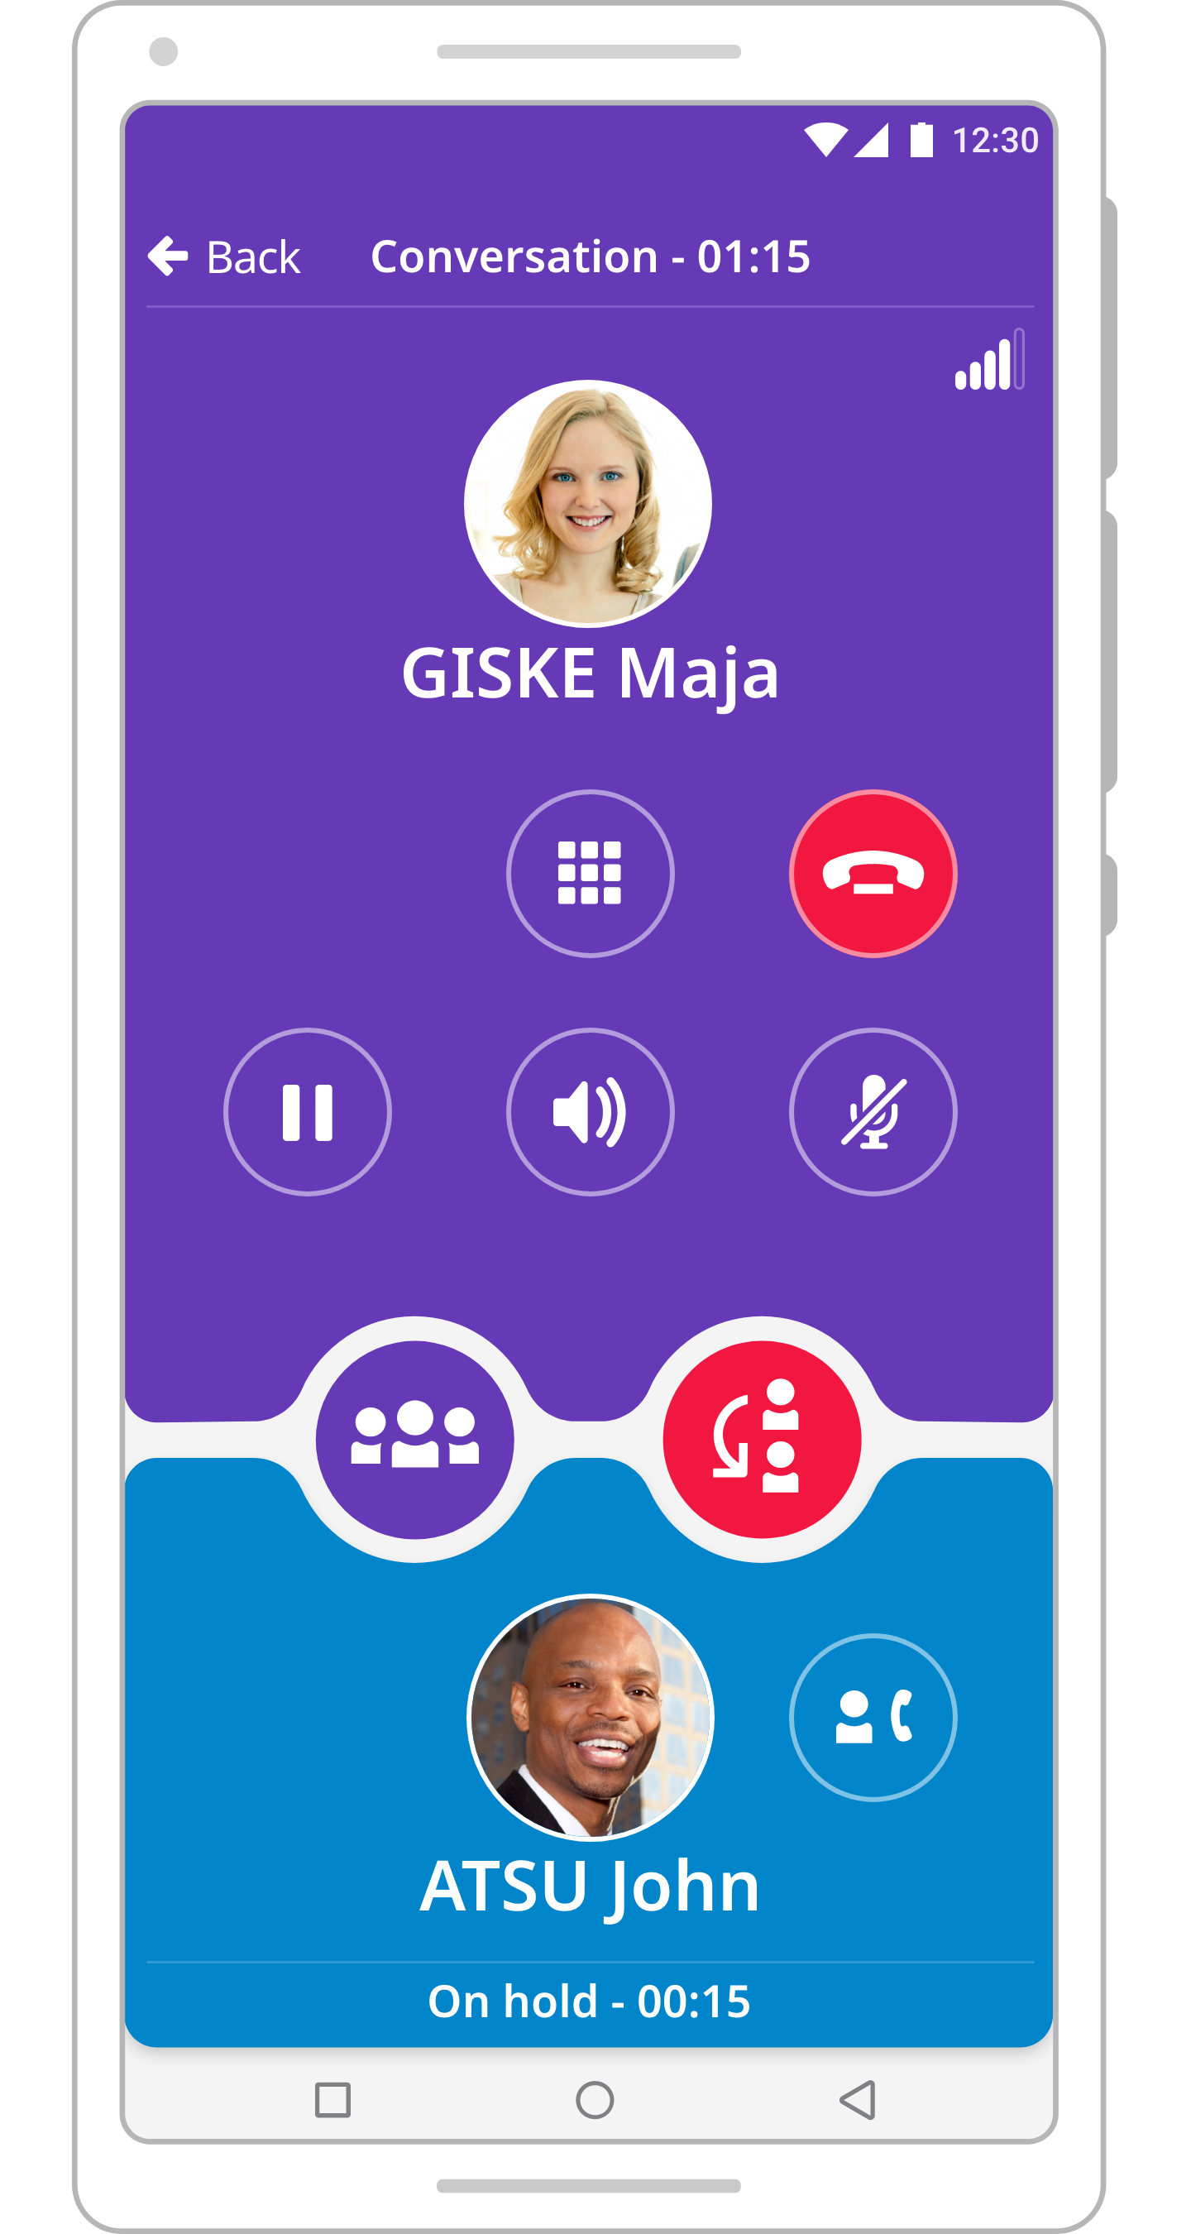

Make a second call
During an active call, you can make a second call using any of the options provided: dial a number, from contacts, call logs, or search by name.
Example of conversation on PC
Example of conversation on Android

Slide 13
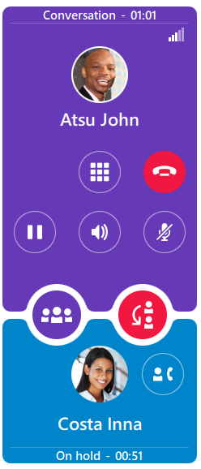
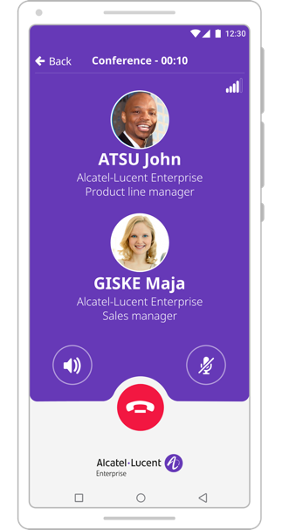
Manage Three-party conversation
When you have two simultaneous conversations you can perform different actions:
Switch between participants. One is active the other one is on hold. Both can be on hold when needed
Transfer the active call to the other participant. You are no longer in the conversation
Merge the calls in a three-party conference
Example on Android
Activate a three-party conference
Contact in conversation with me (purple colour)
Transfer the call to the other participant
Contact on hold (blue colour)
Switch between the participants and make the contact (in blue colour) active. The other participant will be put on hold.

Slide 14
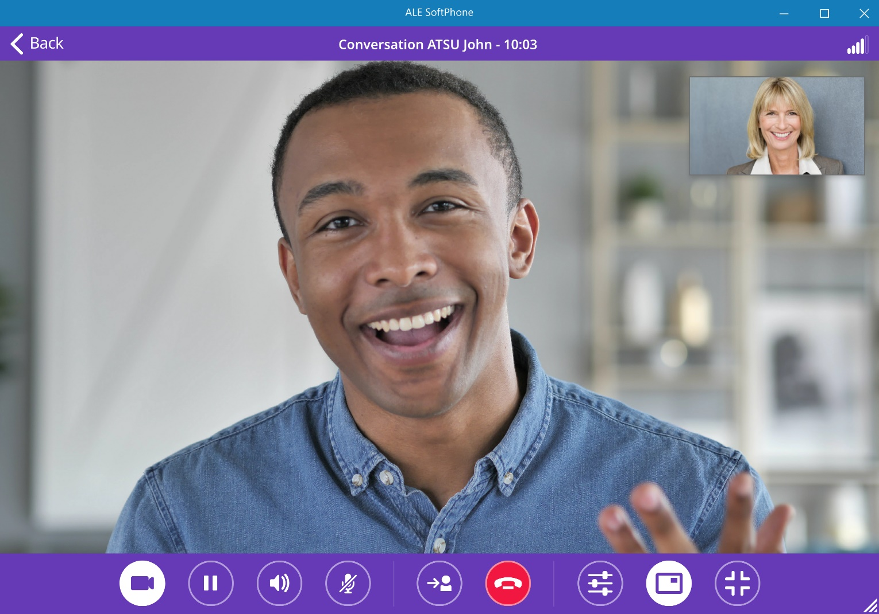
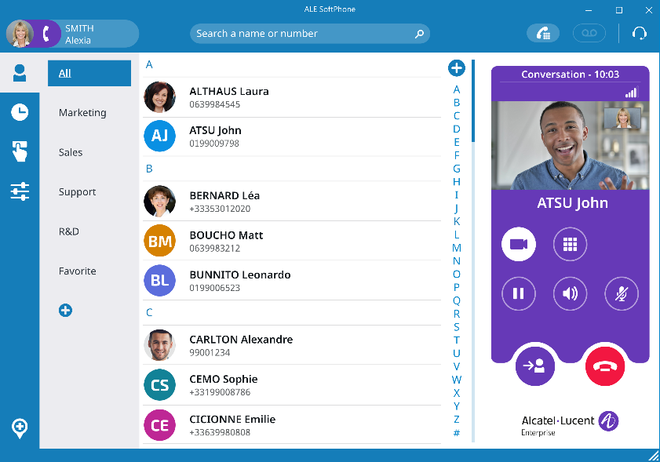
Video call
Add video to an ongoing audio call
See your contact for a better interaction
Start a direct video call to a contact
After a first successful video escalation attempt
High quality video
Support of H.264/AVC
Plug & play video
Detection and auto-configuration of USB video device
Minimized view
Non-invasive conversation

Slide 15
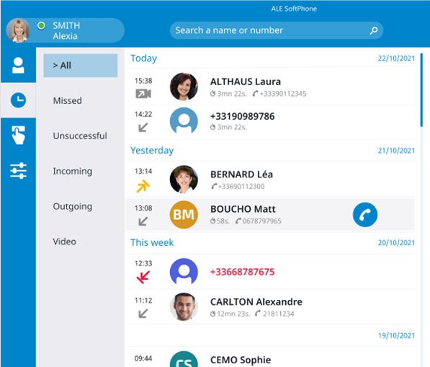
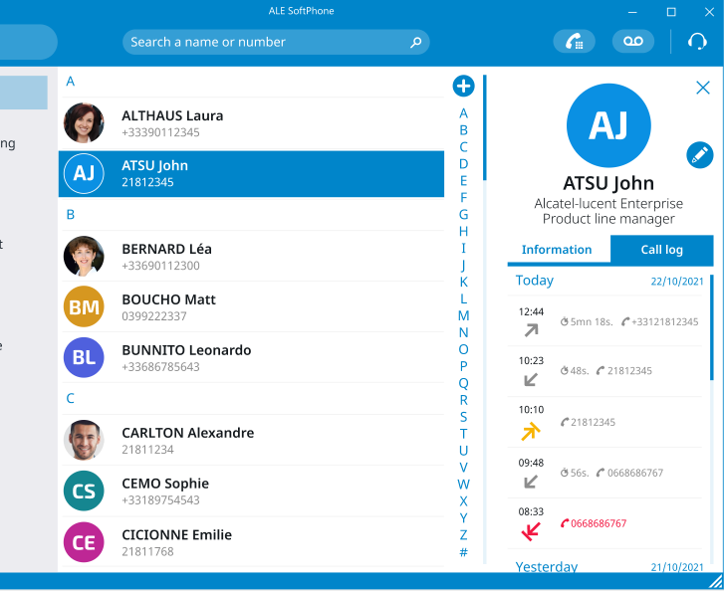
Call history
History of previous calls
Filtered by missed, unsuccessful, incoming, outgoing, conference and video calls
Call log for a contact
See all previous interactions with details from the contact card

Slide 16
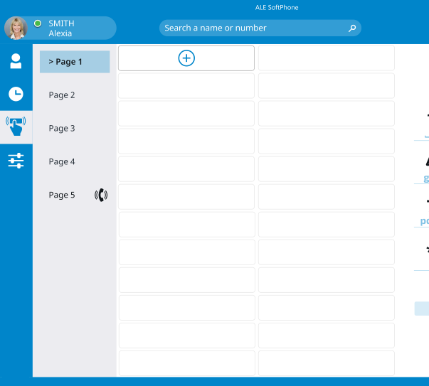
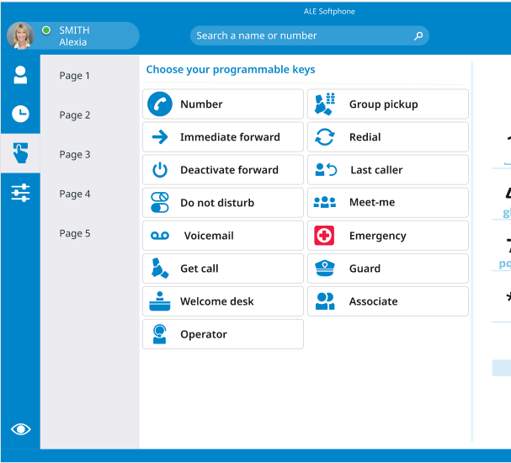
Programmable keys
2
1
3
Quick access to personalized keys
Prefix keys, Shortcuts, Supervision keys
Managed by the user or the administrator
Identified pre-defined icons
Number, forward, voicemail, pickup group, meet-me, emergency etc.

Slide 17
Programmable keys example
Multiple visible columns in a page
Possibility to view up to 4 columns at the same time
Several pages for more keys
Up to 5 pages accessible to organize the programmable keys by type, people group/team etc.

Slide 18
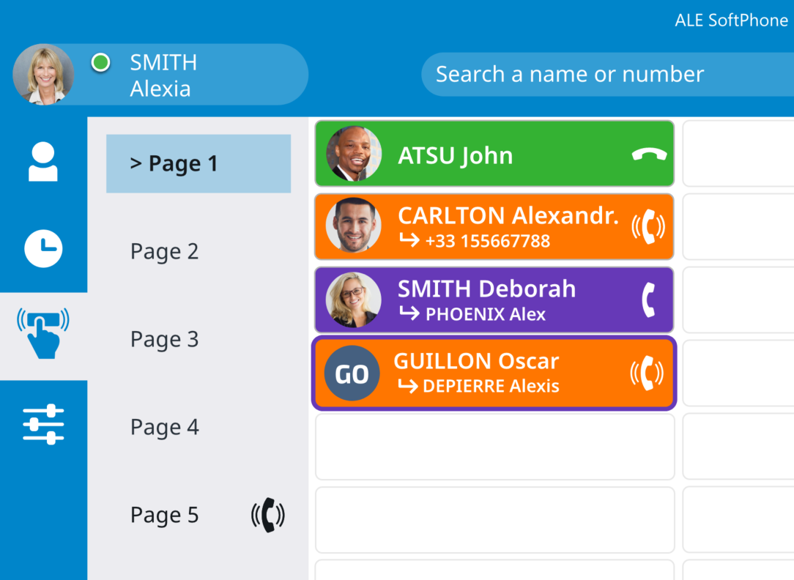

Supervision and call pick-up
Supervision of other business phone numbers
See the telephony status (Free, Ringing, In conversation, Receiving a second call, Out of service)
Free/Idle
Ringing
In conversation
In conversation
+ a second incoming call is presented
Pick-up an incoming call
Supervised contact when the phone is ringing
Out of service
Ringing in another page

Slide 19
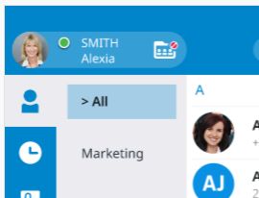
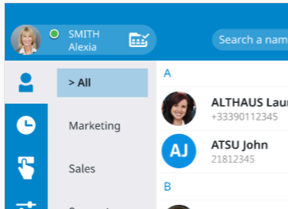
Hunting group
  A dedicated icon is displayed on the user personal information when the device is member of a parallel hunting group.
Flip flop to change the state
The user is logged off and cannot receive group calls or see current calls in call log
The user is logged in, can receive group call
and see current calls in call log

Slide 20
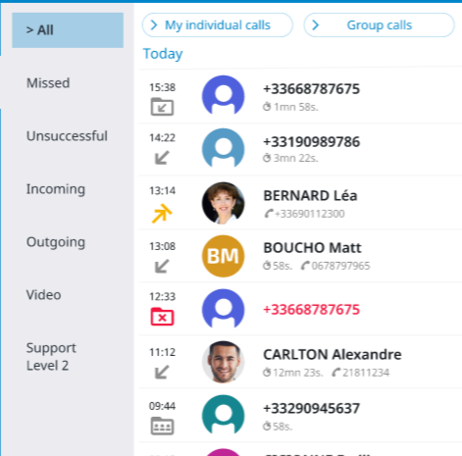
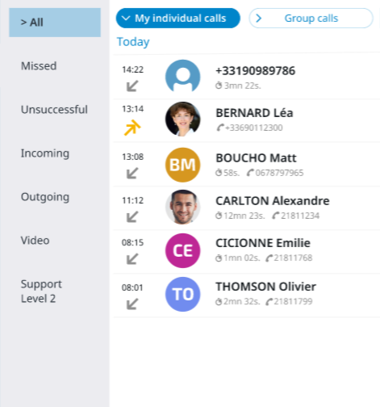
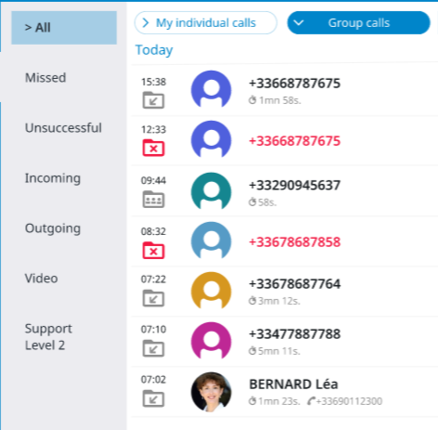
Hunting group: Group call LOG filtering
All calls (individual and group)
Display only my individual calls
Display only my group calls

Slide 21
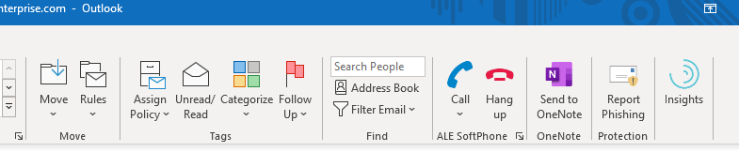
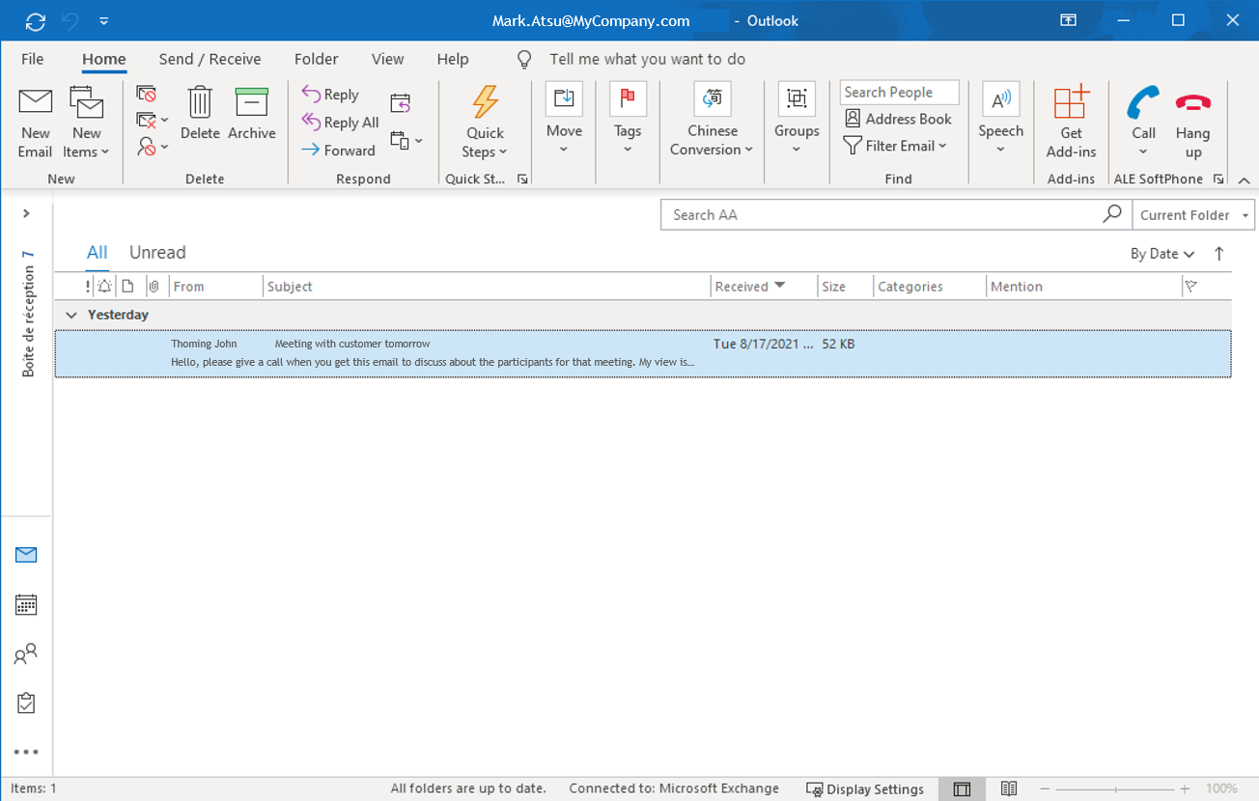
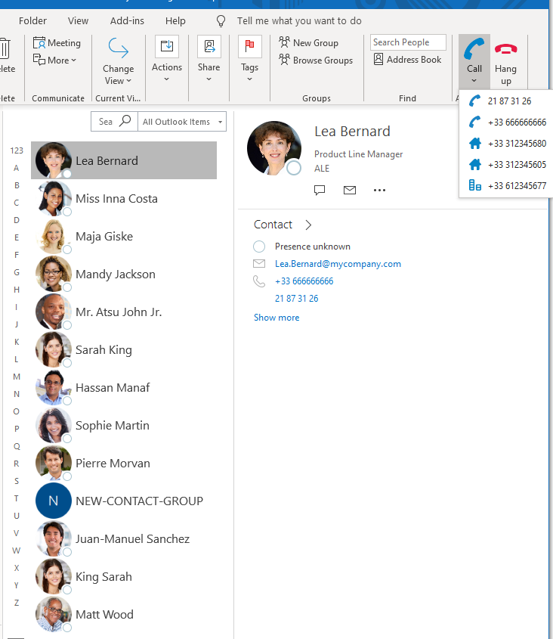
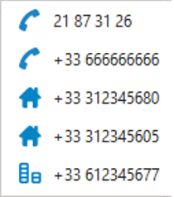
Microsoft outlook add-in
Click-to-call from an email
Select an email in mailbox and click-to-call the recipient
Click-to-call a contact
Select a contact and the number to be called

Slide 22
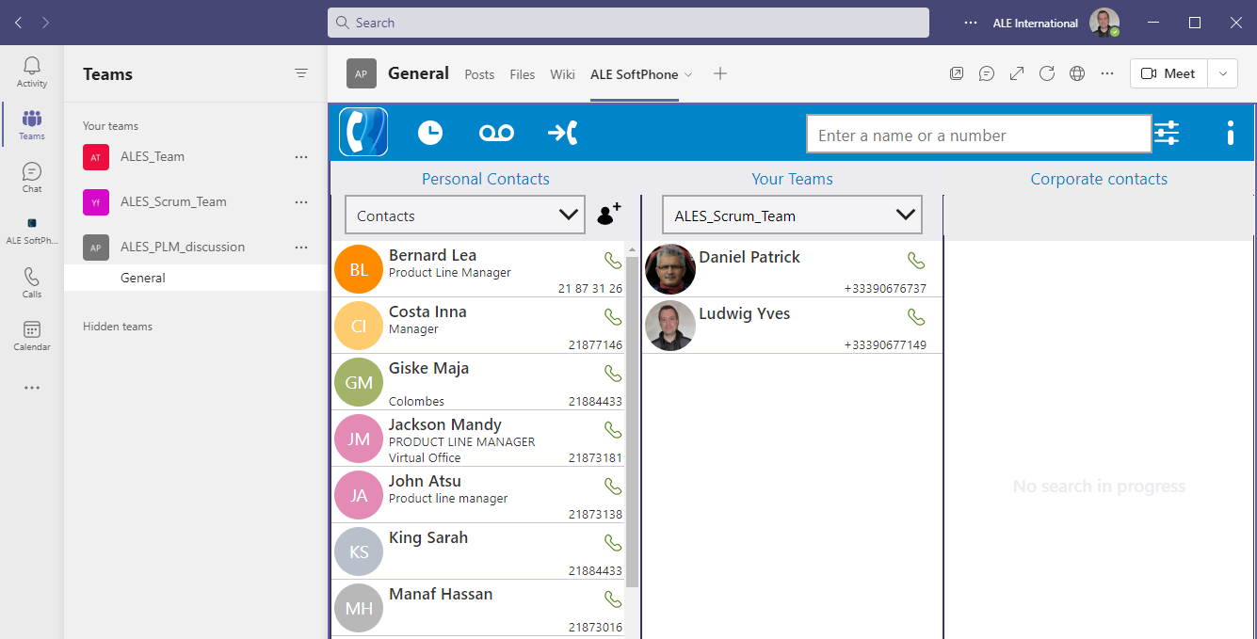
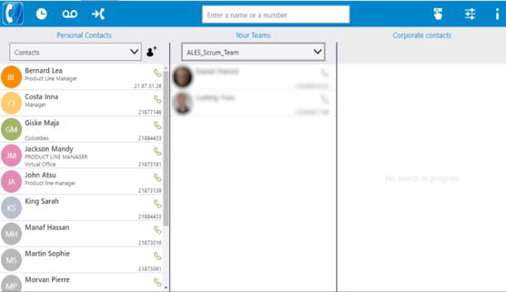
Microsoft teams integration
Bring telephony into MS Teams for all users
Directory search (local Outlook contacts, O365, Azure AD), incoming call notification (toaster pop-up), make/take call, history of previous calls, routing (forward, voicemail etc.), programmable keys
ALE SoftPhone PowerApp
Available for MS Teams desktop and Web version
My Personal contacts (O365 MS Outlook)
My Teams contacts
Corporate contacts (Azure AD)

Slide 23
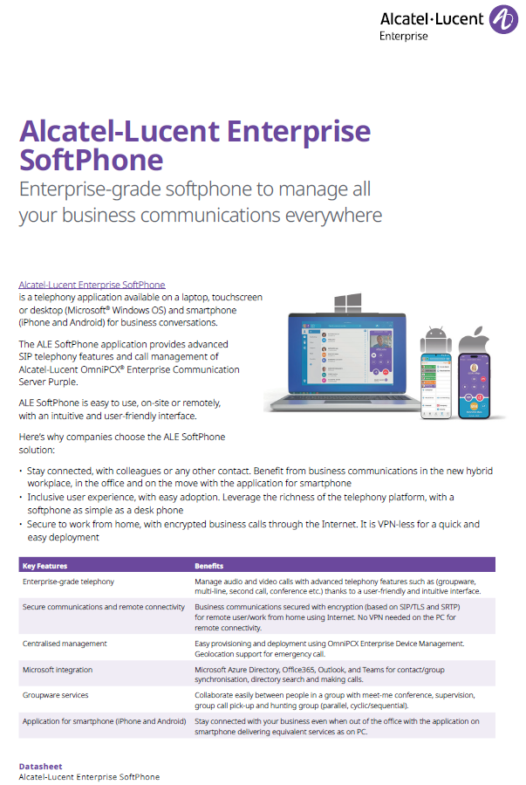
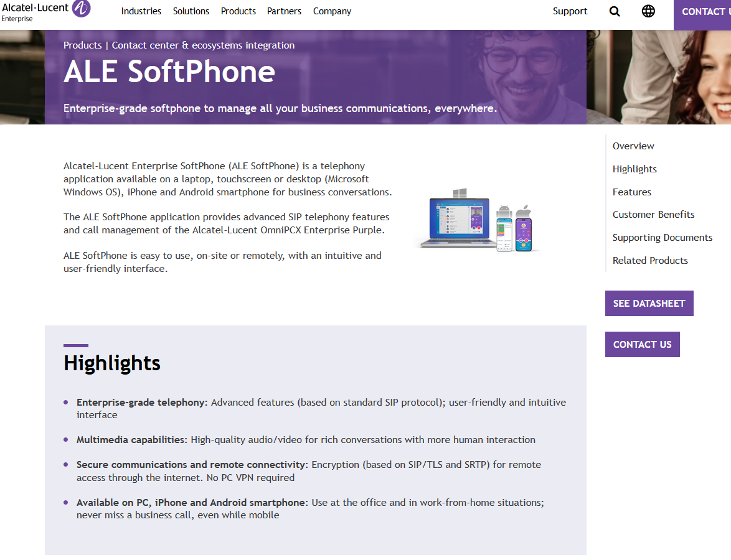
More information
The product datasheet and additional information related to the ALE SoftPhone application are available on the internet:
https://www.al-enterprise.com/en/products/applications/ale-softphone

Slide 24




CONTACTUS
WEBSITE
www.al-enterprise.com
Follow us on:
The Alcatel-Lucent name and logo are trademarks of Nokia used under license by ALE.

Slide 25
Backup slides
For preparation of a workshop with a prospect/customer

Slide 26


What softphone with omnipcx enterprise purple?
Collaboration & mobility
VDI, OmniPCX experience
SIP compliance & mobility
Rainbow Hybrid Cloud | IP Desktop Softphone | ALE SoftPhone
Softphone, collaboration, integrations or softphone-mode only | Access to all ALE communication services (NOE) including agent/supervisor | Access to basic communication services SIP+ evolutions including video call
Web client, PC, MAC, Android, iOS, VDI, MS-Teams integration | PC, MAC, Android, VDI | PC, Android, iOS, MS-Teams integration
SIP and WebRTC | NOE | SIP+
WebRTC firewall traversal | VPN (PC and on-site server) | SIP/TLS and SRTP (SBC+RP on-site)
Hybrid Cloud + Rainbow WebRTC Gateway | Native | Native
REX license + subscription per user per month | IP + IPDSP licenses PoD subscription | SIP + ALE SoftPhone licenses PoD subscription
Experience
Clients
Signaling
Remote user
security
Platform
Licenses
Notes:
ALE proposes a complete range of applications in its portfolio to address the need to manage business calls in mobility and on any device.
The three main applications available today are:
Rainbow based on a hybrid cloud architecture, by connecting the OXE Purple to the cloud services managed by ALE. Rainbow can be used in softphone-mode only, for business telephony calls, or as a complete collaboration, messaging and conferencing app. It is available on any device, and it features a Microsoft Teams PowerApp for integration
IP Desktop Softphone (IPDSP) is an application that gives access to all the communication services available on OmniPCX Enterprise, based on proprietary NOE protocol, including advance services such as contact center agent. IPDSP application connects natively to the OXE, just like an ALE deskphone, and is available for PC, MAC and Android.
ALE SoftPhone is the new streamlined communication experience for business telephony, supporting integration into Microsoft Teams. It connects natively to OXE Purple, using SIP protocol for compliance to standards and secure communications with encryption.

