Slide 1
Dispatch console
customer presentation
October 2023

Slide 2

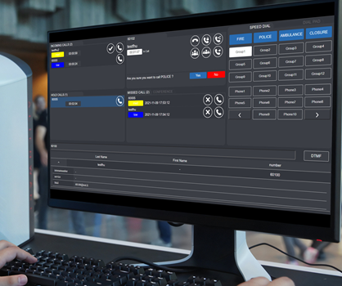
Intelligent call processing for control centers
Dispatch Console by Alcatel-Lucent Enterprise is the ideal solution for call processing dispatcher in high pressure control centers (railway, airport, energy supplier, public emergency etc.) and in high call traffic administrations for standard welcome services.

Slide 3
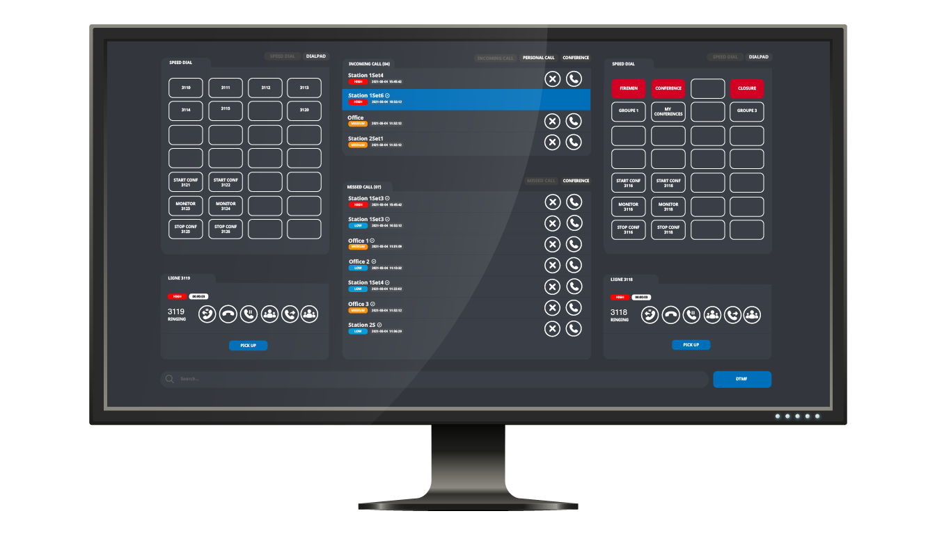
highlights
Web interface accessible from the desktop PC, touchscreen workstation
Visual and intuitive interface for operators to route calls, manage queues, and set up a conference
Operator can manage high volume of calls: presentation and dispatch with priority rules
APIs for integration within a 3rd party control center application (such as SCADA supervision platform)

Slide 4
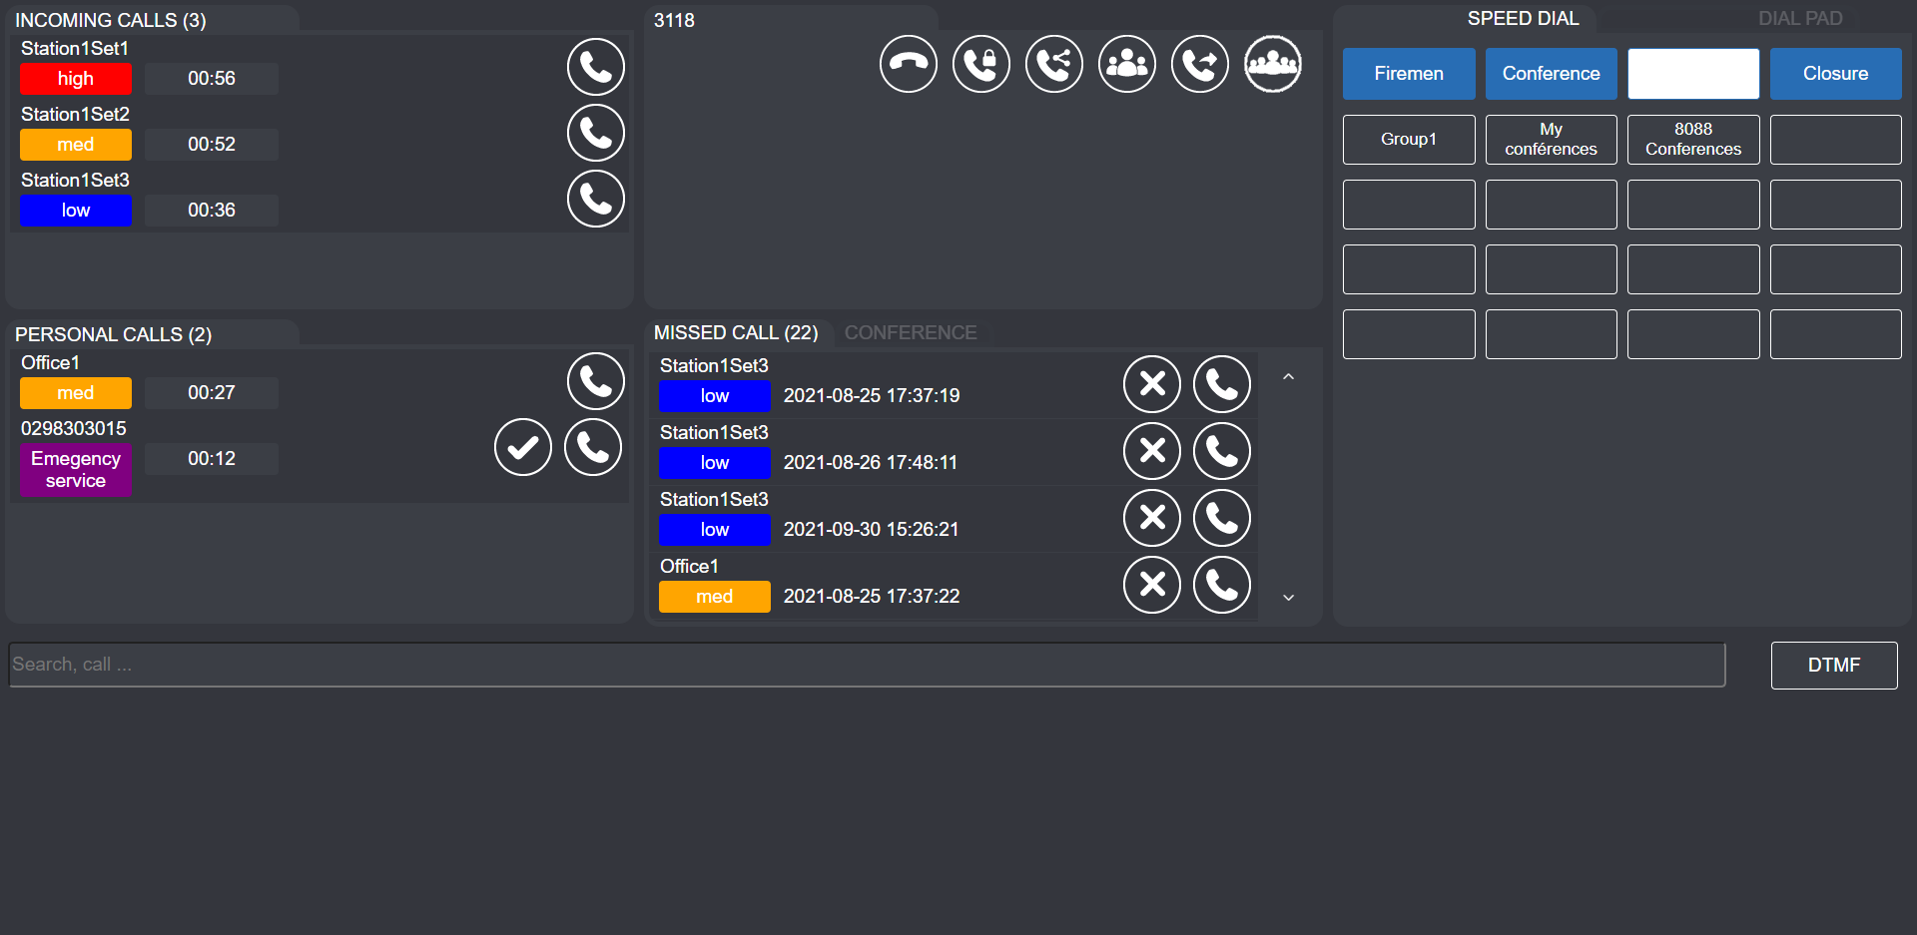
usages
Prioritized incoming calls: with a different colors depending on the caller number

Slide 5


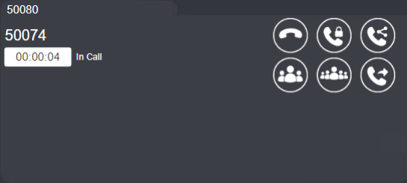




usages
CALLER IDENTITY
ACTION BUTTONS
Release the call
Transfer the call in the user private queue
Transfer the call in the shared queue
Transfer the call on a number
3-party OmniPCX Enterprise conference
Multi-party conference
Manage a call: different action buttons defined by the administrator

Slide 6
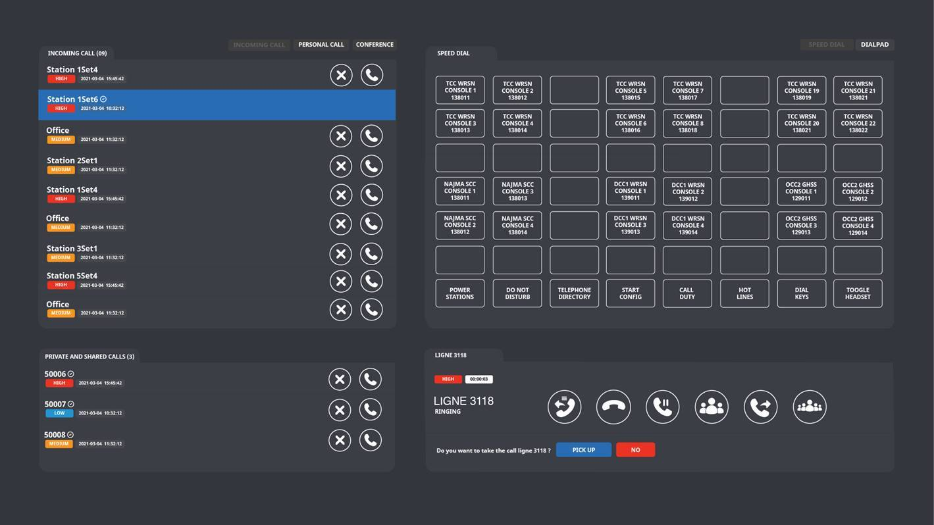
usages
Speed dial: to local/external numbers or web service access

Slide 7
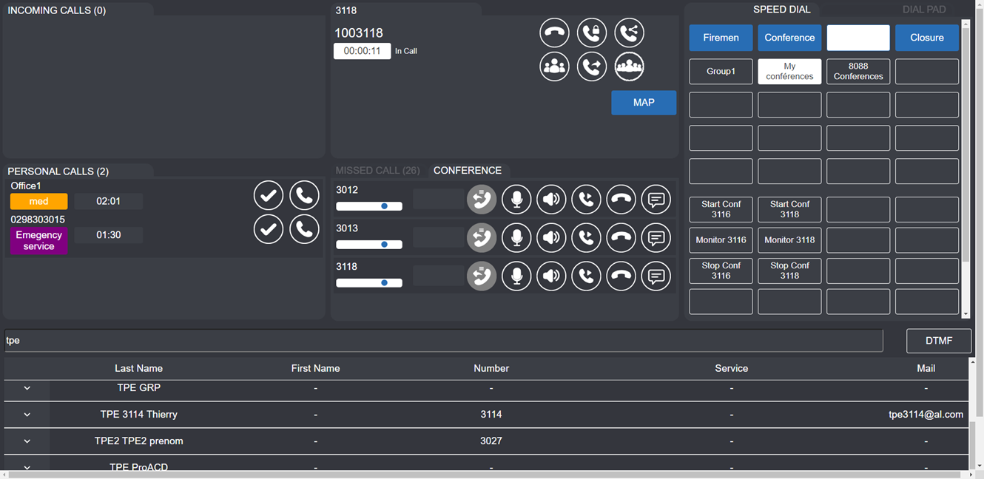
usages
Multiparty conference: manage participants, listen/speak mode, individual on-hold/transfer

Slide 8

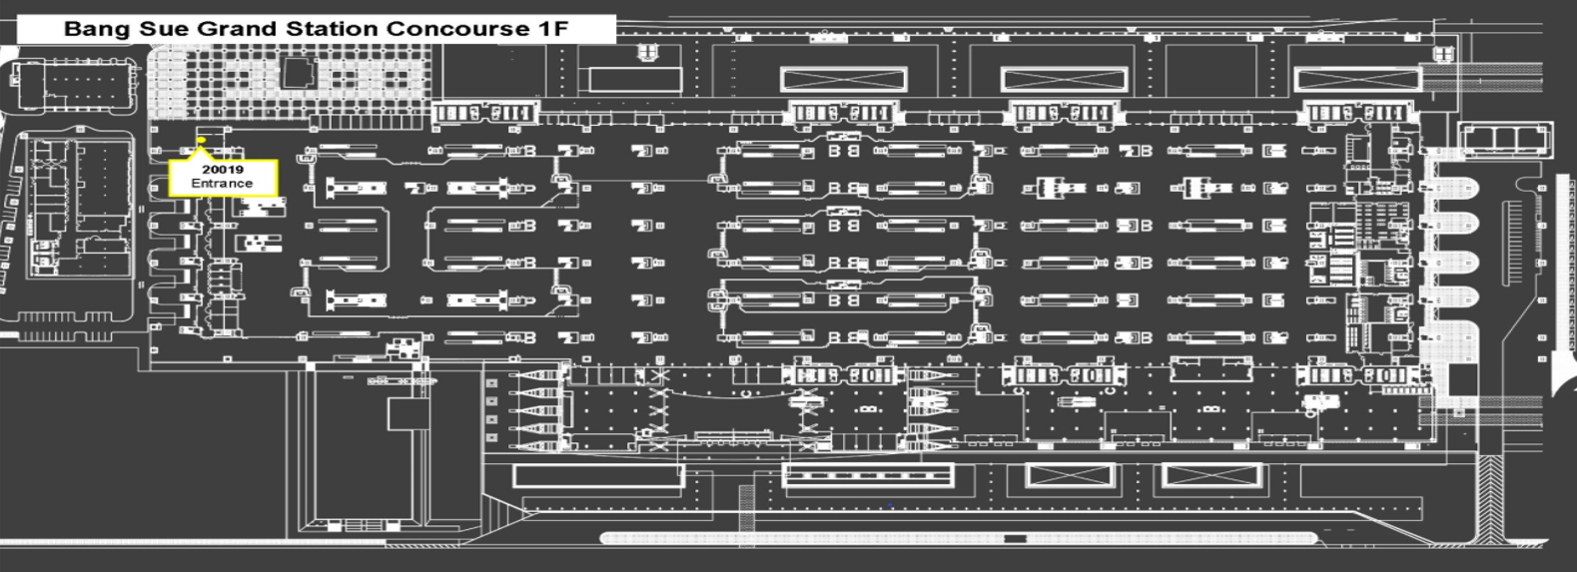
usages
Personalize the dashboard: add on-demand function such as map information or video popup

Slide 9
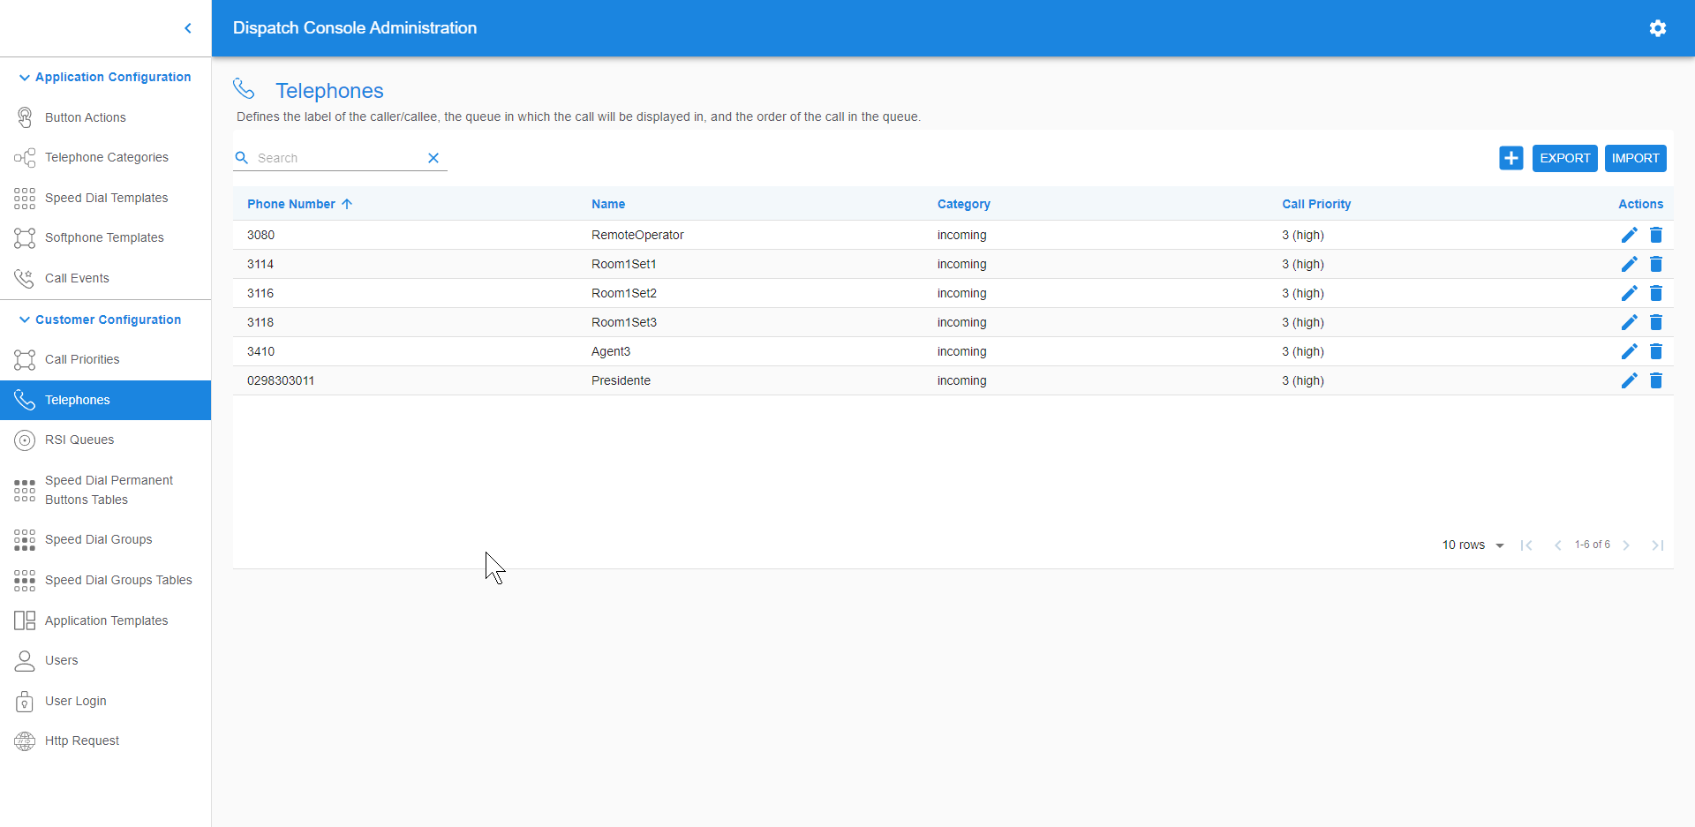
Management interface
Application-level configuration
Button actions
Telephone categories
Speed dial templates
Softphone templates
Call events
Customer-level configuration
Call priorities
Telephones
RSI queues
Speed dial groups
Users
HTTP requests

Slide 10



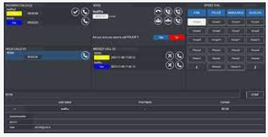
A ministry administration in France
Several local sites in the territories with agents that needs to easily prioritize and dispatch calls
WHY ALCATEL-LUCENT ENTERPRISE?
How to prioritize emergency calls?
How to provide the appropriate answer to any call ?
How to specifically answer to end users' requirements?
Long term relationship
PoC & design thinking
Loyalty & involvement
Design thinking approach with ALE ProServ
Dispatch Console
(personalized interface for the customer)
Automated Attendant
to automate pre-qualification of phone calls 24/7
Notes:
Customer case:
This French administration part of the Ministry of Justice has 173 sites in the territories.
They are in contact with citizens and receive a high volume of phone calls everyday.
The 2000 agents must be able to easily prioritize and dispatch to the relevant person in the organization if necessary.
ALE Professional Services used design thinking methodology to work with the employees of this administration and implement a tailored-made proof of concept based on Dispatch Console. In addition, an automated attendant solution based on VAA (Visual Automated Attendant) by ALE, has been proposed for automatic pre-qualification of calls and 24/7 welcome for the citizens.

Slide 11
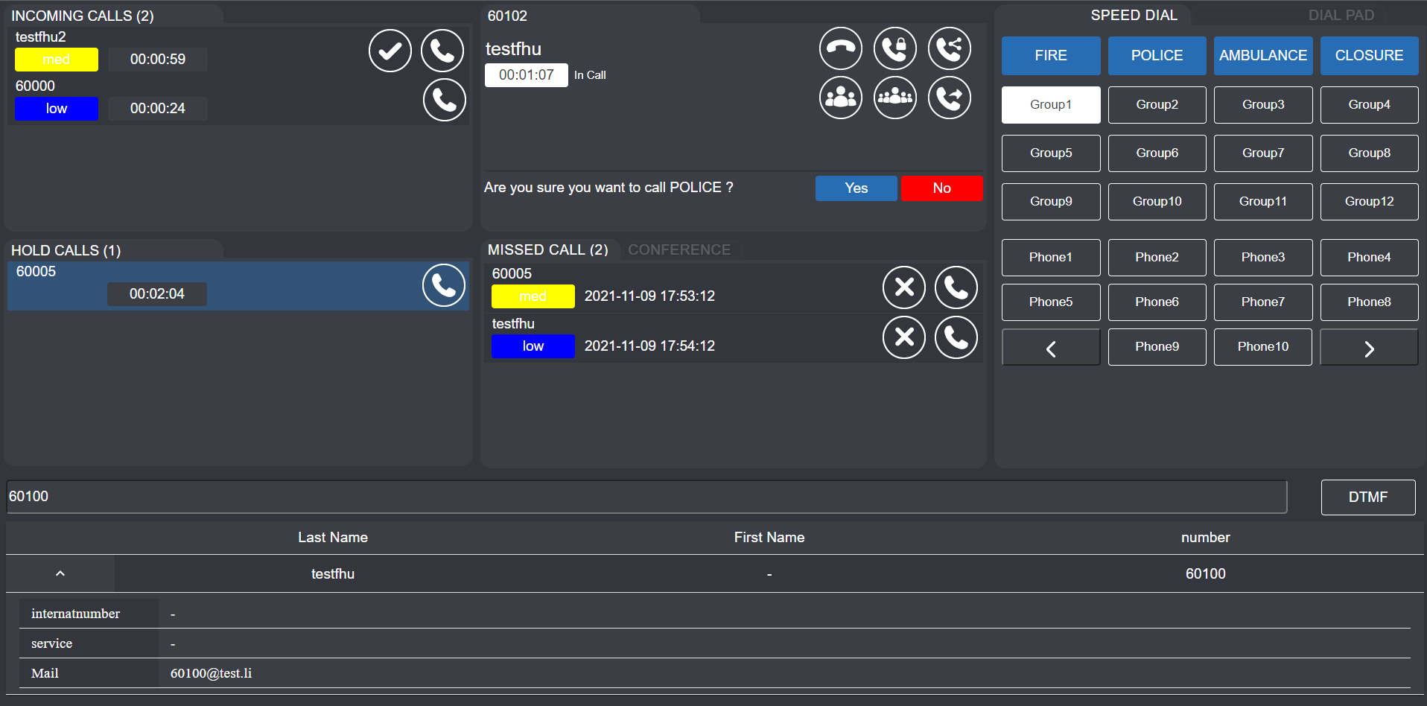


ENERGY SUPPLIER COMPANY IN GERMANY
Call pickup, priorities, speed dial, directory, conferencing
The DISPATCH CONSOLE is used to manage and prioritize incoming calls from both consumers and field agents. In the Energy control rooms, the agents can prioritize the incoming calls and be able to dispatch them or organize conferences.
“We were able to win thanks to our ability to understand customer concern and to demo our solution live” - Viktor Holger
Viktor Holger,
ALE Germany
Notes:
Customer case:
This energy supplier in Germany is specialized in Gas, Electricity and Water.
They needed a solution to differentiate consumers calls from the calls of the field agents that monitor, maintain and fix installations and equipment.
Another need was to prioritize the incoming calls and be able to dispatch them or organize conferences.
ALE proposed the Dispatch Console solution.
The ability to have a live demo with the support of an ALE demonstrator was a key factor of success.
The Dispatch console is very relevant and moreover can be customized to adapt to the customers environment especially for Energy control rooms.

Slide 12



benefits
Improve operators’ operational efficiency
Coordinate operations and share information
Secure and reliable communications
Visual ergonomic and intuitive
calls and queues management
Communication tool to easily coordinate emergency response between staff
High-availability based on a resilient and proven communications system to ensure service continuity

Slide 13
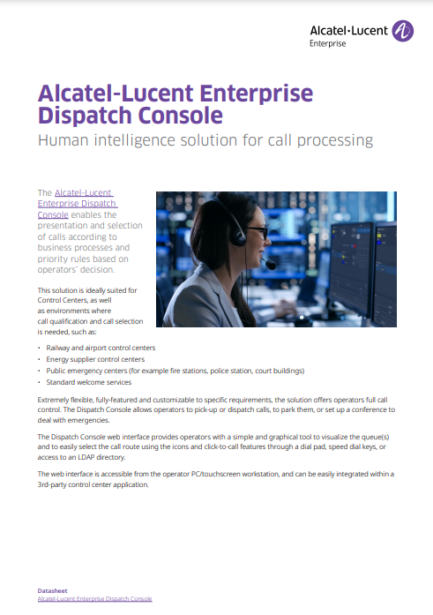
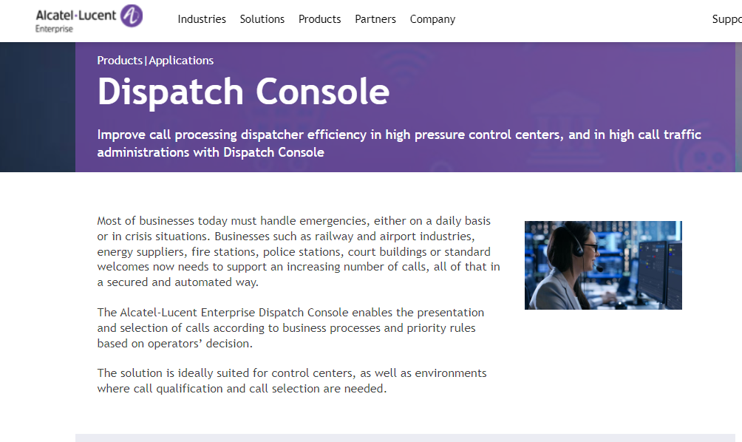
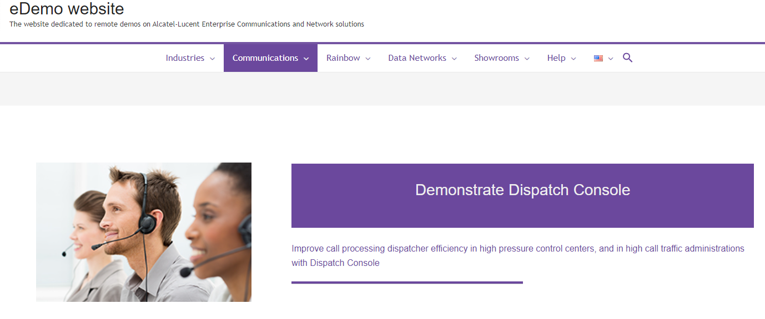
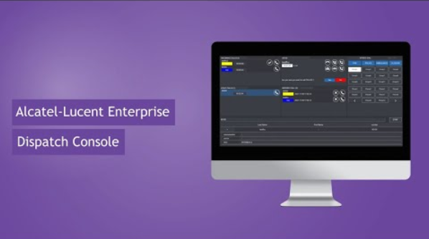
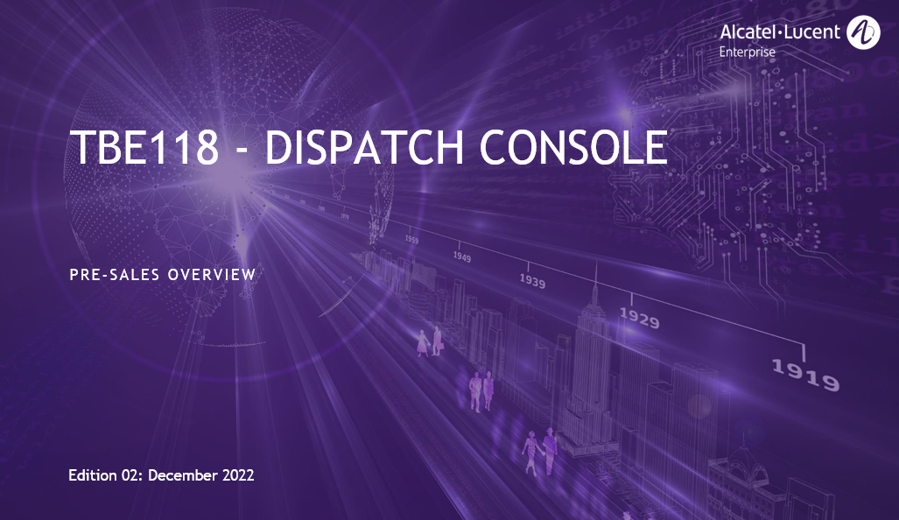
resources
PUBLIC
FOR ALE BUSINESS PARTNERS
Datasheet
Web page
eDemo platform
Design and quotation guidance

Slide 14




CONTACT US
WEBSITE
www.al-enterprise.com
Follow us on:
The Alcatel-Lucent name and logo are trademarks of Nokia used under license by ALE.

Slide 15


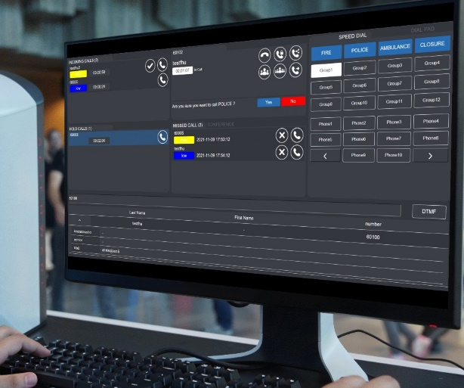

Dispatch console
Intelligent call processing for control centers
Opportunities:
Sell call management for Operation Control Centers
SCADA integration projects
Differentiate with end-to-end solution including call dispatch, interworking with emergency call stations and Rainbow-based automations: Metros, Energy and utilities, Smart Cities
Web browser
Present the various calls which are queued on one or several services
Display priority, presentation order and the kind of service called
Operators can pick up any of such calls according to the called service or priority indication
Oct’23
WHAT’S NEW?
Redial button (bis)
Role based management
Security policy enforcement for passwords
Multi-tenant configuration
Visit the product web page
>> Video demonstration
Notes:
Dispatch Console application is proving very popular with customers in the field of operational control centres (OCCs) but also in more conventional working environments such as town halls and courts.
As the name suggests, it is a solution for receiving, prioritising and distributing calls to operators according to the nature of the call and the operator's expertise.
It can easily manage call matching, trader mode conferences (micro-listener control), prioritised queues and much more.
A possibility that is highly appreciated by customers in the OCC context is the possibility of integrating the application on the SCADA platform, which is THE standard in this field.

