Slide 1
IP DESKTOP SOFTPHONE OVERVIEW
Help businesses optimize employee’s efficiency
october 2023

Slide 2


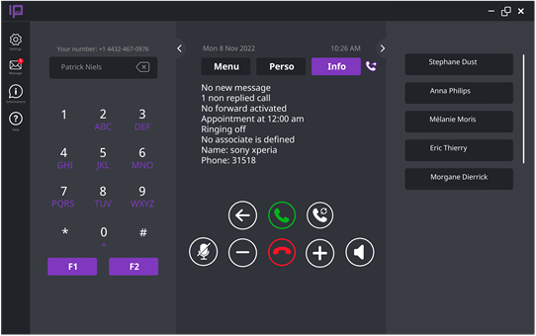

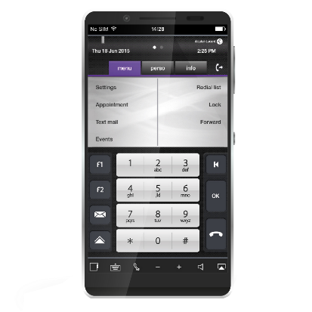
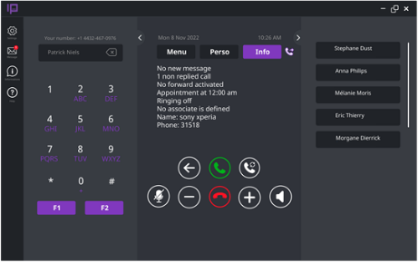
IP Desktop Softphone
VoIP
communications on computer, tablet or smartphone
All telephony features of an ALE DeskPhone including contact center agent
Business telephony inside and outside the enterprise network for more efficiency
Available on site on IP or WiFi network/off-site through VPN
Available on OXE and
OXO Connect

Slide 3
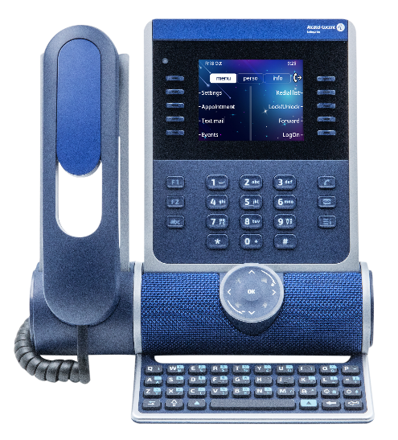
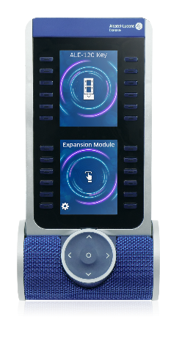
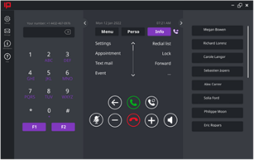
Ip desktop softphone: features
Suitable in both Business and Contact Center environments
Softphone providing all ALE DeskPhones (NOE mode) telephony features on the computer, tablet or Smartphone
Emulation of an ALE DeskPhone (NOE mode) with keys module add-on (multiline and call supervision)
Available for the OmniPCX Enterprise and OXO Connect under Microsoft Windows, Apple Mac OS and Android
Available on-site on wired Ethernet connection or WiFi
Available off-site anywhere the user can connect the customer IP network via a corporate VPN (works on Ethernet, WiFi, 3G/4G/5G cellular)
Visitor Onboarding web application (OmniPCX Enterprise)
Up to 32 different ring tones + personal sound
Multi-language interface
Compatible with CTI applications
Compatible with VDI infrastructure (Citrix)
G.711 and G.729 codecs are supported
QoS Level 3 IP TOS / DSCP
IP Desktop Softphone
ALE DeskPhone and keys module add-on

Slide 4
Ip desktop softphone: key benefits
Fully-integrated telephony solution
Quick and user-friendly access to telephone facilities from multiple devices
Easy integration of remote and on-site workers
Available on the OmniPCX Enterprise and OXO Connect
ALE DeskPhones user experience for fast adoption
Help businesses optimize their employee’s productivity
Communications, connectivity and hardware costs control
Support of VDI Architectures with voice optimization
Suitable for blind and visually impaired employees

Slide 5



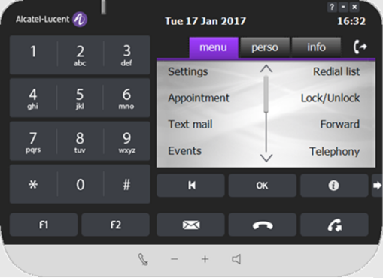

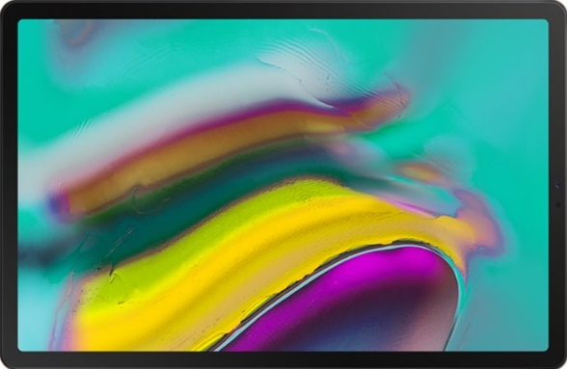
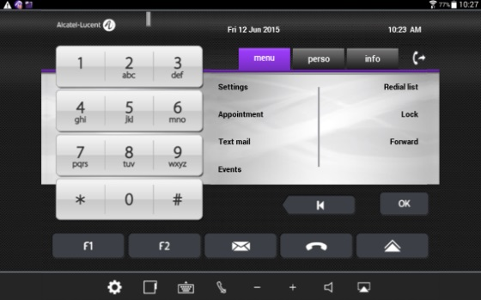

MULTI DEVICES
Mac and Windows
OS
Android tablet and smartphone

Slide 6

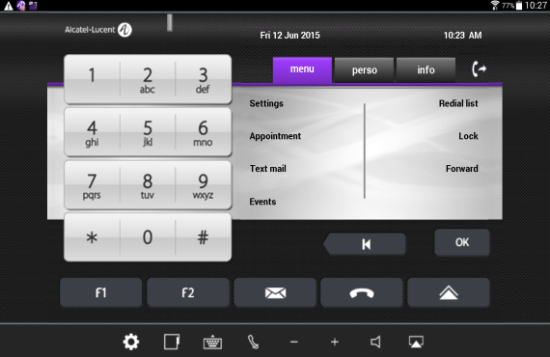
IP Desktop Softphone For Visitor Equipped With Smart Device
  Web app included in a corporate or dedicated web server
  Easy admin thanks to a user-friendly web interface
  Immediate user registration
Android compatible
  Open integration with legacy through Web API

Slide 7
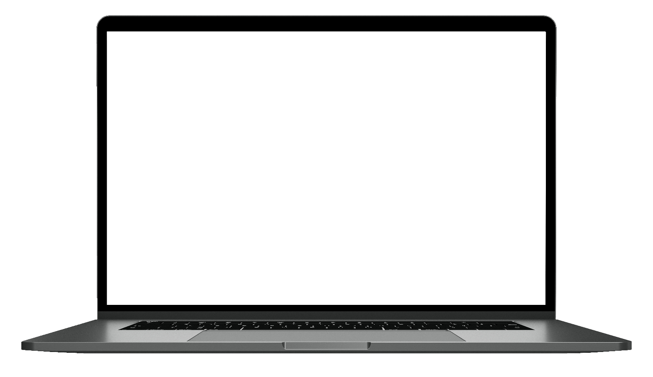
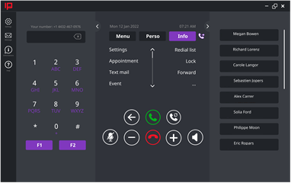

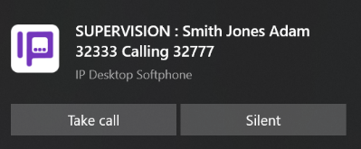
IP DESKTOP SOFTPHONE in a click FOR BUSINESS USE
More features (Microsoft integration, popup notification …)
One-click access to call features
Multiline and call supervision
Ringing on computer speaker + headset
Options and notifications
Contextual menus
as if at the desk
Configurable speed dials calls on keyboard
Direct access to company directory in click
Easy sound volume control,
hang up, call back
Call from Outlook
Call notification and instant call pickup

Slide 8
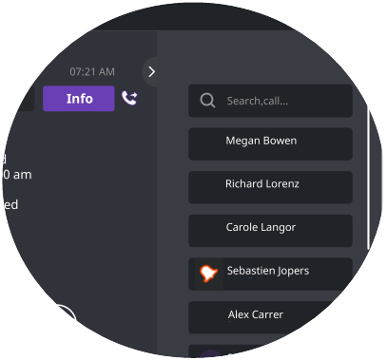


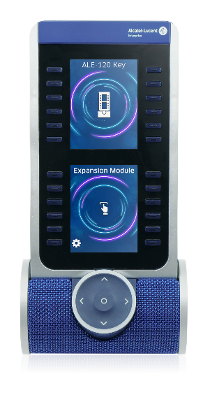
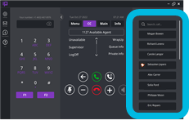
IP DESKTOP SOFTPHONE aOM emulation
Search box to direct access a contact key
Contacts with label
Supervised contact ringing
Scrollbar to navigate among contacts
IP Desktop Softphone
ALE DeskPhone and keys modules add-on

Slide 9

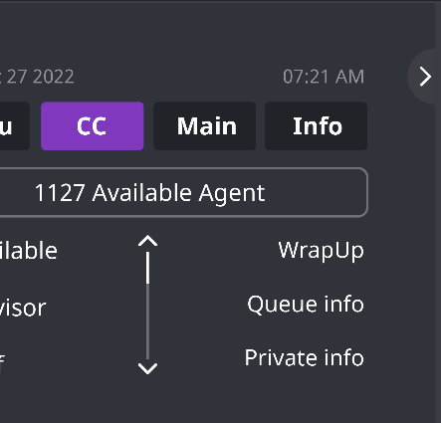

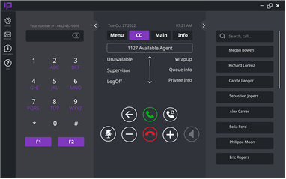
IP Desktop Softphone For CC AGENT
REMAIN CONNECTED TO YOUR CUSTOMERS
Extensive contact center⁽¹⁾ features available from home
Maintain existing call distribution and routing rules
Log in and out of your agent profile as usual
⁽¹⁾Alcatel-Lucent OmniTouch Contact Center Standard Edition

Slide 10
IP DESKTOP SOFTPHONE in a click FOR Call CENTER USE
More features (Microsoft integration, popup notification …)
One-click access to call features
Call center features
Options and notifications
Ringing on computer speaker + headset⁽³⁾
Multiline and call supervision
Dial in a click
Contextual menus
as if at the desk
Configurable speed dials calls on keyboard
Easy sound volume control,
hang up, call back
Call from Outlook
Direct access to company directory in click
Call notification and instant call pickup

Slide 11
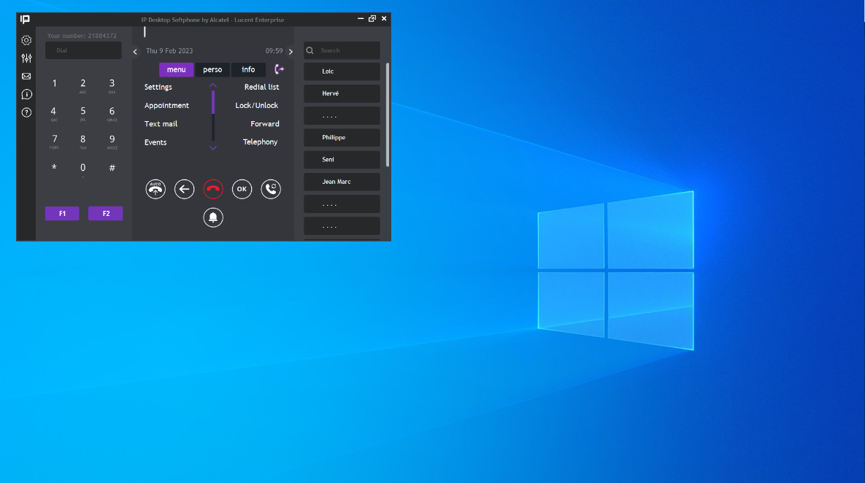
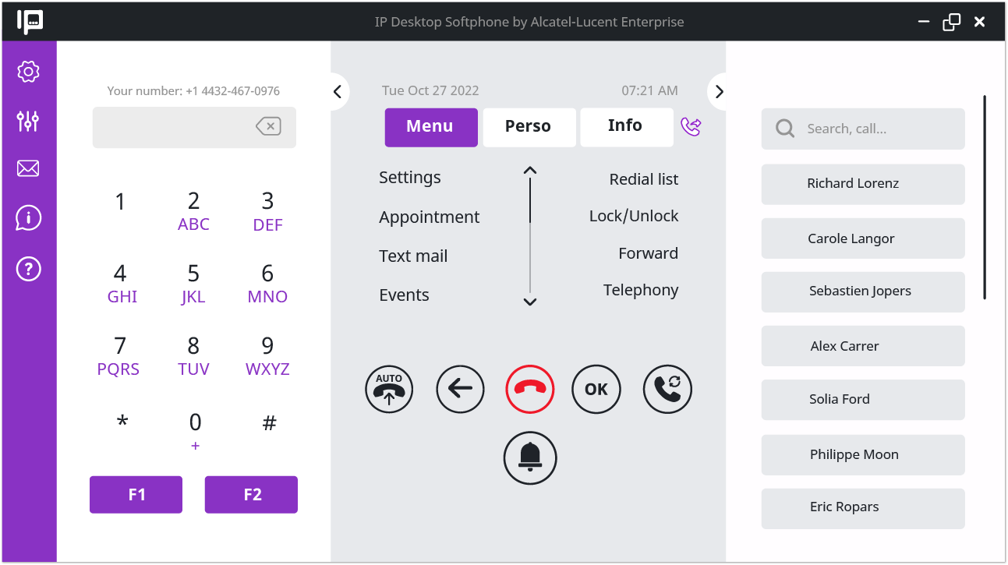
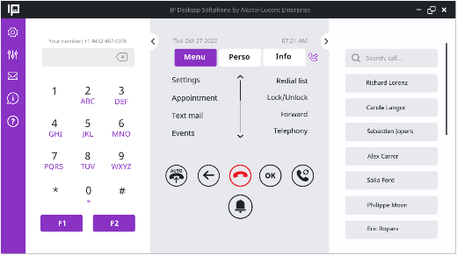
IP DESKTOP SOFTPHONE FOR VISUALLY IMPAIRED EMPLOYEES
IP Desktop softphone offers a “light” theme to facilitate reading for peoples with low vision
IP Desktop softphone allows resizing until full screen, giving people with impaired vision the possibility to use the graphical interface more easily

Slide 12
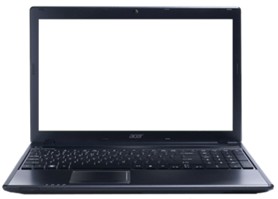
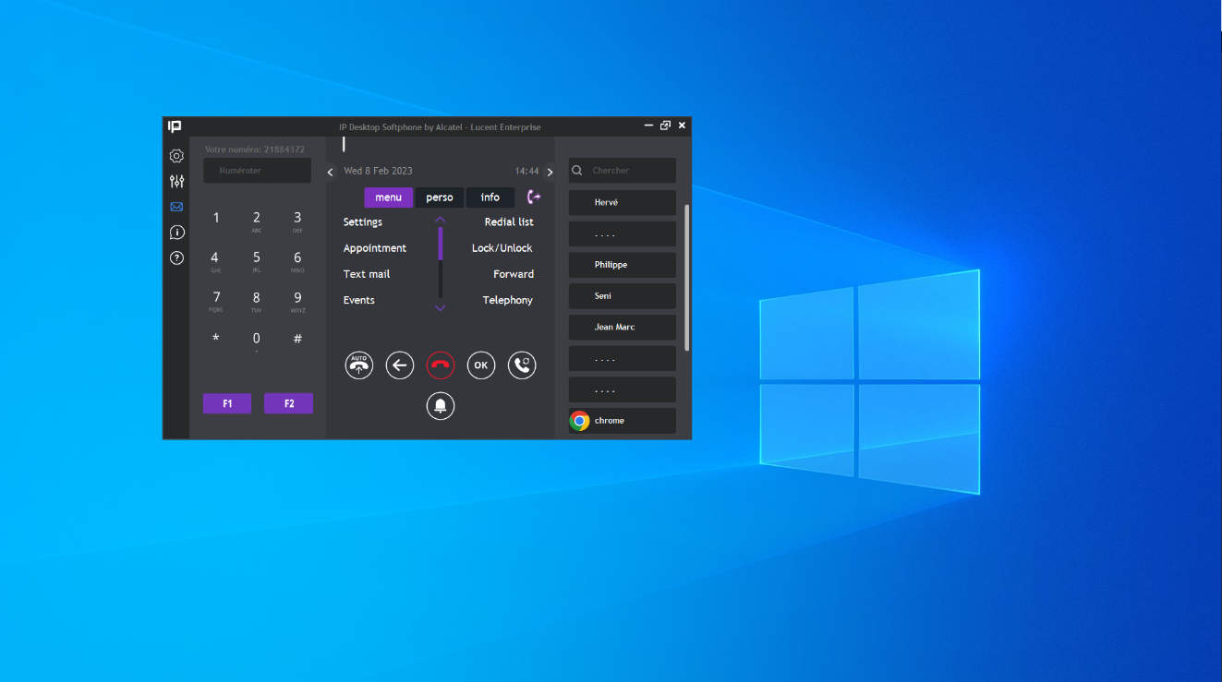

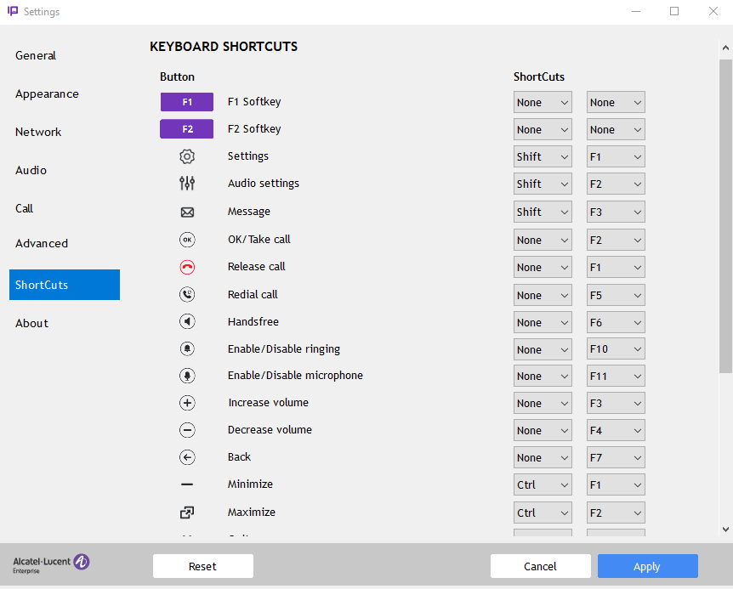
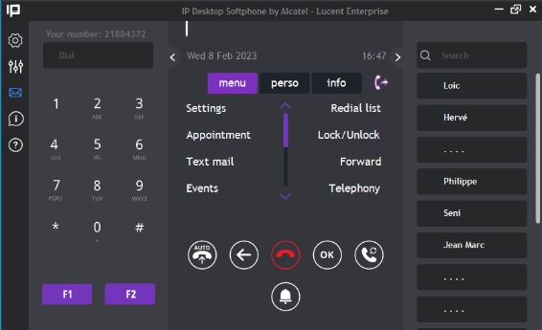


IP DESKTOP SOFTPHONE FOR BLIND EMPLOYEES
IP Desktop softphone allows configuration of keyboard shortcuts to access main functions buttons and actions of the graphical interface
IP Desktop softphone fully compliant with JAWS screen reader to connect braille displays or for audio description

Slide 13
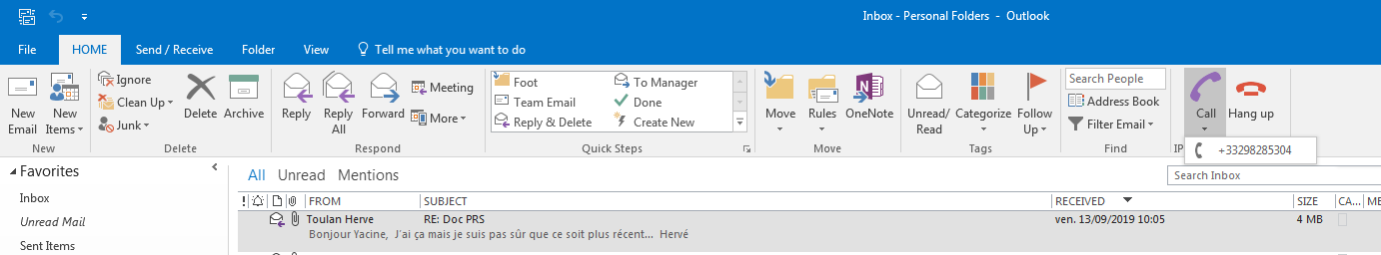
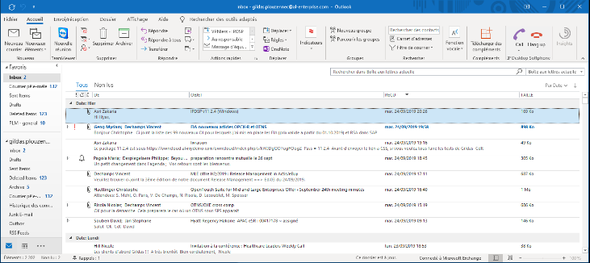
MICROSOFT OUTLOOK PLUGIN FOR WINDOWS
Click to call from Outlook using IP Desktop Softphone

Slide 14


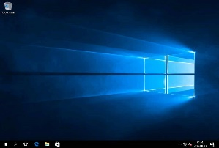


SUPPORT of Virtual Desktop Infrastructure
Virtual Voice eXtension (VVX)
Media stack
NOE signaling
Direct RTP
Audio devices management
For Windows 10 only
Support of main VDI solutions
- Citrix Virtual App and Desktop
IP Desktop Softphone implements a voice optimization mechanism offering connection stability and good voice quality in a VDI environment.
The extension module named Virtual Voice eXtension (VVX) and hosted on the end-user PC oversees the voice optimization with IPDSP.
USB
VDi Client
Virtual Voice eXtension
NOE/RTP
VDi channel
HTTPS (WebSecuredSocket)
VDi servers

Slide 15
Software version AUTO-UPDATE
HTTPS
Check_request
IP Desktop Softphone can update its own version without deployment script:
- Version file stored in OXE drive by administrator
- IP Desktop Softphone checks regularly a new version is available, download the .msi file then displays restart options to the end-user
- IP Desktop Softphone version can be upgraded or downgraded, started from R13.5
Download
Check_request
OXE
Download
exe
ipdesktopsoftphone.msi
Download
Check_request
upload
exe
administrator

Slide 16
Licensing model per user
OMNIPCX ENTERPRISE
  IP Desktop Softphone license (3BA09851JA) for business
  or
  IP Desktop Softphone license (3BA09975AA) for CC agent
  IP license
  Agent license in a contact center environment
Configuration in ACTIS
  OXO CONNECT
  IP Desktop Softphone license (3EH03512AA)
  IP license
  Agent license in a contact center environment

Slide 17
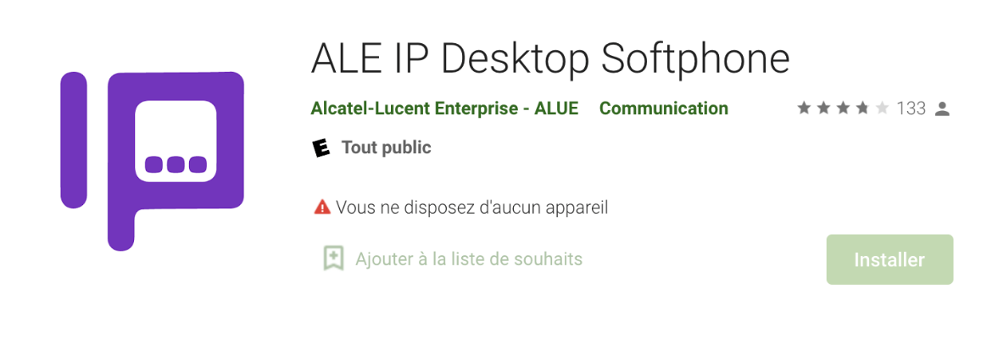
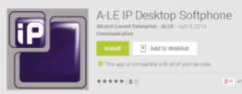


Download for free!
WINDOWS AND MAC OS
ANDROID DEVICES
ALE Business Portal
under Software Download section
Android smart devices compatibility
For a list of compatible devices, please refer to the MLE_Cross_Compatibility document available on the ALE Business Portal

Slide 18


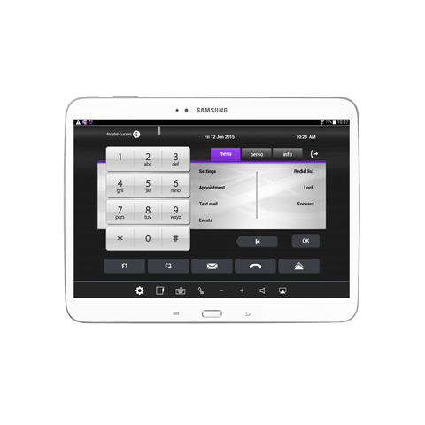

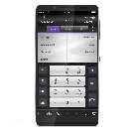
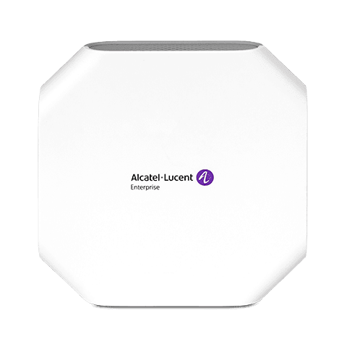
architecture
Off-site
On-site
Home worker
OmniPCX Enterprise
OXO Connect
VPN
VPN
VPN
Internet
Corporate LAN
IP Desktop Softphone on PC or Mac
Road warrior
Cellular 4G/5G
VPN
VPN
IP Desktop Softphone on Android smartphone
IP Desktop Softphone on PC or Mac
IP Desktop Softphone on Android tablet

Slide 19


Architecture for Virtual Desktop Infrastructure
Company
Connection to the OXE required in case of:
- direct link (inside company)
- through VPN (remote worker)
Connection to the VDI server required in case of:
- direct link (inside company)
- through VPN (remote worker)
Remote worker
VDI channel
NOE/RTP
HTTPS
OXE
VPN
VDI servers

Slide 20
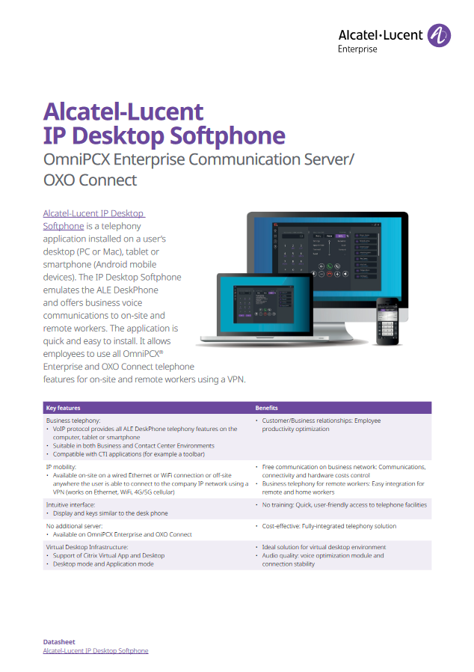
More information
A dedicated web page and collaterals (datasheet etc.) are available on the internet:
https://www.al-enterprise.com/en/products/applications/ip-desktop-softphone
https://myportal.al-enterprise.com/a6f5I0000008RwHQAU
Technical documentation available on MyPortal (search for “IP Desktop Softphone”)

Slide 21




CONTACT US
WEBSITE
www.al-enterprise.com
Follow us on:
The Alcatel-Lucent name and logo are trademarks of Nokia used under license by ALE.

