Slide 1
Omnipcx record suite
Customer presentation
October 2023

Slide 2

Customer challenges in call recording
Employee training
Quality assurance
Regulations
Risk
management
Ethics &
compliance
Sample recordings can be used as a review tool to help identify areas in need of improvement
Recording and monitoring ensures that employees are performing appropriately to their assigned duties
More and more regulations are being enacted that require financial and real-estate transactions to be recorded
When disputes arise, a record of the interaction provides proof of what transpired between the customer and the agent
Enterprises are committed to ensuring their employees and customers have quality transactional experiences
When everything must be on the record
Notes:
Why record employee’s activity ?

Slide 3

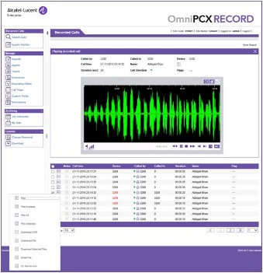
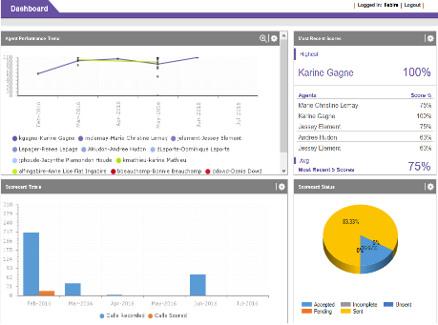
ALE PROPOSAL TO ADDRESS THE CHALLENGES
Alcatel-Lucent OmniPCX Record Suite
The OmniPCX Record Suite offers:
Efficient risk management: in the event of a dispute, a recording of the interaction can provide verification of the exchange between customers and agents.
Regulatory compliance and data protection: the solution meets the legal requirements for payment by phone (PCI-DSS), and interactions with financial institutions (MiFID II). The solution also provides strict security management policies for high protection of customer data.
Improved quality of service: the customizable quality monitoring application helps managers identify areas requiring improvement. Coaching tools and tutorials help improve employee and agent performance.
Easy and cost-effective implementation: seamless integration into existing or newly installed OmniPCX Enterprise environments. The user-friendly web-based interface offers fast access to all features.
EFFICIENT
RISK
MANAGEMENT
REGULATORY
COMPLIANCE
DATA
PROTECTION
IMPROVED
QUALITY OF
SERVICE
EASY AND
COST-EFFECTIVE
IMPLEMENTATION
Notes:
The Alcatel-Lucent OmniPCX® RECORD Suite provides businesses with a reliable application to record and supervise calls that support quality assurance, accelerate customer issue resolution, boost loyalty and streamline employee training and monitoring.

Slide 4
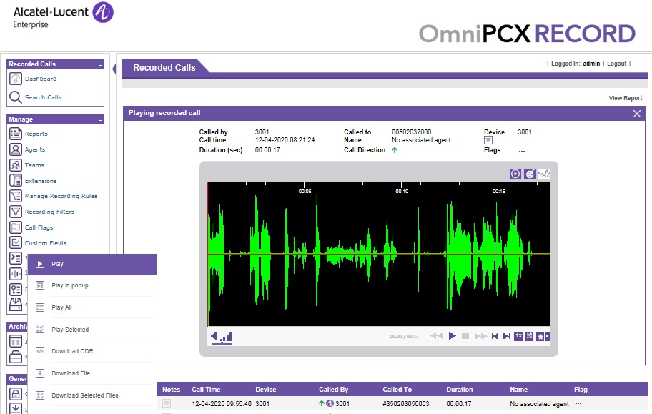
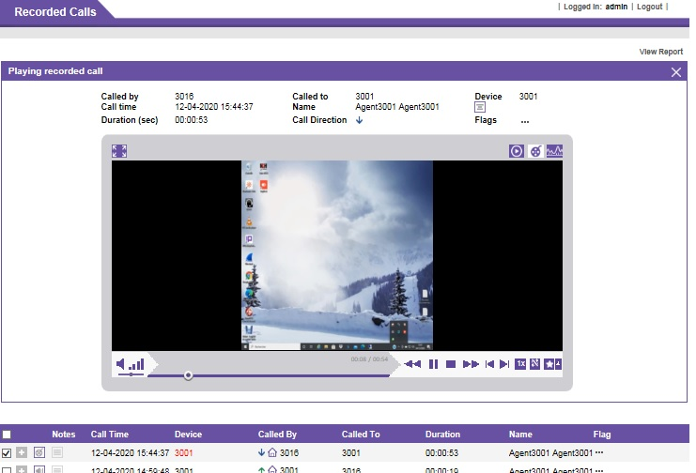
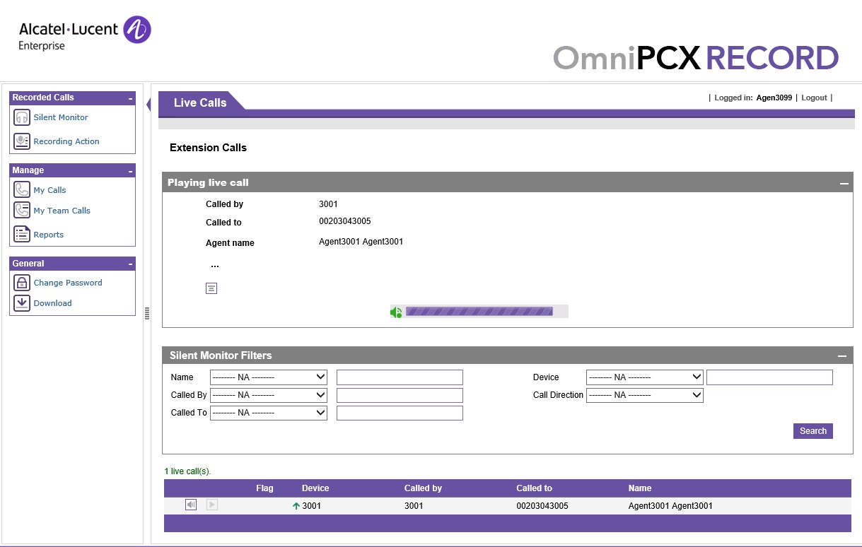
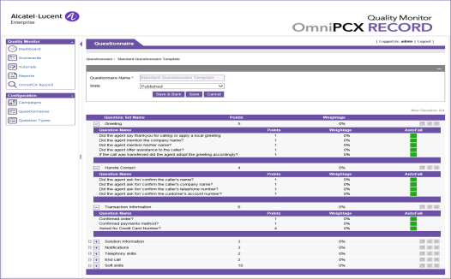
OMNIPCX RECORD SUITE
Components
RECORD
SCREEN CAPTURE
Enterprise solutions for real-time call recording
Because sometimes voice alone is not enough
The base package that offers voice recording of all inbound and outbound calls.
Adds screen activity capture to the RECORD application for a complete audiovisual history of the interaction.
SILENT MONITOR
QUALITY MONITOR
Be there when it happens
Improve the quality of your customer relations
Provides real-time silent monitoring of calls, to both on and off-site supervisors.
Offers quality reporting and evaluation analysis based on real calls, allowing supervisors to proactively manage employee performance with an instant coaching tool

Slide 5


Customer cases
Testimonials from some of our customers
“The Alcatel-Lucent Enterprise solution has dramatically enhanced our capabilities by enabling greater visibility and control of just how effectively we are communicating internally and with our customers. We look forward to continuing our partnership and pushing the boundaries of what we can achieve together even further.”
Christopher CAREW, Manager
“The OmniPCX Record is very useful, light and has a friendly interface. All audio and video files are in standard formats and can be run without any special tool. Also, it does not require special training for administrator. It could be managed by the same technician who administrate OmniPCX Enterprise. That is what we have been looking for.”
Andrey KVOCHKOV, General director

Slide 6
REFERENCES
“The primary focus of our business unit is to ensure customer satisfaction. We can do a much better job in monitoring and coaching our team, resulting in the delivery of an improved level of service to our clients. It is a wonderful thing. Contrasting our old way of doing things with the new system is like comparing a black and white television set to a color model!”
Evelyn GOULD, Contact Center Supervisor
DC Water
Alcatel-Lucent OmniPCX Record solution helps DC Water
to increase levels of customer satisfaction and employee productivity
CUSTOMER DETAILS
CHALLENGES
Location: District of Colombia, USA
Vertical: Energy & Utilities
Enhance customer satisfaction by improving agents’ interactions with clients
Give contact center supervisors better tools to manage operations, including call monitoring, recording, coaching and review
Need for flawless execution because of DC Water’s high-visibility in community
BUSINESS & TECHNICAL BENEFITS
PRODUCTS & SERVICES
Increased customer satisfaction and call center efficiency
Supervisors able to perform real-time monitoring and focused agent coaching
Project completed on time and within budget using proven Alcatel-Lucent Enterprise approach to coordinate all components of implementation
Alcatel-Lucent OmniPCX Record Suite
Alcatel-Lucent OmniPCX Record Quality Monitor
Alcatel-Lucent Enterprise Professional Services

Slide 7
REFERENCES
“The OmniPCX Record solution is very light (…). We found it easy to install with no requirement for special training and the agency has found it simple to use and manage.”
Andrey KVOCHKOV, General director
ALBERTA
Alcatel-Lucent Enterprise Professional Services worked with premium Business Partner,
Alberta, to ensure faster resolution to citizen inquiries
CUSTOMER DETAILS
CHALLENGES
Location: Europe (CIS region)
Vertical: Government
Provide an integrated voice network and contact center to multiple sites to better respond to citizen queries
Introduce an affordable, convenient recording solution to support administrative requirements
To minimize training and implementation costs
BUSINESS & TECHNICAL BENEFITS
PRODUCTS & SERVICES
Fully integrated, reliable and robust solution offers maximum simplicity; easy to install, configure and use
Cohesive recording of citizen interactions has enabled more effective responses to inquiries, no matter where the call is taken
Reduced importation administration and associated costs
Alcatel-Lucent OmniPCX Record Suite
Alcatel-Lucent OmniPCX Enterprise Communication Server
Alcatel-Lucent Enterprise Professional Services

Slide 8











MORE THAN 400 REFERENCES in all industries

Slide 9








MORE THAN 400 REFERENCES in all industries

Slide 10

Key take-aways
Alcatel-Lucent OmniPCX Record Suite offers:
Customer satisfaction
Recording interactions minimizes disputes, while monitoring can accelerate customer issue resolution
Compliance
Satisfy legal and regulatory compliance requirements
Affordable solution
Cost-effective and fully integrated with OmniPCX Enterprise communication server from voice expert ALE

Slide 11




CONTACTUS
WEBSITE
www.al-enterprise.com
Follow us on:
The Alcatel-Lucent name and logo are trademarks of Nokia used under license by ALE.

Slide 12
Backup slides

Slide 13



Omnipcx record suite
When everything must be on the record
RECORD CALLS
SCREEN CAPTURE
SILENT MONITORING
QUALITY MONITORING
Oct’23
WHAT’S NEW:
Support OPUS codec for all recording methods
Web hooks extended with additional call events
FIPS security standard compliance
Two-factor authentication (Microsoft and Google authenticators)
Optimization for encryption processing (+25% simultaneous live recorded calls)
Support of virtualization with Hyper-V server 2019 and 2022

Slide 14

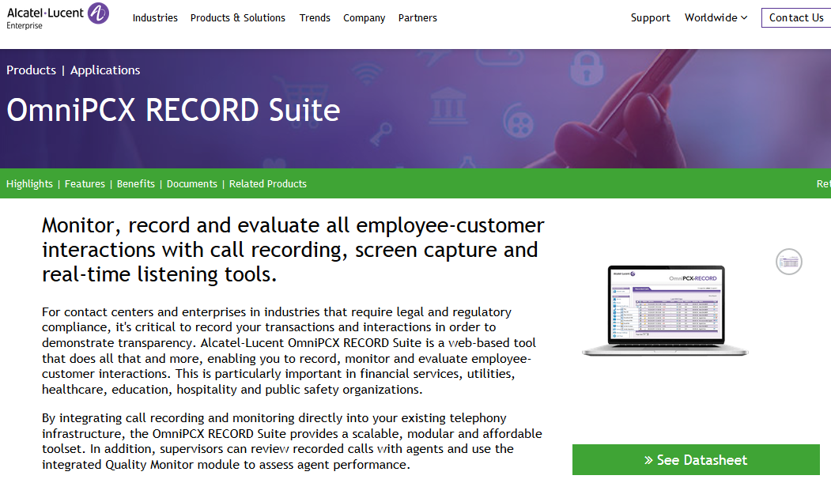
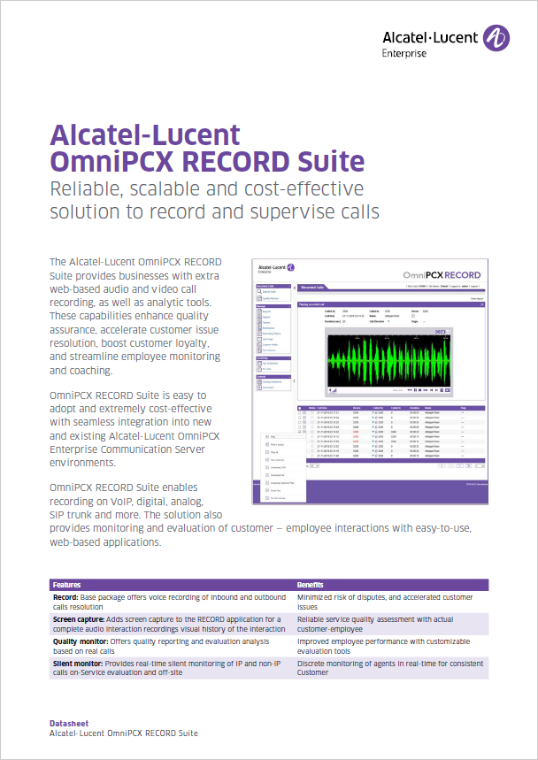
WANT TO KNOW MORE?
Product information
Support center reseller
Web page
Datasheet (EN FR DE ES)
Presales design guide

