Slide 1
Rainbow Meeting for citizen digital engagement

Slide 2
AGENDA
Trends & Challenges
Value proposition
Solution description
Customer Service approach
Key take-aways
Notes:
In this 45 minutes webinar we will address how ALE help government to deliver digital public services and enable them to orchestrate communications in case of crisis.
I will start this webinar by presenting the Digital Governments trends and the age of citizen experience. Then, followed by how ALE helping business continuity and enable remote employees & workers to keep engaged with citizen and in the 3rd section, I will present you how we help institutions to improve operations in case of crisis and enhance collaboration to manage emergency situation.

Slide 3



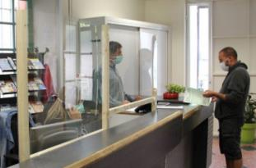
health regulations change the way we Live the barrier gestures, strict measures TO go to the buildings
Difficult for client
1m5 in long waiting line is not always respected, mostly at peak times
Booking an appointment outside of opening hours is not available since no receptionist working
Telephone calling with busy line may make client not happy
Difficult to administration
Increase risks with face to face meeting
Increased number of phone call for booking may disturb the job of receptionist, also cause stress of multitasking

Slide 4




administrative procedures is processed ONLINE
Identity card, passport, building …
Citizens request an online appointment for administrative service from the municipality website.
Partnership request an online appointment with technical department for new project

Slide 5




Engage with Students and parents
Parents book an appointment with school’s counsellor or for a distant interview with teacher
Distant student make regular appointments with the professor for up-to-date information

Slide 6
VALUE PROPOSITION
  Facilitate communication
  Business continuity during crisis
  Deliver safety-oriented and reliability solution
  Deliver more user-friendly booking solution for client via online booking
  Encourage communication from anywhere and any devices that suits the client.
  Get the official and up-to-day information.
  Gain more effective communication not only by voice but also by video, document sharing, presentation sharing.
  Boost the service with available online booking 24/7.
  Solution is able to connect to the calendar on your choice
  Cost-effective, improve the collaboration between user, reception center and agent

Slide 7

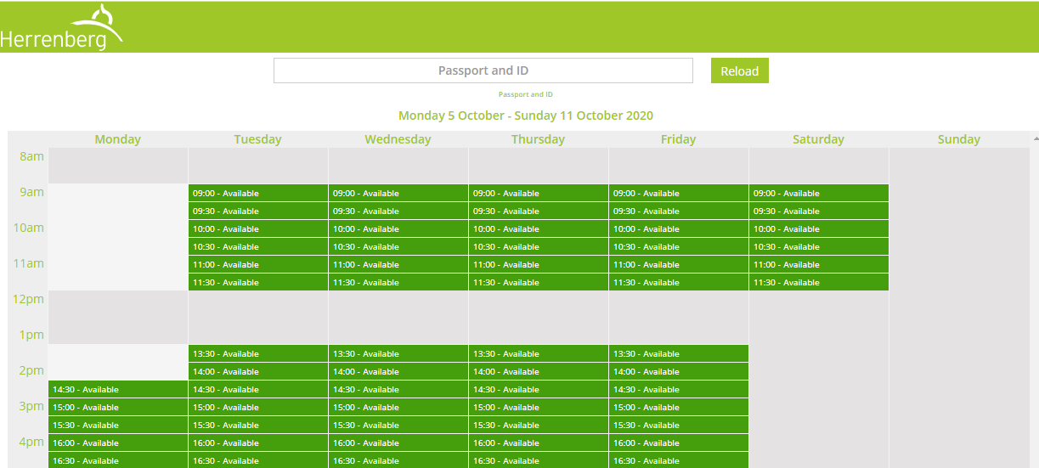

facilitation of communication
Meeting calendar selection
MAKE
APPOINTMENT
The client can request an appointment directly by clicking on “Make appointment” button from the website.
  Making the appointment simply and fast encourages the client avoid unnecessary moving.
The client can select a suitable time for the appointment, as well as the purpose
The reception center can handle all booking request without interruptions at work

Slide 8
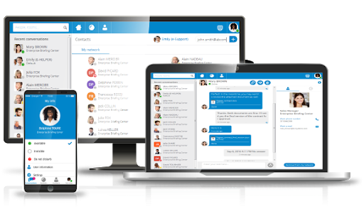
business continuity during crisis
A booking request is registered with all necessary information (phone number, time, purpose, note,…) 24/.
All the procedure is automatic and digital
Instead of waiting in the building for the appointment, now the client can manage the time to the meeting
A multimedia conversation via Rainbow helps the client get all the information comprehensively
With Rainbow meeting, the clients can engage from anywhere and any devices

Slide 9








Safety-ORIENTED and reliability solution
  The booking of an appointment will be registered on any calendar as your choice (Google, Outlook,…)
MAKE
APPOINTMENT
  Transferring the conversation in Rainbow pushes the internal collaboration of your employees
  Booking an appointment with Rainbow ensures the effectiveness of conversation with appointment confirmation via SMS/Email

Slide 10
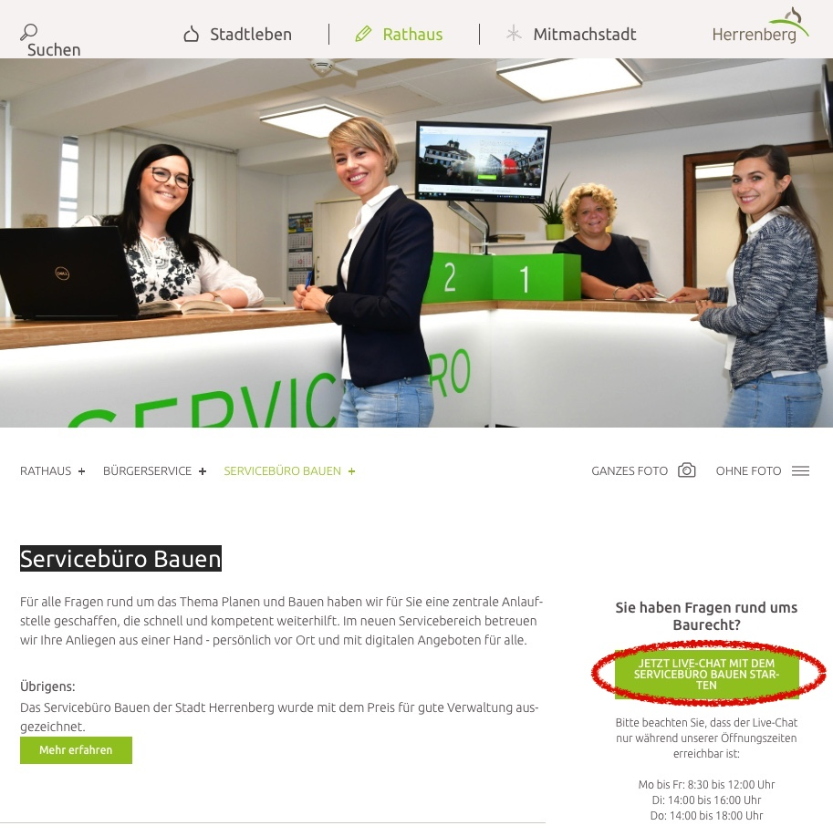
City of Herrenberg
Breathtaking Time-to-market
Reception time saving of 20% or 1 Day per week
Excellent Conference user experience
End-customer satisfaction
Ease of use
a. Website integrated Chat
b. OXE connection with Rainbow UC &
Rainbow Room

Slide 11
Solution Description

Slide 12


Function
Click to Call : initiate the call from agent’s phone to client number.
Rainbow conversation enriches the communication by video, screen sharing, file sharing and recording.
The client receives the appointment confirmation with the invitation link via SMS/email.
Agent’s available times are displayed for the client that he/she can select the suitable time.
Agent can track the appointment statistics (booking, pending, canceled, …) on dashboard.
Fast installation as the communication service is ready-to-use and scalable in the cloud.
Consistent integration with the website by adding a simple ‘Make appointment’ button on it.
Click to Call
Rainbow meeting service
Calendar service
Integrations

Slide 13
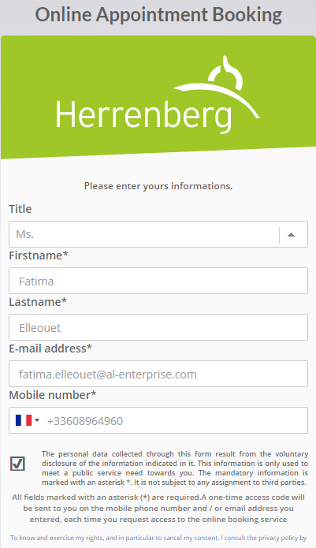

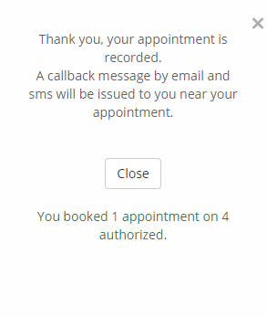
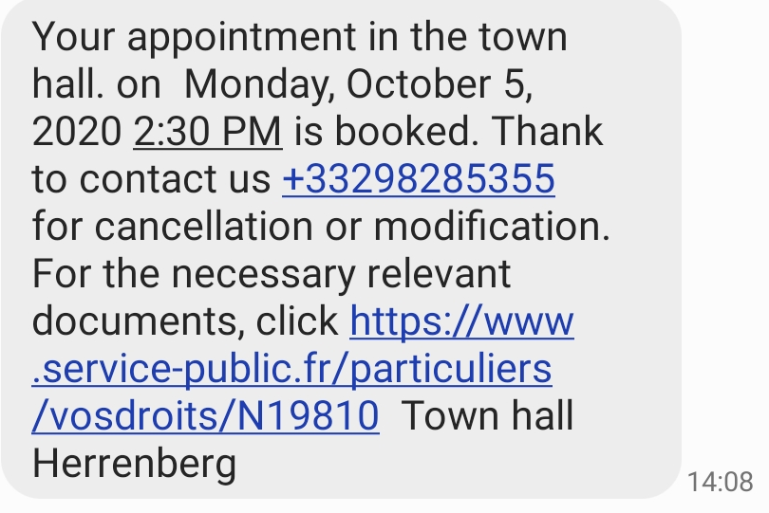
How to SET UP an appointment 1/3
3
1
Form to get citizen credentials
The client requests for an appointment on the button integrated in the website
4
Form to get citizen credentials
MAKE
APPOINTMENT
2
Dedicated calendar per type of services: ID card, urban services, ..
3
Available slots are displayed on the calendar interface

Slide 14
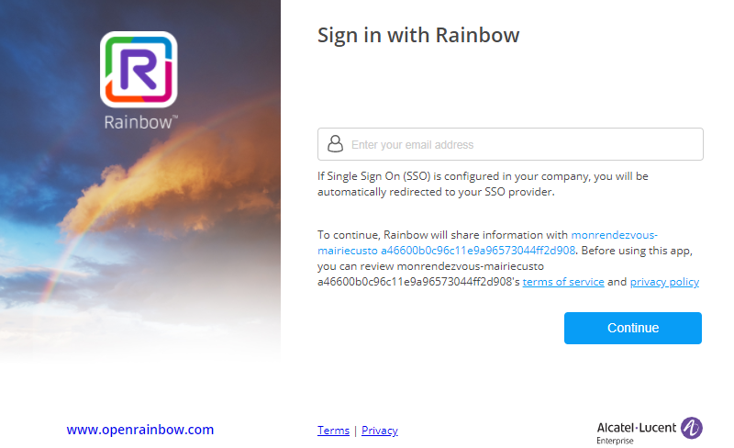
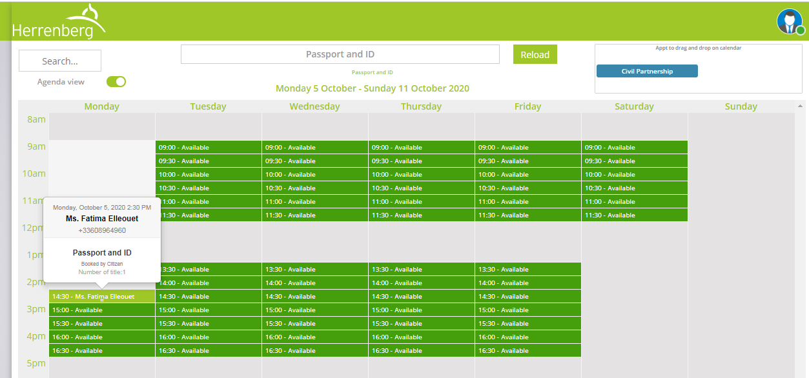
How to SET UP an appointment 2/3
Login screen of agent
In Reception Center, the agent will login to calendar interface with Rainbow account
After login successful, the agent sees the slot booked by the client on the calendar

Slide 15
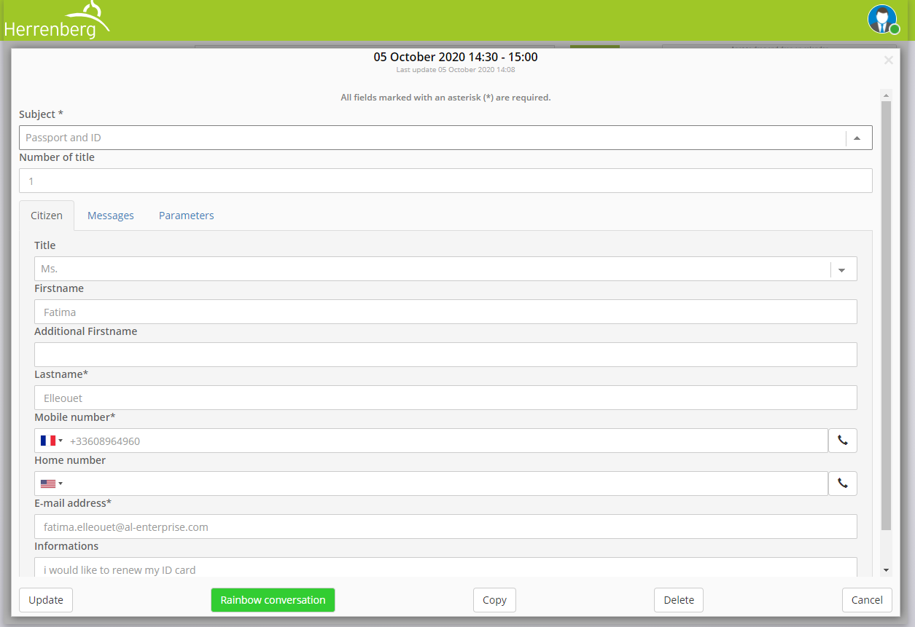
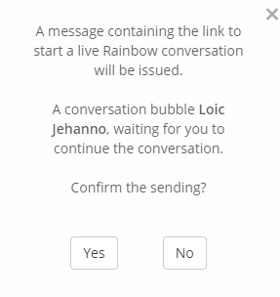
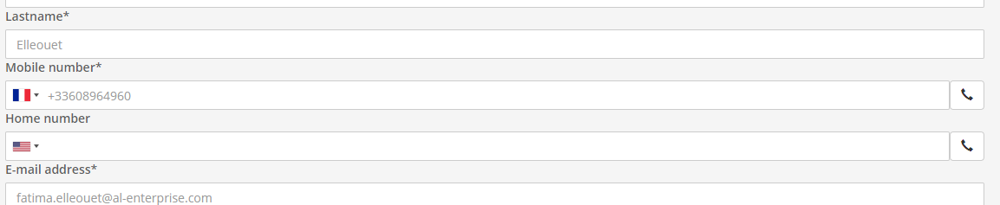
How to SET UP an appointment 3/3
Otherwise, the agent can make a rapid call from his phone by click on Click to Call button
Meeting information form
Open Rainbow
Conversation Rainbow
The agent clicks to open Rainbow application that initiates the communication service
To set up the meeting, the agent proposes a Rainbow conversation for the appointment.
The client receives a confirmation for the appointment with the invitation link as the agent toke the booking into account.

Slide 16
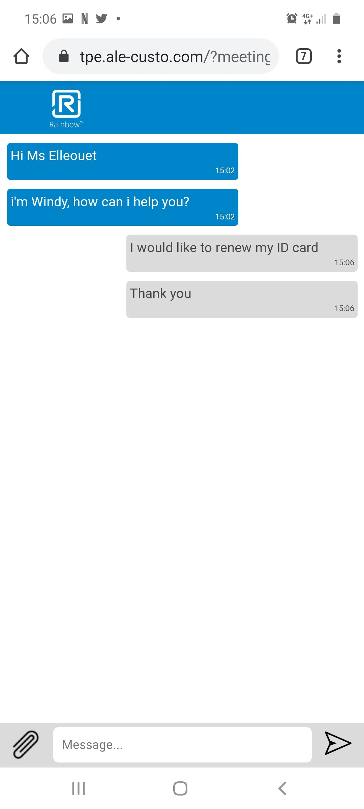
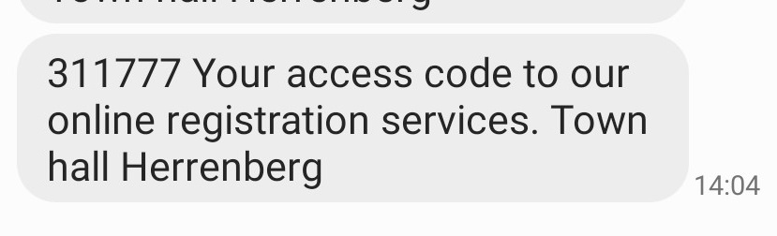
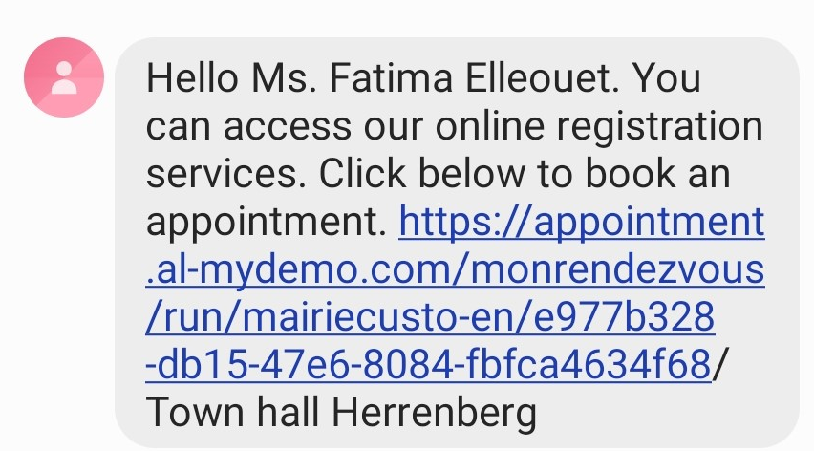
CONFIRMATION EMAIL AND SMS
Say GOOD-bye to MISSED appointments
No personal information required for authentication.
The client receives a secret code to access the booking.
The client confirms the appointment and connects to Rainbow meeting
With the confirmation email/SMS, the agent can notify, remind the client to join the meeting, thus it reduces the missed or forgotten appointments.
Beside, the client will be notified vie SMS/Email if the appointment is canceled by any reason.

Slide 17
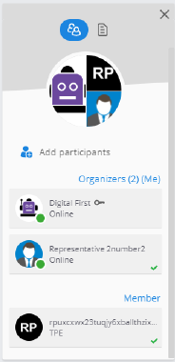
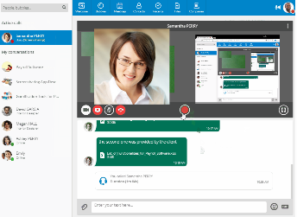
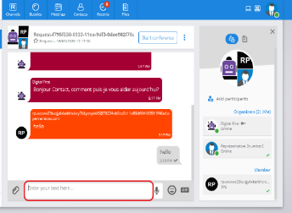
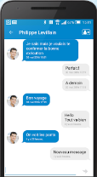
COMMUNICATION with AGENT 1/2
Otherwise, the agent can invite his/her colleague into the meeting (a counsellor, an officer or a medical specialist) for a specific demand.
After opening the Rainbow application, the agent will be in Rainbow conversation which is set up automatically with a welcoming message.
At the meeting time, the client clicks on the meeting link to join it.
In the participant list, the agent will see the client account.
To start a private chat or call, the agent clicks on the client account.

Slide 18
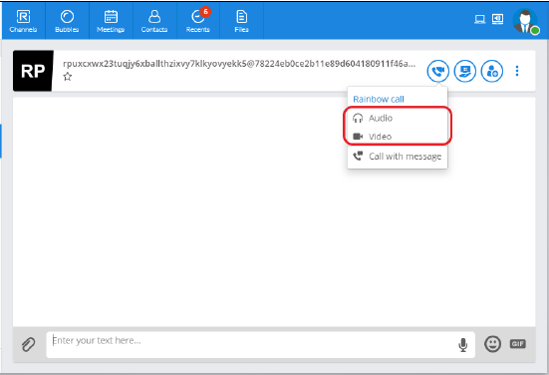
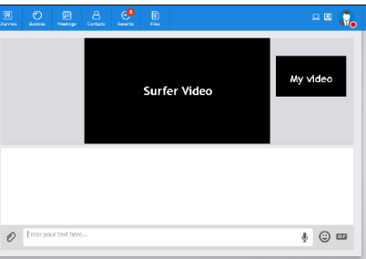
COMMUNICATION with AGENT 2/2
Private conversation interface
Or the agent can start a call with screen sharing rapidly to do a presentation.
In the private conversation, both of them can launch a audio or video call with Audio and Video option in call menu
Video call interface
Besides chat, both of them can share media file or document.

Slide 19
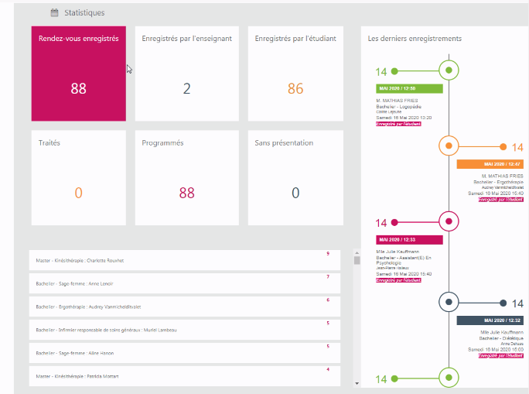
Calendar Management DASHBOARD
Number of accesses to services
Number of requests
Number of confirmed requests
Number of no-shows and ratio
Weekly statistic via email
MEETING STATISTIC
MEETING PROCESSED
APPOINTMENT REGISTERED
EFFICIENCY OF CONVERSATION
Archived data available for 8 months

Slide 20
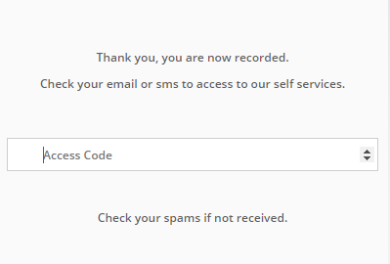
Confidentiality of data
Internal exchange
SECURITY FEATURE
Client account is secured by using contact information: email and phone.
Authentication with secret code sent by SMS or email.
Agent account is created and managed by organization’s administrator with Rainbow platform.
Instead of taking note the conversation then sending it, with Rainbow, all the conversation content can be transferred to a colleague email with all security.
GDPR compliancy
Client enters secret code
every time accessing the booking

Slide 21
Customer Service Approach

Slide 22
PROCEDURE
3
2
1
Delivery
Production phase
Installation document
Operation document
Transfer of knowledge
Verification of requirement
Installation and configuration
The deployment
Launch product after data collection
Testing
Post Assistance over 2 days.
Homologation phase
Verification of requirements (infrastructure, licenses, account)
Installation and configuration of the solution
Deployment of the solution
Testing all the services
Implementation of demonstration
Preparation for production

Slide 23
Project MANAGEMENT
Business
Partner / Customer
Project Manager
ALE project teams
Project Manager
Customization
Concerning specific request, the SAS contract will be applied as in the Services Proposal drawn up by ALE.
The Project Manager serves as the bridge between the Customer or the Business Partner and the ALE project teams.
PM handles the project kick-off meeting
Requirement and task management
Business analysis on site
Update regularly the progress of the project
Change management
The scope of project management is limited to the relevant Alcatel-Lucent Enterprise solution.

Slide 24
PRICING Model
Price list
 | Unit price/month (€ WPL) | Unit price/Year (€ WPL) | Total (€ WPL)
Setup fees -upfront |  |  | 4 200 €
Online meeting - price per user | 20 | 240 | 240 €
Online calendar - price per cal | 35 | 420 | 420 €
Customization and integration
Our solution is natively Integrated with SMSFactor. New integration with any SMS provider is possible considering specific customization
The openness of our solution allow integration with any Customer calendar

Slide 25




CONTACT US
WEBSITE
www.al-enterprise.com
Follow us on:
The Alcatel-Lucent name and logo are trademarks of Nokia used under license by ALE.

